Slide 1
Loan Calculator
An Introduction
To Programming
Using
Visual Basic
Exercises for Beginners
06
Write a program in which user specifies a value to calculate, enters three other values, and clicks on the Calculate button. Before any calculations are made, the program should use a function to validate that radio button is checked and that the values entered into the three text boxes corresponding to unchecked radio buttons are valid

Slide 2
Calculations
The most common type of loans are mortgage loans. Loan consists of 4 components – amount, interest rate, duration, and periodic payment,
We will assume that the duration is in months, that interest (given as percent) is compounded monthly, and that payments are made monthly.
Pmt (interest rate / 1200, duration, - amount) – gives total monthly payment
1200 * Rate(duration, monthly payment, - amount) – gives interest rate
PV(interest rate/1200, duration, -monthly payment) – gives loan amount
Nper(interest rate/1200, monthly payment, - amount) – gives duration in months

Slide 3
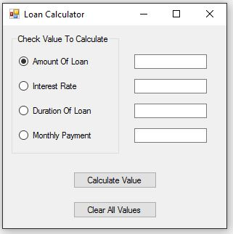
INPUT
Amount Of Loan - txtAmount
Interest Rate - txtInterestRate
Duration - txtDuration
Monthly Payment – txtMontlyPayment
OUTPUT
Any text Box – depending on selected RadioButton
EVENTS
Calculate Value - btnCalculate
Clear Values - btnClear

