Slide 1
Caffeine Absorption
An Introduction
To Programming
Using
Visual Basic
Exercises for Beginners
01
After caffeine is absorbed into the body, 13% is eliminated from the body each hour. Assume a person drinks 8-oz cup of coffee containing 130mg of caffeine, and caffeine is absorbed immediately into the body. Write a program to calculate the following:
The number of hours required until 65 mg (one half the original amount) remains in body
The amount of caffeine in the body 24 hours after the person drinks the coffee
Suppose the person drinks a cup of coffee at 7a.m. and then drinks a cup of coffee at the end of each hour until 7a.m. the next day. How much caffeine will be in the body at the end of the 24 hours?

Slide 2
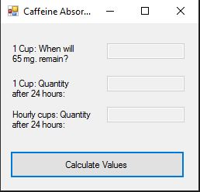
INPUT
No input. Everything is calculated in the background
OUTPUT
txt1 – Answer to question 1
txt2 – Answer to question 2
txt3 – Answer to question 3
EVENTS
Calculate Values - btnCalculate

