Slide 1
Rule of 72
An Introduction
To Programming
Using
Visual Basic
Exercises for Beginners
02
The rule is used to approximate the time required for prices to double due to inflation. If the inflation rate is r%, then the Rule of 72 estimates that prices will double in 72/r years. For instance, at an inflation of 6%, prices double in about 72/6 or 12 years. Write a program to test the accuracy of this rule. For each interest rate from 1% to 20%, the program should display the rounded value of 72/r and the actual number of years required for prices to double at an r% inflation rate.
Assume prices increase at the end of each year.

Slide 2
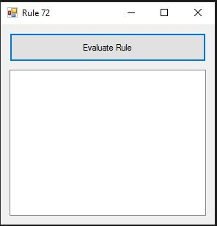
INPUT
No Input – calculations are done in the background
OUTPUT
lstOutput – List Box
EVENTS
Evaluate Rule - btnEvaluate

