Slide 1
Projectile Motion
An Introduction
To Programming
Using
Visual Basic
Exercises for Beginners
03
Write a program to provide information on the height of a ball thrown straight up into the air. The program should request as input the initial height in feet, and the initial velocity (feet per second).
Determine the maximum height of the ball. NOTE: the ball will reach its maximum height after v/32
Determine approximately when the ball will hit the ground. HINT: Calculate the height after every 0.1 second and determine when the height is no longer a positive number
Display a table showing the height of the ball every quarter second for 5 seconds or until it hits the ground.

Slide 2
Calculations
The height of the ball (in feet) after t seconds is given by the formula
H + vt – 16t feet.
2

Slide 3
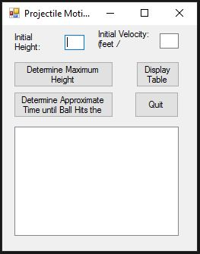
INPUT
Initial Height – txtInitialHeight
Initial Velocity - txtInitialVelocity
OUTPUT
Maximum Height – lstOutput
Time for Ball to Hit Ground – lstOutput
Height of ball for 5 seconds - lstOutput
EVENTS
Finding Max Height – btnMaxHeight
Finding Time for Ball To Hit Ground – btnApproxTime
Displaying Table of ball height for 5 secs – btnTable
Quit - btnQuit

