Slide 1
Depreciation
An Introduction
To Programming
Using
Visual Basic
Exercises for Beginners
04
For tax purposes an item may be depreciated over a period of several years. (n). With the straight-line depreciation, each year the item depreciates by 1/nth of its value. With double-declining-balance method of depreciation, each year the item depreciates by 2/n of its value at the beginning of that year. (In its final year, it is depreciated by it’s value at the beginning of the year). Write a program that performs the following:
Requests a description of the item, the year of purchase, the cost of the item, the number of years to be depreciated (estimated life), and the method of depreciation. The method of depreciation should be chosen by clicking on one of the two buttons
Display a year-by-year description of the depreciation

Slide 2
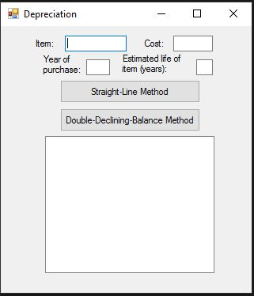
INPUT
Item Description - txtDesc
Cost – txtCost
Year Of Purchase – txtYear
Estimated Life - txtNumYears
OUTPUT
Straight-line or Double-Declining Balance – lstOutput
EVENTS
Straight Line Method – btnStraight
Double-Declining-Balance - btnDouble

