Slide 1
Alphabetical Order
An Introduction
To Programming
Using
Visual Basic
Exercises for Beginners
05
The following words have 3 consecutive letters that are also consecutive letters in the alphabet. THIRSTY, AFGHANISTAN, STUDENT. Write a program that accepts a word as input and determines whether or not it has three consecutive letters that are also consecutive letters in the alphabet. The program should use a
Boolean-valued function named IsTrippleConsecutive that accepts an entire word as input.
HINT: Use Asc function.

Slide 2
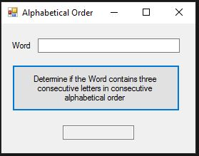
INPUT
Word (string) – txtWord
OUTPUT
Yes/No - txtOutput
EVENTS
Determine if word contains 3 alphabetically consecutive letters
- btnDetermine

