Slide 1
Parentheses
An Introduction
To Programming
Using
Visual Basic
Exercises for Beginners
06
Write a program that does the following:
Asks the user to input a sentence containing parentheses.
Display the sentence with the parentheses and their content removed

Slide 2
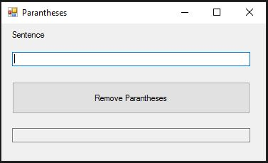
INPUT
Sentence (string) – txtSentence
OUTPUT
String – altered sentence- txtOutput
EVENTS
Remove Parentheses - btnRemove

