Slide 1
Palindrome
An Introduction
To Programming
Using
Visual Basic
Exercises for Beginners
07
A palindrome is a word or a phrase that reads the same forward and backward, character for character, disregarding punctuation, case, and spaces. Some examples: “racecar”, “Madam, I’m Adam”, “Was it a cat I saw?”.
Write a program that allows the user to input a word or a phrase and then determines if it’s a palindrome. The program should use a Boolean-valued Function procedure named IsPalindrome that returns True if the word is a palindrome.
NOTE: Remove all spaces and punctuation before analyzing the word or phrase.

Slide 2
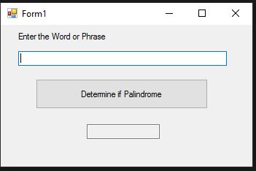
INPUT
String – txtWord
OUTPUT
True/False – txtOutput
EVENTS
Analyze word- btnDetermine

