Slide 1
Individual Retirement Accounts
An Introduction
To Programming
Using
Visual Basic
Exercises for Beginners
08
Money earned in an ordinary savings account is subject to federal, state, and local taxes. However, a special type of retirement account, called IRA allows these taxes to be deferred until retirement. The purpose of this project is to show the benefits of starting IRA early.
Earl and Larry begin full time jobs in January 2013 and plan to retire in January 2061, after working 48 years. Assume that any money they deposit to IRA earn 4% interest compounded annually. Earl opens a traditional IRA account immediately and deposits $5,000, at the beginning of each year for 15 years. Larry plans to wait 15 years before opening IRA and then deposits $5,000 into the account at the end of each year until he retires.
Write a program that calculates the amounts of money each person has deposited into his account and the amount of money in each account upon retirement

Slide 2
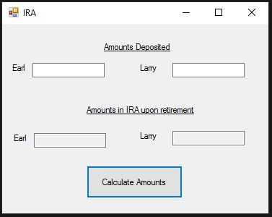
INPUT
None – everything is hardcoded
OUTPUT
txtEarlTotalDeposits
txtLarryTotalDeposits
txtEarlTotalIRA
txtLarryTotalIRA
EVENTS
Calculate all amounts - btnCalculate

