Slide 1
Binary Search
An Introduction
To Programming
Using
Visual Basic
Exercises for Beginners
09
A binary Search looks for a value by first determining in which half of the list it resides. The other half of the list is then ignored, and the retained half is temporarily regarded as entire list. The process is repeated until item is found or entire list has been considered.
The Boolean variable flag keeps track of whether or not the searched value has been found.

Slide 2
1. At each stage, denote the index of the first item in the retained list by first and the index of the last item by last. Initially, set the value of first to zero, set the value of last to one less than the number of items in the list, and set flag to False
2. Look at the middle item of the list – the item having index
middle = Cint((first + last) / 2)
3. If the middle item = the searched item, set flag = True and exit search (item was found).
4. If middle item is greater than searched item, than searched item must be in the first half of the list. So index of the searched item must be between first and middle – 1. Set last = middle – 1
5. If middle item is less than searched item, than searched item must be in the second half of the list. So the index of the searched item must be between middle and last. Set first = middle + 1
6. Repeat steps 2 – 5 until searched item is found or until halving process uses up the entire list (When entire list has been used up first > last). If that happens, the searched item is not in the list.

Slide 3
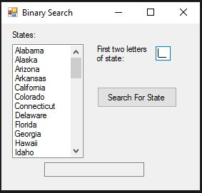
INPUT
txtInput – First 2 letters of a state
OUTPUT
txtOutput – State name or Not Found
EVENTS
btnSearch – Perform Binary Search

