Slide 1
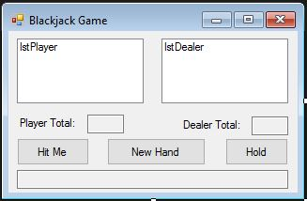
BlackJack
An Introduction
To Programming
Using
Visual Basic
Exercises for Beginners
02
Write a program for a game BlackJack.
Use the following form.

