Slide 1
Repair Bill
An Introduction
To Programming
Using
Visual Basic
Exercises for Beginners
02
Suppose automobile repair customers are billed the rate of $35 per hour for labor. Also, suppose costs for parts and supplies are subject to a 5% sales tax.
Write a program to display a simplified bill. The customer's name, the number of hours of labor, and the cost of parts and supplies should be entered into the program via text boxes.
When a button is clicked, the customer's name and the three costs should be displayed in a list box.

Slide 2
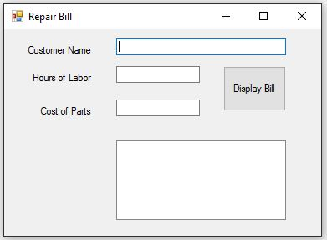
INPUT
Customer Name - txtName
Hours of Labor - txtLabor
Cost of Parts – txtParts
OUTPUT
Output List Box - lstDisplay
EVENTS
Display Bill Button – btnDisplay

