Slide 1
Length Conversion
An Introduction
To Programming
Using
Visual Basic
Exercises for Beginners
04
Write a program to convert a U.S. Customary System length in miles, feet, and inches to a Metric System length in kilometers, meters, and centimeters.
After the numbers of miles, yards, feet, and inches are read from the text boxes, the length should be converted entirely to inches, and then divided by 39.37 to obtain the value in meters. The Int function should be used to break the total number of meters into a whole number of kilometers and meters. The number of centimeters should be displayed to one decimal place.

Slide 2
Formulas
total inches = 63360 * miles + 36 * yards + 12 * feet + inches
total meters = total inches / 39.37
kilometers = Int(meters / 1000)

Slide 3
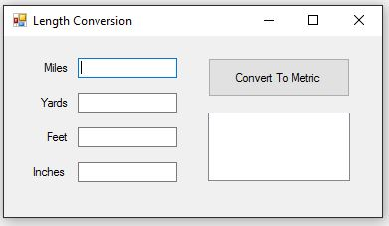
INPUT
Miles – txtMiles
Yards – txtYards
Feet – txtFeet
Inches - txtInches
Output
ListBox – lstMetric
EVENTS
Convert To Metric - btnConvert

