Slide 1
Car Loan
An Introduction
To Programming
Using
Visual Basic
Exercises for Beginners
05
If dollars are borrowed at r % interest compounded monthly to purchase a car with monthly payments for n years, then the monthly payment is given by a special financial formula.
Write a program that calculates the monthly payment after the user gives the amount of the loan, interest rate, and number of years.

Slide 2
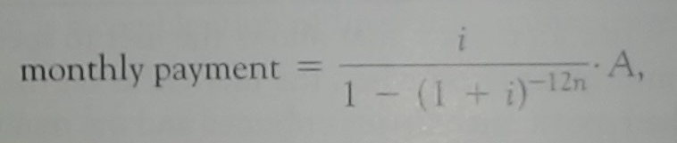
Formulas
Where
r = interest rate
i = r / 1200
A = amount borrowed
n = number of years
Sample Output
Monthly payments of $234.23 are required to pay off a 5-year loan of $12,000 at 6.4% interest.

Slide 3
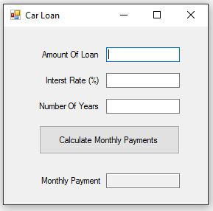
INPUT
Amount of Loan - txtAmount
Interest Rate - txtInterest
Number of Years – txtYears
Output (Read Only)
Monthly Payment - txtPayment
EVENTS
Calculate Payments - btnCalculate

