Slide 1
Rental Cost
An Introduction
To Programming
Using
Visual Basic
Exercises for Beginners
01
Write a program that displays rental table in a list box, and an invoice in another list box, when appropriate button is clicked.
The bill should include a $30 deposit.

Slide 2
Price Schedule For Equipment Rental
Place Of Equipment | Half-Day | Full Day
1. Rug cleaner | $16.00 | $24.00
2. Lawn mower | $12.00 | $18.00
3. Paint sprayer | $20.00 | $30.00

Slide 3
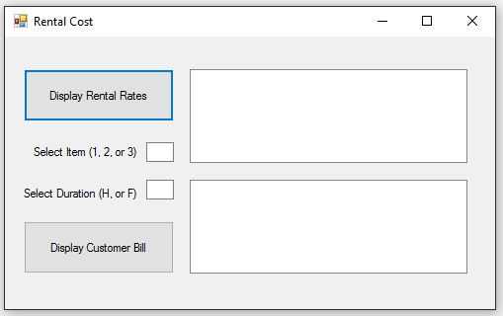
INPUT
Item - txtItem
Duration – txtDuration
OUTPUT
ListBox – lstRentalRates
ListBox - LstBill
EVENTS
Display Rental Rates Button – btnDisplayRates
Display Bill Button – btnDisplayBill

