Slide 1
Nutrition
An Introduction
To Programming
Using
Visual Basic
Exercises for Beginners
02
Write a program that requests the name of the food, number of calories per serving, and the grams of fat per serving as input; and tells whether the food meets the American Heart Association (AHA) recommendation.
NOTE: AHA recommends at most 30% of calories to come from fat
NOTE: 1 gram of fat contains 9 calories

Slide 2
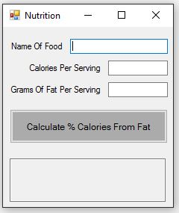
INPUT
Name Of Food - txtNameOfFood
Calories Per Serving – txtCaloriesPerServing
Grams Of Fat Per Serving - txtGramsOfFat
OUTPUT – Text Box with MultiLine enabled
Output Text Box - txtDisplay
EVENTS
Calculate Calories Button – btnCalculate

