Slide 1
Car Loan
An Introduction
To Programming
Using
Visual Basic
Exercises for Beginners
03
Write a program to analyze a car loan. The user should enter the amount of the loan, the annual percentage rate of interest, and the duration of the loan in months. When the user clicks on the button, the information that was entered should be checked to make sure it’s reasonable. If bad data has been supplied, the user should be advised. Otherwise, monthly payments and total amount of interest paid should be displayed.

Slide 2
Monthly payments =
p * r
_______________________
-n
1 – (1 + r)
p = amount of the loan
r = monthly interest rate (annual rate divided by 12) given as a number between 0 (for 0%) and 1 (for 100%)
n = duration of the loan in months
Total interest = n * monthly payment - p

Slide 3
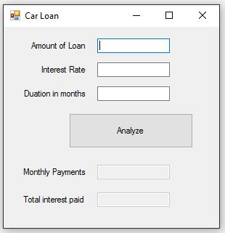
INPUT
Amount of Loan - txtAmountOfLoan
Interest Rate – txtInterestRate
Duration in months - txtDuration
OUTPUT
Output Text Box – txtMonthlyPayments
Output Text Box – txtInterestPaid
EVENTS
Analyze Button – btnAnalyze

