Slide 1
Orders and Inventory Management
An Introduction
To Programming
Using
Visual Basic
Exercises for Beginners
01
The database Microland.accdb contains 3 tables. The table Customers identifies each customer by an ID number and gives, in addition to name and address, the total amount of purchases during the current year prior to today. The table Inventory identifies each product in stock by an ID number and gives, in addition to the description and price per unit, the quantity in stock at the beginning of the day. The table Orders gives the orders received today. Suppose that it is now the end of the day. Write a program that:
1. Displays in a list box the items that are out of stock and those that must be reordered to satisfy the orders. 2. Displays in a list box bills for all customers who ordered during the day. Each bill should show the customer’s name, address, items ordered (with costs), and total cost of the order.

Slide 2
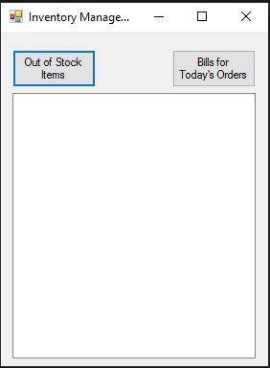
INPUT
Input from database
OUTPUT
Out of stock items
Today’s orders
EVENTS
btnOutOfStock – displays out of stock items
btnBills – displays today’s orders

