Slide 1
Grade Book
An Introduction
To Programming
Using
Visual Basic
Exercises for Beginners
02
A teacher maintains a database containing 2 tables – Students and Grades.
At the beginning of the semester, the Students table is filled in completely with a record for each student in a class, and the Grades table has a record for each student that contains only the student’s ID number.
Write a program that allows the instructor to record and process the grades for the semester.
Use a navigation toolbar to fill Grades table
After all grades are entered, display a DataGridView showing the name of each student and his or her semester average. The semester average should be calculated as
(firstExam + secondExam + (2 * finalExam) ) / 4

Slide 2
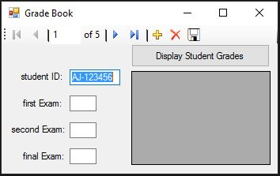
INPUT
Text boxes for grades for exams
OUTPUT
DataGridView – Student info + grade
EVENTS
Database driven
btnDisplay – displays information for all students

