Slide 1
Cape Town Airbnb Ratings & Weather Analysis
Correlating weather conditions with guest ratings across Cape Town Airbnb listings.
Phila Dyantyi | Data Engineer

Slide 2
Problem Statement & Objective
Task
Collect and analyze Cape Town Airbnb listings (Dec 2023) and determine if a correlation exists between ratings and weather conditions.
Goal
Deliver a Python ingestion script, SQL data model, and a visual dashboard with actionable insights.
Deliverables
Python (.py)
DDL & DML scripts (.sql)
Data model diagram (.drawio)
Analysis slide deck (.pptx)

Slide 3
Solution Architecture
End-to-end Pipeline
1
2
3
4
5
6
Data Sources
Ingestion
Staging / Bronze
Transform / Silver
DWH / Gold
Dashboard
Open-Meteo API
InsideAirbnb CSV
Python script
SQL Server
NVARCHAR tables
Views + TRY_CAST
Type validation
Dimensional model
Facts & Dims
Visualisations
& Insights
BRONZE
SILVER
GOLD

Slide 4
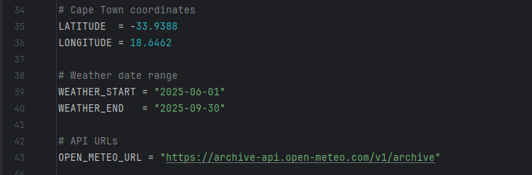
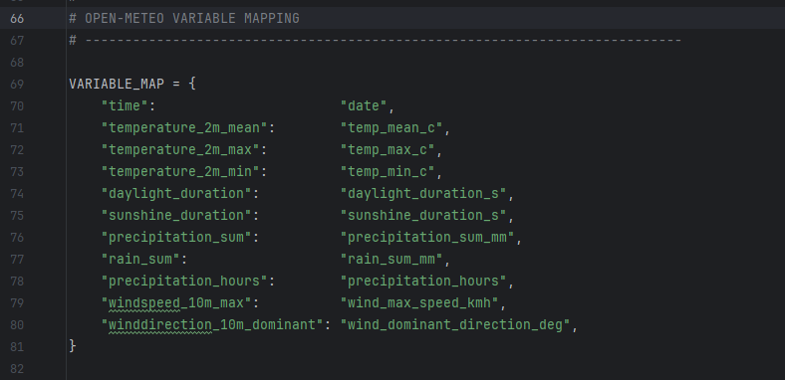
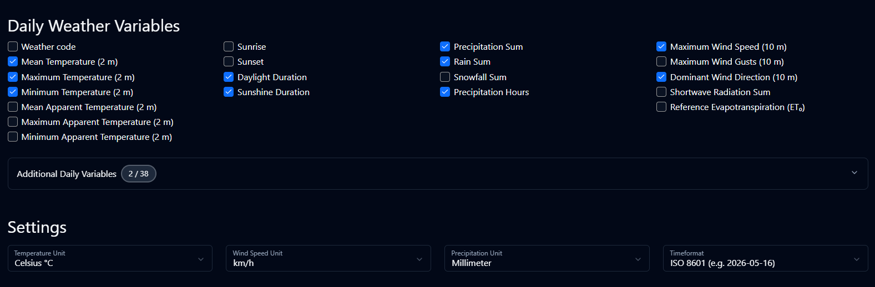
Weather Data - Open Meteo API
DATA ACQUISITION
Free historical data - no subscription
No banking card details required
No API key authentication needed
Structured JSON responses
Daily aggregation - ideal for this analysis
The Open-Meteo UI doesn't have Africa/Johannesburg in its dropdown, so I used Africa/Cairo instead. Both are UTC+2 with no daylight saving time, so the timestamps are identical for South Africa.

Slide 5
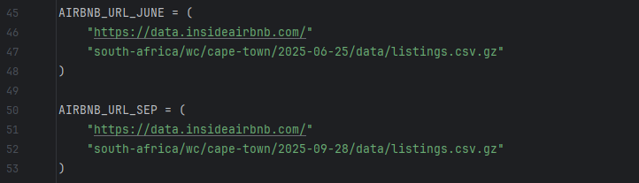
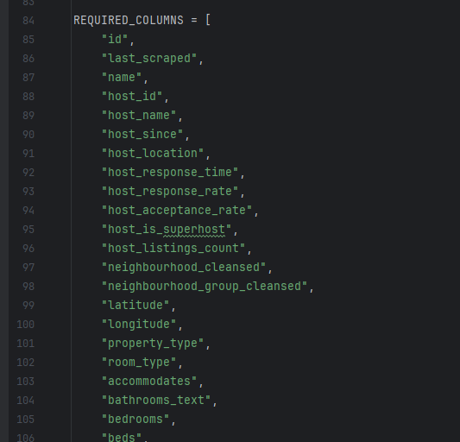
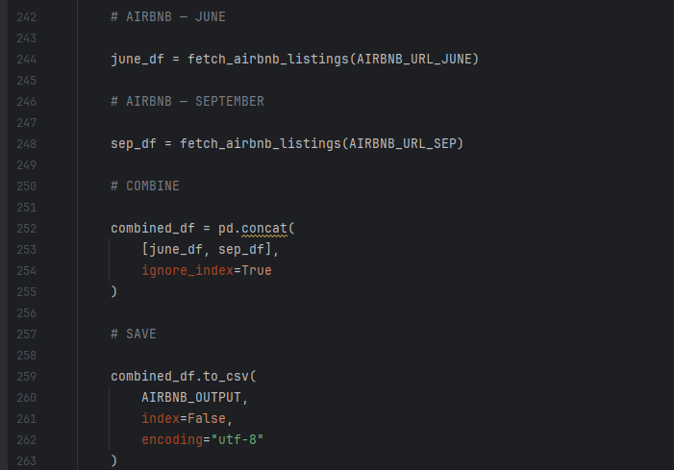
Airbnb Dataset - InsideAirbnb Cape Town
DATA ACQUISITION
Source: InsideAirbnb
Dataset: June 2025 & September 2025
Required fields: Only kept columns that directly support business analysis - pricing, occupancy, host performance, guest reviews etc.
Eliminate irrelevant fields to ensure clean, focused data aligned with the case study objectives.

Slide 6
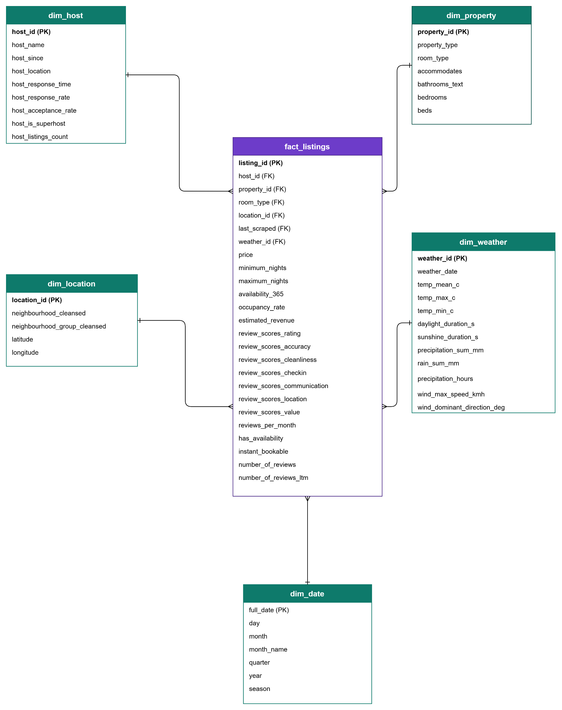
DATA MODEL
Dimensional Data Model - Kimball Approach

Slide 7
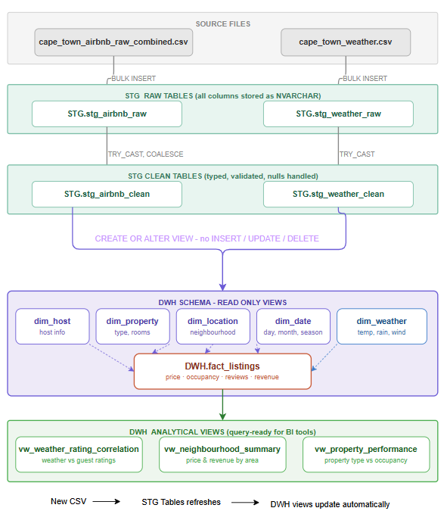
DATA TRANSFORMATION
SQL Transformation
(DDL & DML)
Notes:
NVARCHAR
BULK INSERT
TRY_CAST
INDEXES
ROW_NUMBER
Why Analytical view?

Slide 8
 | temp_mean | temp_max | temp_min | precip_sum_mm | rain_sum_mm | wind_max_speed_kmh | listing_count | avg_rating | avg_cleanliness | avg_value | avg_price | avg_occupancy
temp_mean | 1.00
temp_max | 0.90 | 1.00
temp_min | 0.80 | 0.49 | 1.00
precip_sum_mm | (0.50) | (0.65) | (0.14) | 1.00
rain_sum_mm | (0.50) | (0.65) | (0.14) | 1.00 | 1.00
wind_max_speed_kmh | (0.11) | (0.36) | 0.16 | 0.56 | 0.56 | 1.00
listing_count | 0.72 | 0.65 | 0.51 | (0.48) | (0.48) | 0.02 | 1.00
avg_rating | (0.06) | (0.12) | 0.10 | 0.05 | 0.05 | (0.35) | 0.05 | 1.00
avg_cleanliness | (0.06) | (0.12) | 0.11 | 0.06 | 0.06 | (0.34) | 0.05 | 1.00 | 1.00
avg_value | (0.07) | (0.14) | 0.11 | 0.08 | 0.08 | (0.32) | 0.04 | 1.00 | 1.00 | 1.00
avg_price | 0.19 | 0.39 | (0.02) | (0.45) | (0.45) | (0.53) | 0.10 | 0.59 | 0.59 | 0.57 | 1.00
avg_occupancy | 0.32 | 0.35 | 0.11 | (0.53) | (0.53) | (0.29) | 0.39 | (0.51) | (0.51) | (0.52) | (0.42) | 1.00
There is clearly no correlation between weather conditions and the ratings.
Location of the property shows that some wards score better ratings than others.
Room type also shows some variations in ratings, but it is not that significant.
Cleanliness, value and price actually show positive correlation with ratings.

Slide 9
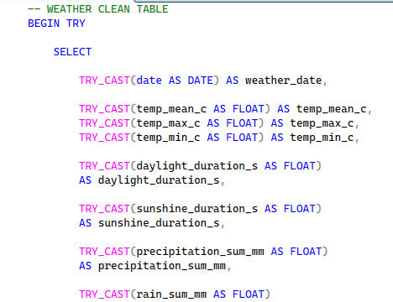
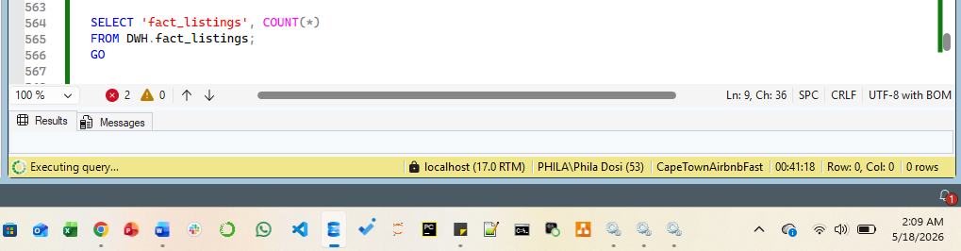
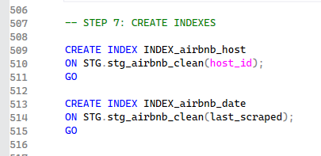
Challenges
PROBLEM SOLVING
OpenWeather API required paid subscription.
InsideAirbnb Dec 2023 data unavailable.
Raw CSV data too messy for direct SQL load - mixed types, nulls, bad values .
Staged all columns as NVARCHAR. TRY_CAST in views - Pipeline stays live.
Optimize SQL Query

Slide 10
Things to do in future
INITIATIVE &VISION
Pipeline Automation - Orchestrate - scheduled daily ingestion runs.
Seasonal Analysis - Extend to 12 months to surface seasonality trends and year on year comparisons.
Cloud Deployment - Host on AWS
Predictive Modelling - Build a price or occupancy predictor using weather forecasts + historical data.
Slowly Changing Dimensions (SCDs) - dim_host & dim_property
Data Quality Monitoring - Add a checking step between STG raw and STG clean that catches and logs bad data before it reaches the DWH.
This becomes critical once the pipeline is automated and cloud-hosted, as bad data could flow into the views undetected for days with no one manually watching.

Slide 11


