Slide 1

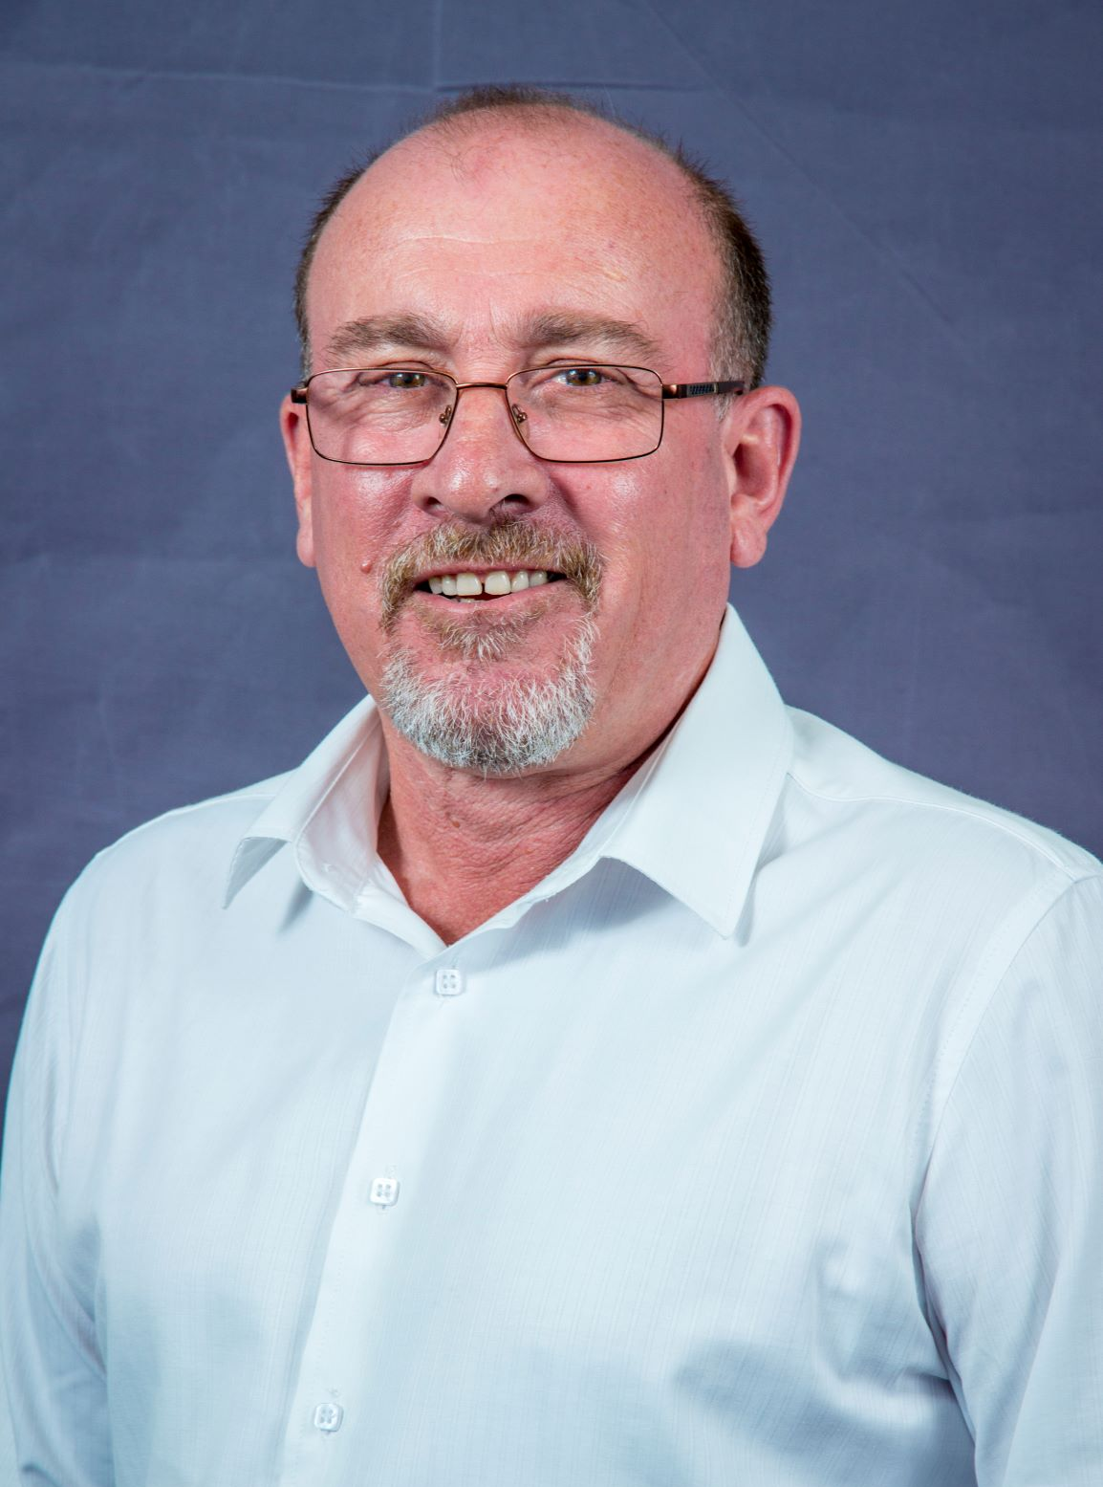
Derek Zimmerman- Biography ‘Deputy Chairperson’
‘Derek has been involved in the Development Finance and Economics realm for the past thirty years, with a strong emphasis on infrastructure, industrial development, renewable energy and the Ocean Economy.
Derek lectures Maritime Economics at Nelson Mandela University at a masters level, and is Deputy Chairperson of the MBMC.
Projects of relevance to our Maritime Cluster are as follows:
South African Ocean economy within the Operation Phakisa framework on behalf of the Department of Forestry, Fisheries and Environment (DFFE) in 2022,
The Business Plan for the East London Industrial Development Zone, which included rail upgrades, port logistics and development,
The Masterplan for the Coega Industrial Development Zone, including Aquaculture and the logistics of the Deepwater Port of Ngqura for the IDZ,
The preparation of a number of feasibility study reports and business plans for port infrastructure and developments in SA, Africa and the Middle East,
The Feasibility Study and Business Plan for the Waterfront in the Port of Port Elizabeth,
The Eastern Cape Ocean Economy and Road Map to highlight commercial opportunities, and
The preparation of the maritime cluster support framework for this cluster, the Mandela Bay Maritime Cluster.’
Derek Zimmerman.
Deputy Chairperson.
Mandela Bay Maritime Cluster.
2006 The Beaches, Summerstrand, Gqeberha, (Port Elizabeth), South Africa.
Postnet Suite 12, Private Bag X 40106, Walmer, 6065.
P: +27 (0) 41 811 2478 |C: +44 (0) 776 235 9146 |F: +27 (0) 86 618 0289
C: + 27 83 263 6796 (WhatsApp, Signal, Telegram)
E: derekzim@worldonline.co.za | derekzim76@gmail.com

