Slide 1
Electricity Load Forecasting Using Random Forest
Smart Meter Data Across Rwandan Cities
Presented by: Philbert Hakorimana

Slide 2
Introduction
Electricity demand forecasting is critical for grid stability and planning.
Smart meters provide detailed consumption data across cities.
Random Forest is a machine learning model effective in handling large datasets.
Focus: Forecasting electricity load patterns in Rwandan cities.

Slide 3
Problem Statement
Rwanda faces increasing electricity demand with urban growth.
Inaccurate forecasts lead to blackouts or wastage.
Traditional models struggle with nonlinear consumption trends.
Need for accurate, scalable, and adaptive forecasting methods.

Slide 4
Methodology
Data Collection: Smart meter readings across Rwandan cities.
Preprocessing: Cleaning, handling missing values, normalization.
Feature Engineering: Time, weather, holidays, and regional factors.
Model: Random Forest Regression.
Evaluation: MAE, RMSE, and R² metrics.

Slide 5
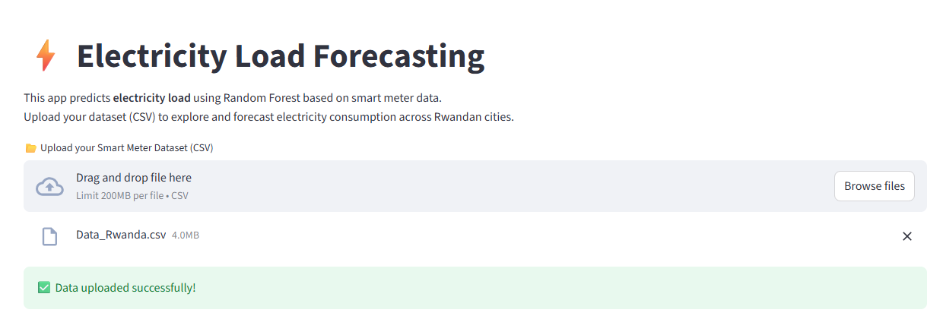
Implementation of project

Slide 6
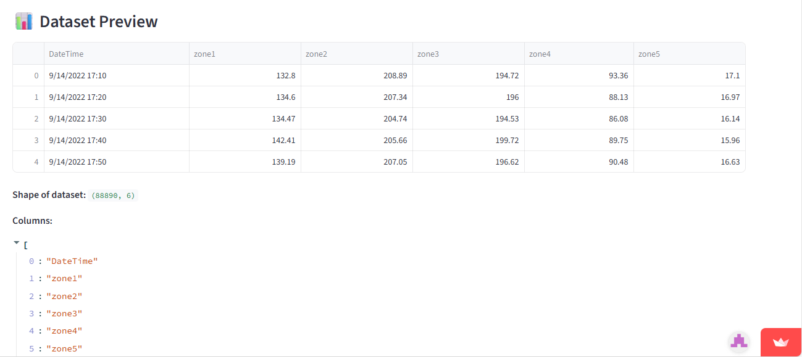
Implementation of project

Slide 7
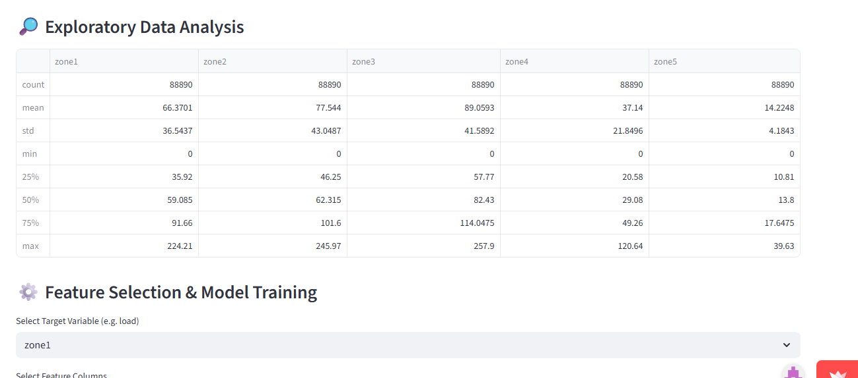
Implementation of project

Slide 8
Results
Random Forest outperformed traditional forecasting models.
Achieved high accuracy with low error rates.
Able to capture nonlinear load patterns across different cities.
Reliable for short-term and medium-term load forecasting.

Slide 9
Applications
Grid load balancing and stability.
Optimized energy distribution in urban centers.
Support for renewable energy integration.
Policy and decision-making for energy planning.

Slide 10
Conclusion
Random Forest is effective for electricity load forecasting.
Smart meter data enhances prediction accuracy.
Provides valuable insights for Rwandan energy sector.
Future work: Incorporating deep learning and real-time predictions.

Slide 11
Thank you!!

