Slide 1
Letter-Recognition
Presented by: Philip George, Seif Nagi, Marian Kromel, Ahmed Osama, Youssif Assem
Supervised by: Dr. Ammar Mohamed, Eng: Haytham Metawie

Slide 2
Agenda
Introduction
Data set
Machine learning classifiers
Deep learning model

Slide 3
Introduction
Data set contains 16 features attributes.
Data set contains a target label named as (letter)
We tried to get the best accuracy by applying multiple classifiers and deep learning model.

Slide 4
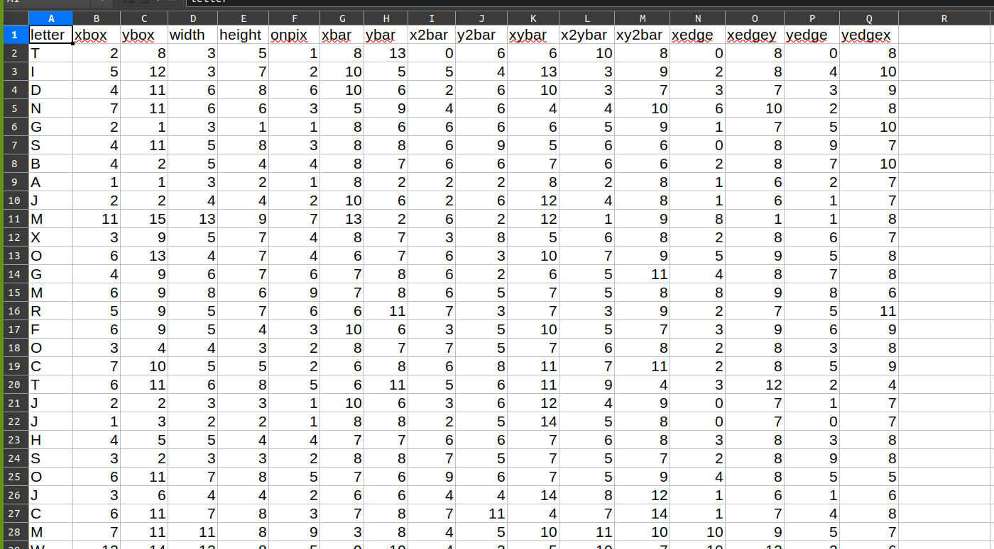
Data set

Slide 5
Machine learning models
Naive Bayes Classifier
Classifier | Accuracy | Precision | Recall | F1- score
Naive Bayes | 0.65% | 0.66 | 0.65 | 0.65

Slide 6
Machine learning models
KNN classifier
Classifier | No of neighbors | Accuracy | Precision | Recall | F1- score
KNN | 10 | 0.94% | 0.94 | 0.94 | 0.94
KNN | 4 | 0.95% | 0.95 | 0.95 | 0.95
KNN | 2 | 0.95% | 0.95 | 0.95 | 0.95
KNN | 7 | 0.95% | 0.95 | 0.95 | 0.95

Slide 7
Machine learning models
Random Forest Classifier
Classifier | criterion | n_estimators | Accuracy | Precision | Recall | F1- score
Random Forest | entropy | 200 | 96.37% | 0.96 | 0.96 | 0.964
Random Forest | entropy | 250 | 95.75% | 0.96 | 0.96 | 0.958
Random Forest | gini | 200 | 95.67% | 0.96 | 0.96 | 0.957
Random Forest | gini | 250 | 95.95% | 0.96 | 0.96 | 0.96

Slide 8
Machine learning models
SVM Classifier
Classifier | C | Kernel | Accuracy | Precision | Recall
SVM | 1.0 | rbf | 0.9945 | 0.9305 | 0.929
SVM | 200 | linear | 0.9854 | 0.8184 | 0.8102
SVM | 100 | poly | 0.9958 | 0.9461 | 0.9457
SVM | 10 | sigmoid | 0.9312 | nan | 0.1051

Slide 9
Deep learning model
MLP Classifier
Classifier | Activation Function | Optimization | No Of Iterations | No Of Hidden layers | No Of preceptors | Accuracy
MLP | Relu | sgd | 2000 | 3 | 100 | 0.95
MLP | Relu | adam | 2000 | 3 | 250 | 0.96
MLP | logistic | adam | 2000 | 3 | 200 | 0.96

Slide 10
Thank You! Any Questions ?!

