Slide 1
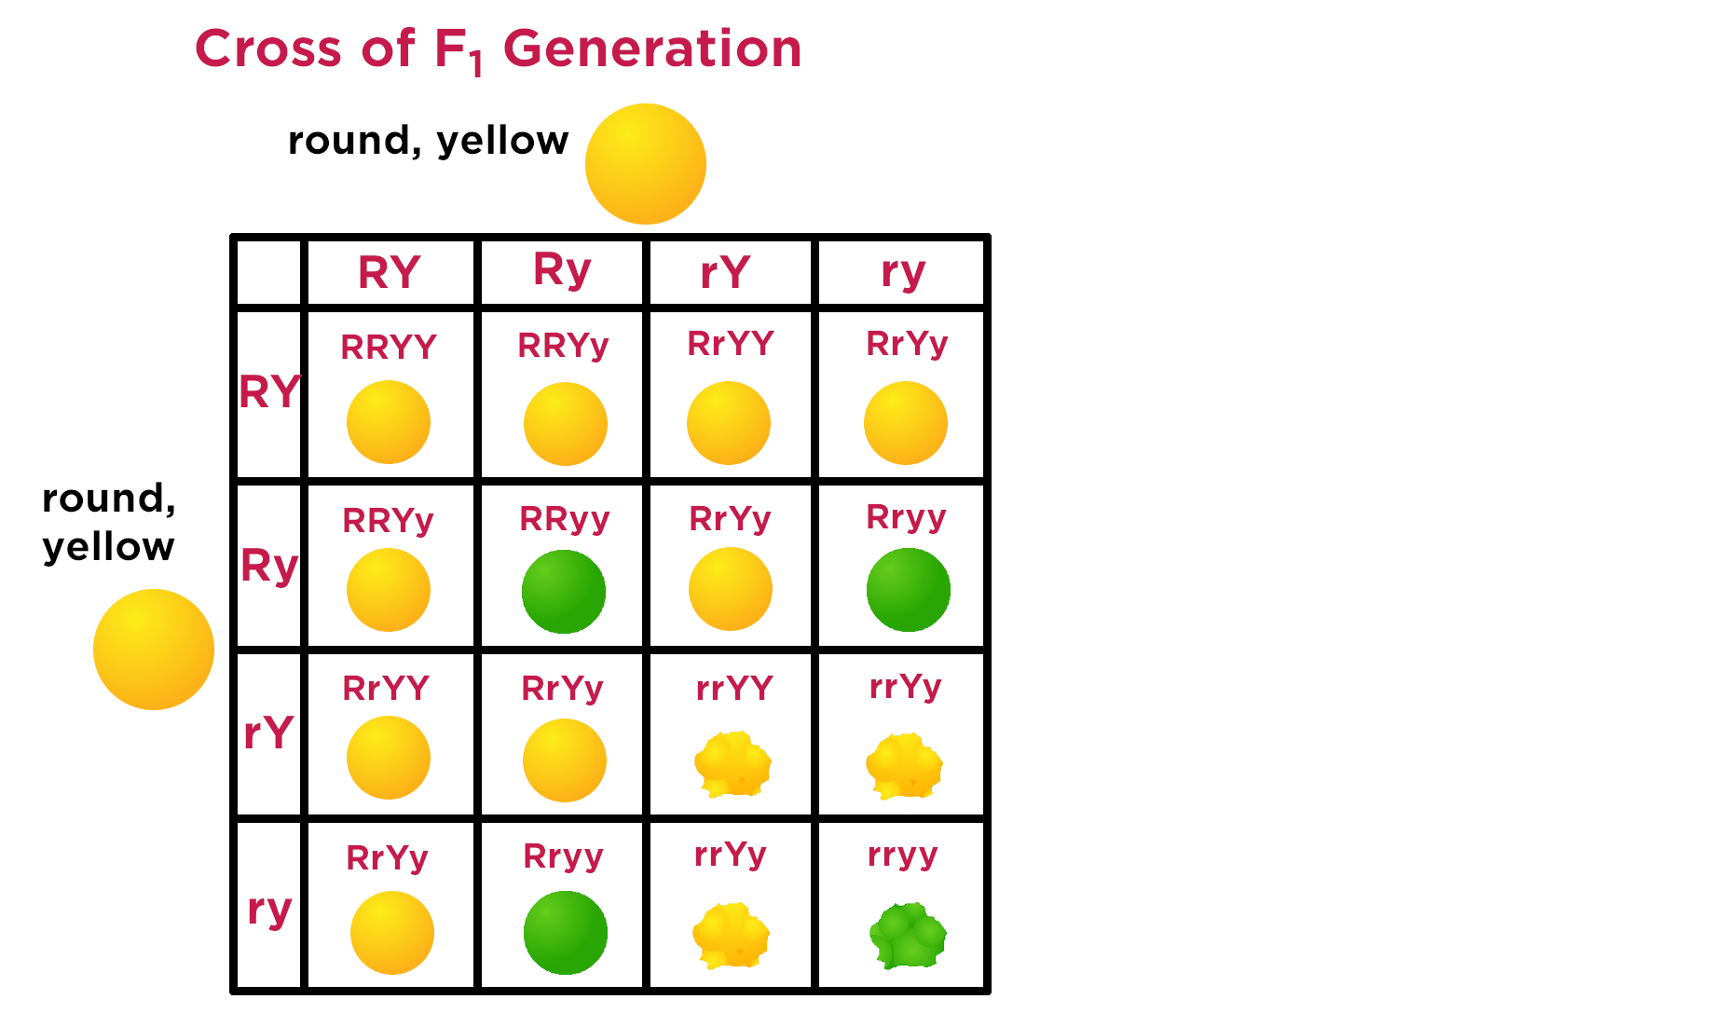





round, yellow
round, green
wrinkled, yellow
wrinkled, green

Slide 2
round, yellow
round, green
wrinkled, yellow
wrinkled, green

Slide 3
round, yellow
round, green
wrinkled, yellow
wrinkled, green

Slide 4
round, yellow
round, green
wrinkled, yellow
wrinkled, green

Slide 5
round, yellow
round, green
wrinkled, yellow
wrinkled, green

Slide 6
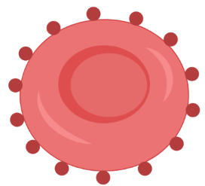
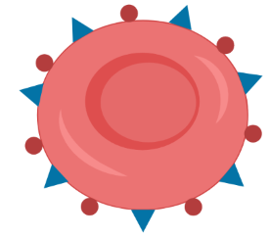
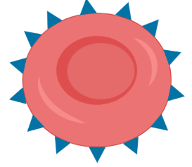
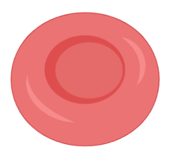


AO
A
O
AB
BO
B
AO
OO
BO
A antigen
O
B antigen

Slide 7
I^{A}I^{O}
I^{A}
I^{O}
I^{A}I^{B}
I^{B}I^{O}
I^{B}
I^{A}I^{O}
I^{O}I^{O}
I^{B}I^{O}
A antigen
I^{O}
B antigen

Slide 8
I^{A}I^{A} fut1^{H} fut1^{h}
I^{A} fut1^{H}
I^{A} fut1^{h}
I^{A}I^{B}
fut1^{H} fut1^{H}
I^{A}I^{B}
fut1^{H} fut1^{h}
I^{B} fut1^{H}
I^{B}I^{B}
fut1^{H} fut1^{h}
I^{A}I^{B}
fut1^{H} fut1^{h}
I^{A}I^{B}
fut1^{h} fut1^{h}
I^{B} fut1^{h}
A antigen
B antigen

Slide 10
A antigen
I^{A} allele
H antigen
Fut1 gene
I^{B} allele
B antigen

Slide 11

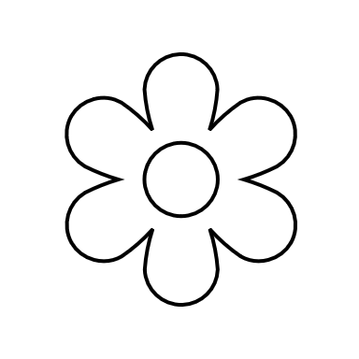

Red
RR
White
rr
R
r
Pink
Rr

Slide 12
I^{A}I^{A} fut1^{H} fut1^{h}
I^{A} fut1^{H}
I^{A} fut1^{h}
I^{A}I^{B}
fut1^{H} fut1^{H}
I^{A}I^{B}
fut1^{H} fut1^{h}
I^{B} fut1^{H}
I^{B}I^{B}
fut1^{H} fut1^{h}
I^{A}I^{B}
fut1^{H} fut1^{h}
I^{A}I^{B}
fut1^{h} fut1^{h}
I^{B} fut1^{h}

