Slide 1
SIT215 – Artificial and Computational Intelligence
Problem Solving Task 2 – Knight’s Tour

Slide 2
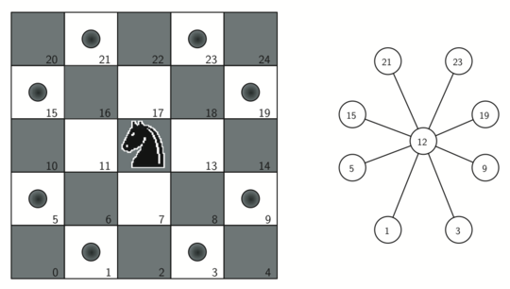
The Knight’s tour problem
A knight must tour a chess board from it's starting position, visiting each location once exactly.
Quick facts
First reference of the problem was in 9th century AD.^{[1]}
26,534,728,821,064 directed closed tours on 8 x 8 board.^{[2]}
4×10⁵¹ possible move sequences on 8x8 board.^{[3]}
Image from: http://interactivepython.org/courselib/static/pythonds/Graphs/BuildingtheKnightsTourGraph.html

Slide 3
Skills Audit
Skill | Level of knowledge (None, Basic, Competent, Proficient) | Action(s) to improve
Problem domain: What tools and knowledge is required to implement a ‘knight’s tour’ | Lee: None Phil: Basic | http://www.mindmagician.org/tourhelp.aspx
State-space search algorithms | Lee: Basic Phil: Competent | https://www.hackerearth.com/practice/algorithms/graphs/depth-first-search/tutorial/
Backtracking | Lee: None Phil: None | https://www.geeksforgeeks.org/the-knights-tour-problem-backtracking-1/ https://ieeexplore.ieee.org/abstract/document/8126004/
Warnsdorff’s algorithm, heuristics | Lee: None Phil: None | https://www.geeksforgeeks.org/warnsdorffs-algorithm-knights-tour-problem/
Neural Networks | Lee: None Phil: Basic | https://dmitrybrant.com/knights-tour

Slide 4
Solution Challenges
How to represent the problem so we can apply an algorithm?
Difficult to make the boards state and past moves computationally efficient
Very large state space, brute force with uninformed search becomes impractical very quickly

Slide 5
Our solution
Initialisation
Traversal
Uninformed Search: Depth-first search
Informed search: Warnsdorff’s Rule
Re-evaluation
Backtracking when hitting a dead end
Completion
Solved tour
Printing finished board with moves taken
Create board
Rules for movement
Continuing a new path

Slide 6
Demonstration
Demonstration goes here

Slide 7
Limitations and constraints
No test cases for bugs when solver doesn’t find solution
Depth-first search is too slow to be practical for boards larger than 5 x 5 or 6 x 6
In the tests we ran it found a solution very quickly on most boards
Would add test cases if needed to enhance the program
Warnsdorff’s rule helps alleviate this

Slide 8
References
[1] https://en.wikipedia.org/wiki/Knight%27s_tour
[2] https://cosmosmagazine.com/mathematics/knight-s-tour-still-going-strong
[3] http://www.josiahland.com/archives/781

Slide 9
Empty slide

