Slide 1
SIT215 – Artificial and Computational Intelligence
Problem Solving Task 2 – Knight’s Tour

Slide 2
Skills Audit
Skill | Level of knowledge (None, Basic, Competent, Proficient) | Action(s) to improve
Problem domain: What tools and knowledge is required to implement a ‘knight’s tour’ | Lee: None Phil: Basic | http://www.mindmagician.org/tourhelp.aspx
State-space search algorithms | Lee: Basic Phil: Competent | https://www.hackerearth.com/practice/algorithms/graphs/depth-first-search/tutorial/
Backtracking | Lee: None Phil: None | https://www.geeksforgeeks.org/the-knights-tour-problem-backtracking-1/ https://ieeexplore.ieee.org/abstract/document/8126004/
Warnsdorff’s algorithm, heuristics | Lee: None Phil: None | https://www.geeksforgeeks.org/warnsdorffs-algorithm-knights-tour-problem/
Neural Networks | Lee: None Phil: Basic | https://dmitrybrant.com/knights-tour

Slide 3
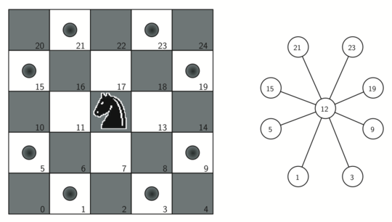
The Knight’s tour problem
Explanation of knights tour goes here
Quick facts
First reference of the problem was in 9th century AD
26,534,728,821,064 directed closed tours on 8 x 8 board
4×10⁵¹ possible move sequences on 8x8 board
Image from: http://interactivepython.org/courselib/static/pythonds/Graphs/BuildingtheKnightsTourGraph.html

Slide 4
Our solution
Initialisation
Traversal
Depth-first search
Warnsdorff’s Rule
Black magic/sacrificing virgins
Re-evaluation
Backtracking when hitting a dead end
Completion
Solved tour
Printing finished board with moves taken
Create board
Rules for movement
Continuing a new path

Slide 5
Demonstration
Demonstration goes here

Slide 6
Limitations and constraints
No test cases for bugs when solver doesn’t find solution
In the tests we ran it found a solution very quickly on most boards
Would add test cases if needed to enhance the program

Slide 7
Requirements
1) Explanation of the Knight’s Tour problem, and what makes it challenging to solve
2) Explanation of the solution algorithm you chose or designed
3) Explanation and demonstration of your software implementation of this algorithm
4) Discussion of any limitations or constraints of your solution
5) You must also clearly identify which group members did what work, to contribute to the solution

Slide 8
Add a Slide Title - 5

Slide 9
Add a Slide Title - 5

Slide 10
Add a Slide Title - 5

Slide 11
Add a Slide Title - 5

Slide 12
Add a Slide Title - 5

