Slide 1
SIT215 Artificial And Computational Intelligence
Problem solving task 3 – A game of Nim
Lee Copland
Philip Castiglione

Slide 2
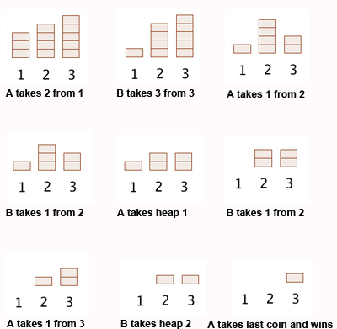
How to play Nim
Nim is a strategic game between two players
Tiles are arranged in heaps/rows
Players take turns picking up tiles, can pick any number of tiles from a singular row
Two game modes:
Normal – Player who picks up the last tile wins
Misère – Player who picks up the last tile loses
Image from:
https://plus.maths.org/content/play-win-nim

Slide 3
Skills Audit
Skill | Level of knowledge (None, Basic, Competent, Proficient) | Action(s) to improve
Problem Domain: What tools and knowledge is required to implement ‘a game of Nim’ | Lee: None Phil: Basic
Minimax algorithm | Lee: None Phil: Proficient
Validation | Lee: None Phil: Basic

Slide 4
Solution Challenges

Slide 5
Our Solution
Initialisation
Create tiles
Game state
All possible moves calculated
AI selects move with best chance of winning
???
Game continues I guess?
Completion
AI wins
Prompt to play again
Choose player
Allocate rules
More black magic

Slide 6
Demonstration

Slide 7
Demonstration - continued

Slide 8
Limitations and constraints
Large number of heaps/rows is very computationally expensive

Slide 9
References

