Slide 1
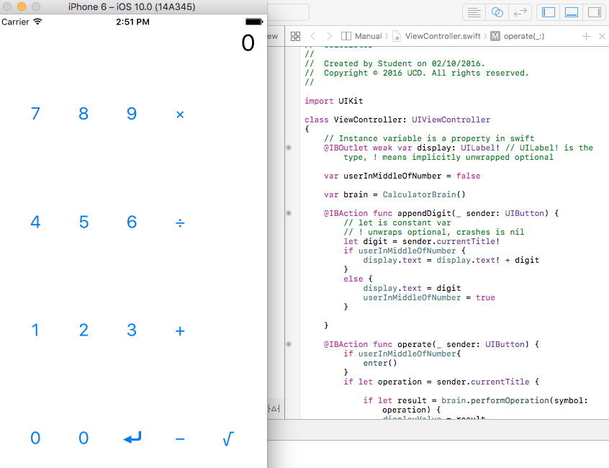
IOS - Introduction

Slide 2
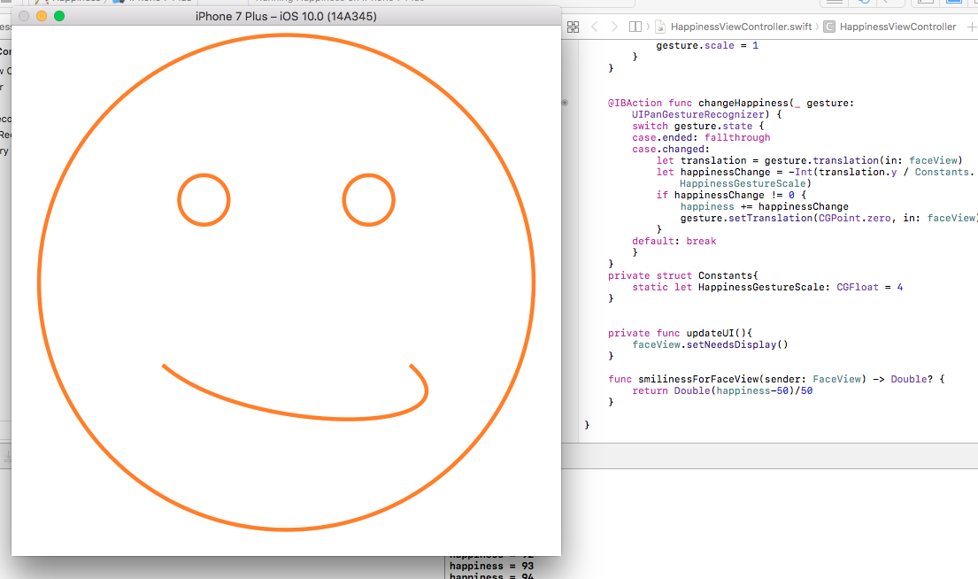
IOS - Gestures

Slide 3
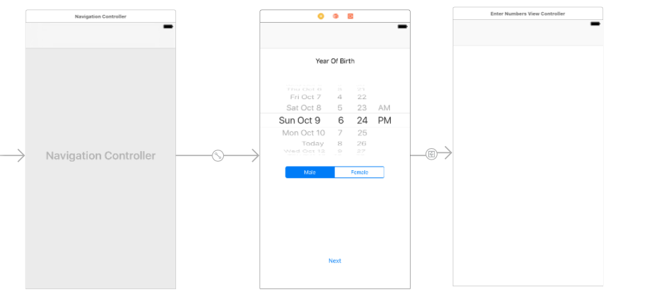
Current App

Slide 4
Questions
How to pass data into NN?
  Need to incorporate extra paramaterisation
  Force, time taken, acceleration, start/end point
  Definitly using convolutional network?
    Should I look into other types or focus on conv?
    Will become more apparent with further tensorflow research...

