Slide 1
INTRODUCTION TO MACHINE LEARNING AND ARTIFICIAL INTELLIGENCE

Slide 2
What is Data Analytics?
Process that turns data into knowledge, insights and actions that improves decision making
In other words it is deriving intelligence out of data
Involves data collection, transformation, analysis and reporting
Data Analytics helps us:
To understand our world better
To make better decisions
To optimize processes

Slide 3
Types of Analysis
Data
Analytics
Descriptive
What happened?
Diagnostic
Why did it happen?
Predictive
What will happen?
Prescriptive
What should I do?

Slide 4
Steps in Data Analysis Process
Start with an interesting question
Collect data
Clean and Explore the data
Create data models
Interpret and Communicate the results

Slide 5
Tools used in Data Analytics
R
SAS
Python
MATLAB
STATA
SPSS
Julia
…

Slide 6
Why R?
Most comprehensive statistical analysis package
Free and open source software
Most popular data analysis tool
More then 5000 packages (libraries) available
Cross-platform capability
Active user groups
Disadvantages
Memory Limitation

Slide 7
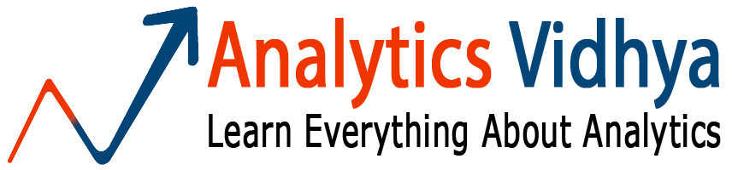

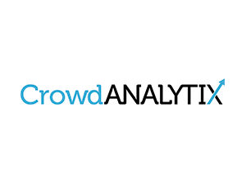



Top Learning Sites

Slide 8
Key Tools and Skills
Basic Stats
Linear and Logistic Regression
Clustering
XGBoost and Random Forest
Artificial Intelligence and Deep Learning
Excel
R
Python
Spark
Text Pad
Word
Power Point

Slide 9
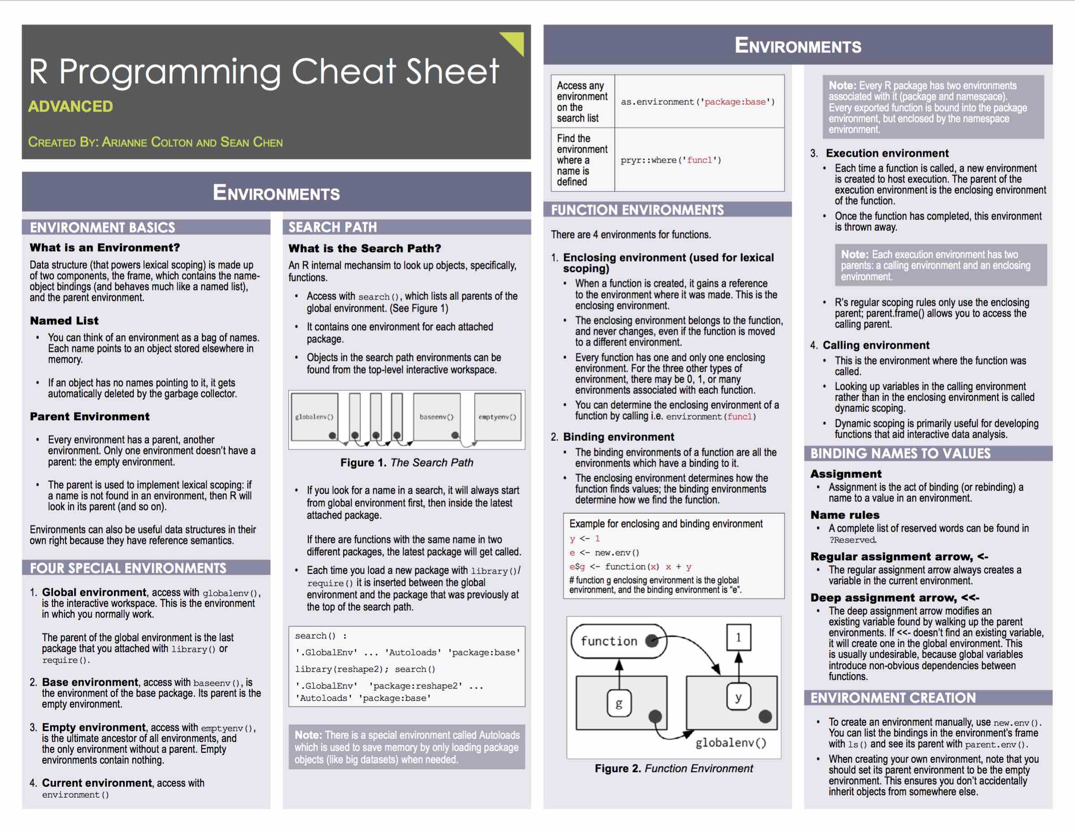
R Cheat Sheet

Slide 10
What is Machine Learning?
Machine learning is a scientific discipline that is concerned with the design and development of algorithms that allow computers to evolve behaviors based on empirical data, such as from sensor data or databases.
Machine learning is the training of a model from data that generalizes a decision against a performance measure.
A computer program is said to learn from experience E with respect to some class of tasks T and performance measure P, if its performance at tasks in T, as measured by P, improves with experience E
Broad Steps:
Collecting the right data
Cleansing the data
Processing the data using algorithms
Validating the Outputs
Predicting for New data

Slide 11
Supervised Learning
Variables under study can be split into 2 groups: explanatory variables and dependent variables
Target is to specify a relationship between these two variables
The relationship is obtained by analysing the training data
Example: Prediction of revenue for a planned new store
Explanatory variables: Store size, Location etc.
Dependent variable: Revenue
Training Data: Data from existing stores

Slide 12
Unsupervised Learning
No distinct dependent variable
All variables are treated the same way
Target is to find patterns in data
Example: Segmenting customers into distinct groups

Slide 13
Exercise
Classify whether the following problems as supervised or unsupervised:
Predicting future stock market prices
Identifying major topics people are tweeting about
Classifying a tumour as either malignant or non-malignant
Detecting spam in email
Identifying groups of houses according to their house type, value and location

Slide 14
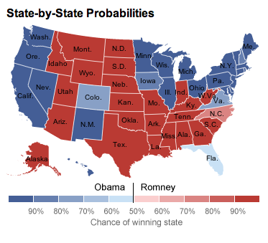

Predicting who is going to be the next US President
http://fivethirtyeight.com/
Notes:
Nate Silver. In the last two US Presidential elections, he correctly predicted 99 out of 100 states. Started off as a data analyst in sports. In 2009, was named one of The World’s most influential people by Time magazine

Slide 15
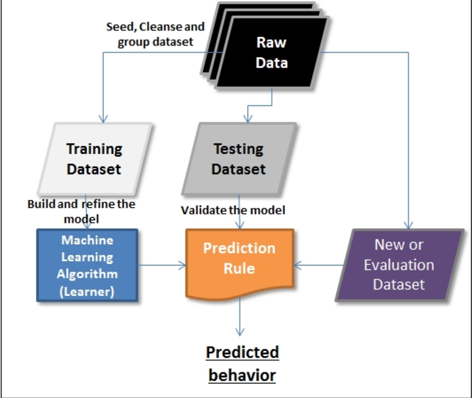
Machine Learning -Steps

Slide 16
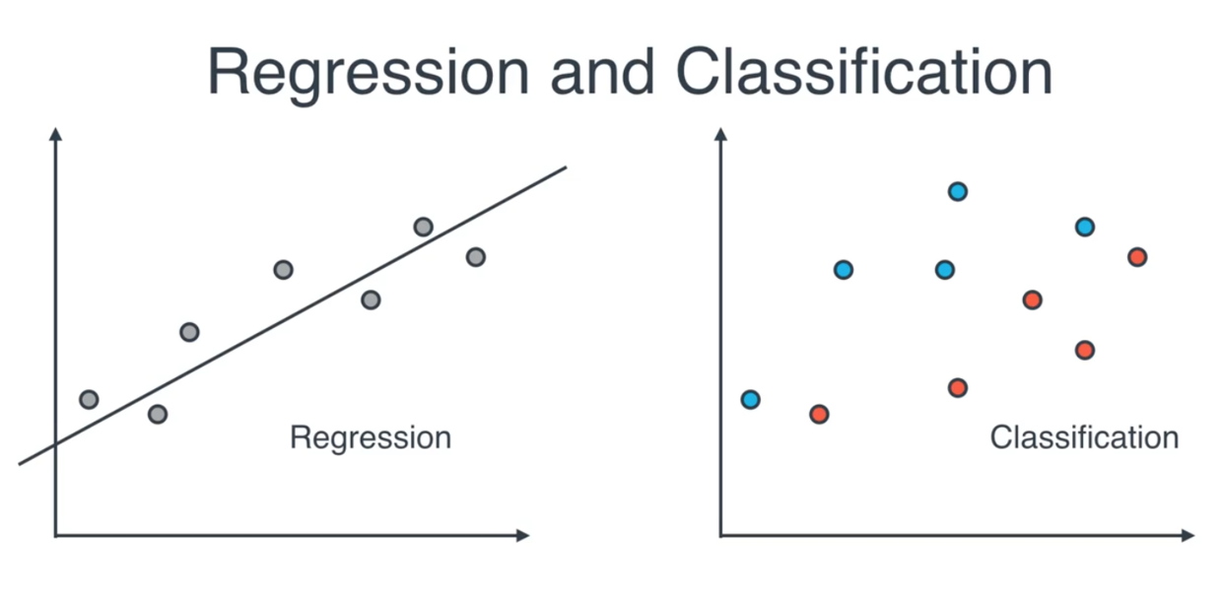
Regression and Classification

Slide 17
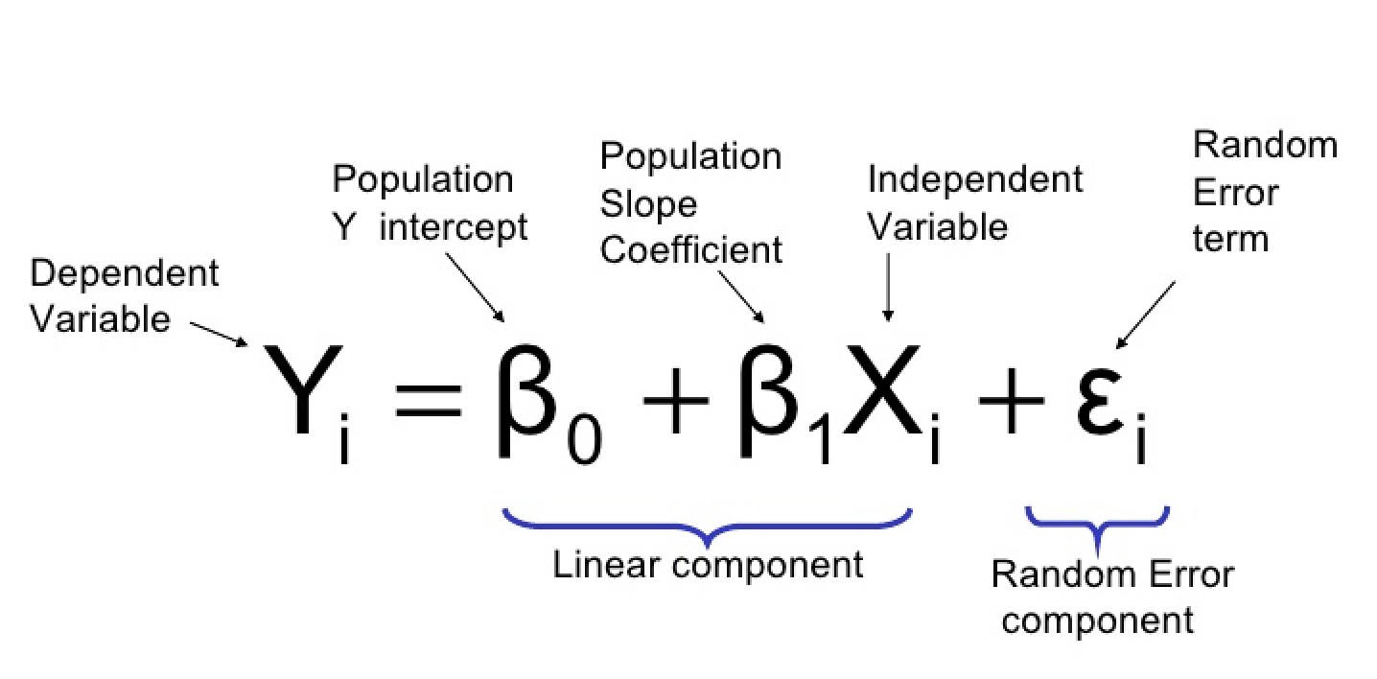
Linear Regression

Slide 18

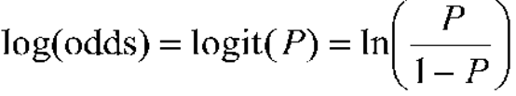
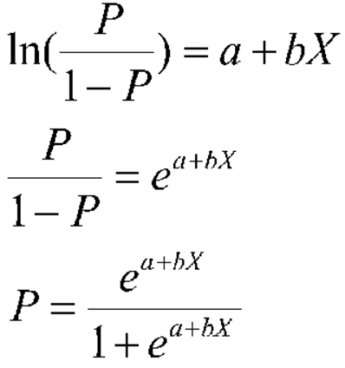
Logistic Regression

Slide 19
Types of Variables
Variables
Quantitative
Qualitative
Discrete
Continuous
Notes:
Use titanic data to explain the types of variables

Slide 20
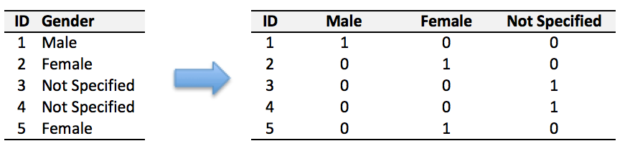
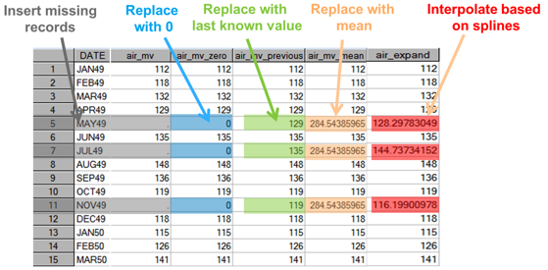
Data Cleansing –Part1

Slide 21
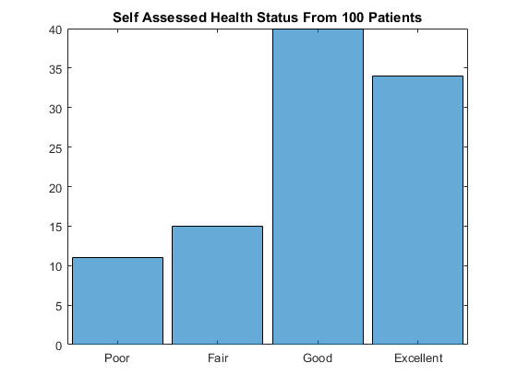
Data Cleansing –Part II

Slide 22
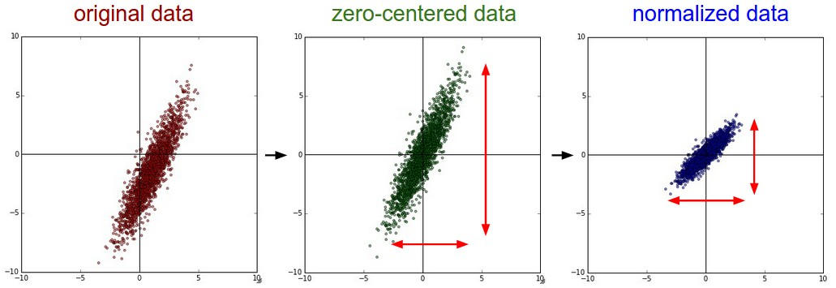
Data Cleansing –Part III

Slide 23
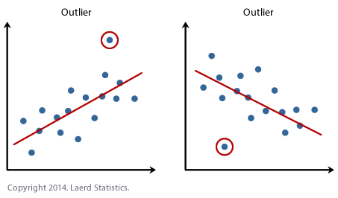
Data Cleansing –Part IV

Slide 24
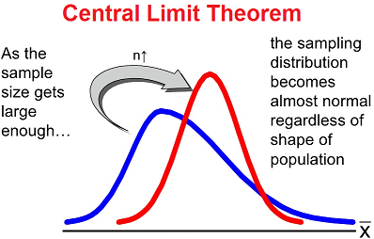
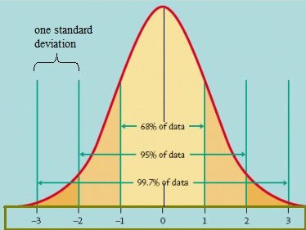
Normal Distribution

Slide 25

Covariance
Covariance measures how two variables vary together
If one variable increases with increase in another variable, then covariance is positive
If one variable decreases with increase in another variable, then covariance is negative
Covariance doesn’t tell us anything about the strength of the relationship
Notes:
Covariance doesn’t tell us whether the relationship between two variables is strong or weak

Slide 26

Correlation
Correlation is another measure that explains the relationship between two variables
Correlation explains both the direction and the strength of the relationship
Correlation ranges between -1 to +1

Slide 27
Correlation (contd.)
Direction of relationship: If the value of correlation is
> 0, then the relationship is positive
< 0, then the relationship is negative
Close to 0, then no relationship
Strength of relationship: If the value of correlation is
> 0.8 or < -0.8, then the relationship is strong
Between 0.4 to 0.8 or between -0.8 to -0.4, then the relationship is of medium strength
Between -0.4 to 0.4 then the relationship is weak

Slide 28
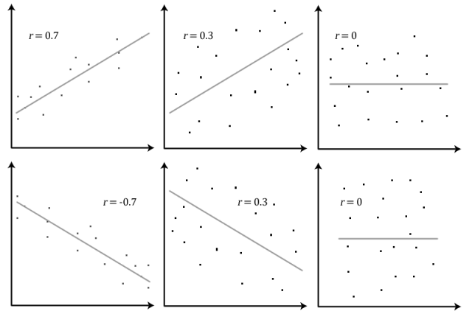
Correlation (contd.)
https://statsmethods.wordpress.com/2013/05/10/pearson-correlation-coefficient-r/
Notes:
Top two left are positively correlated. Bottom two left are negatively correlated. Left two are strongly correlated middle two are medium correlated and right two are not correlated

Slide 29
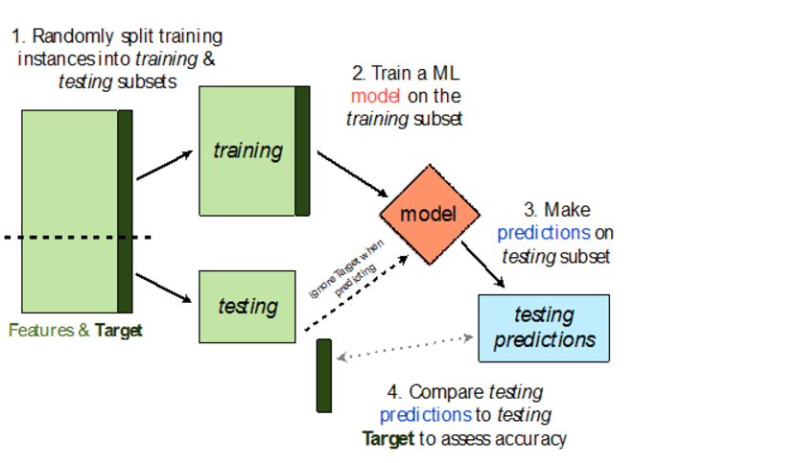
Train and Test Dataset

Slide 30
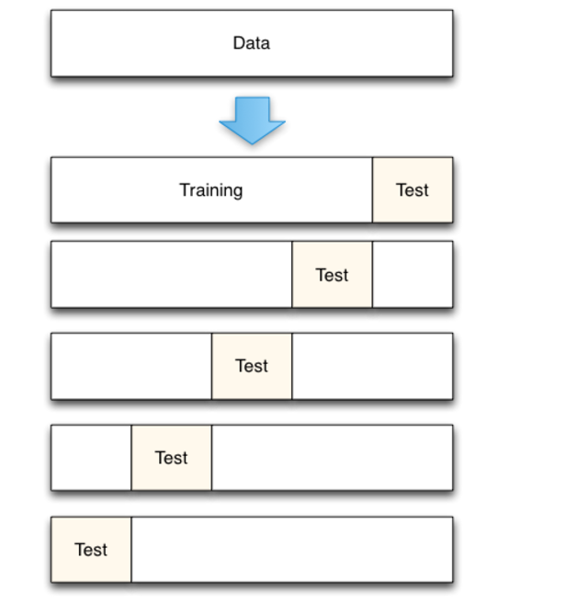
Cross Validation

Slide 31
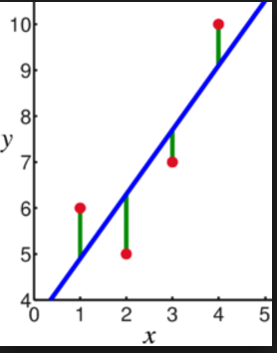
Model Performance -I

Slide 32
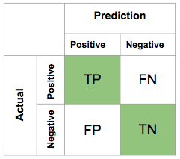
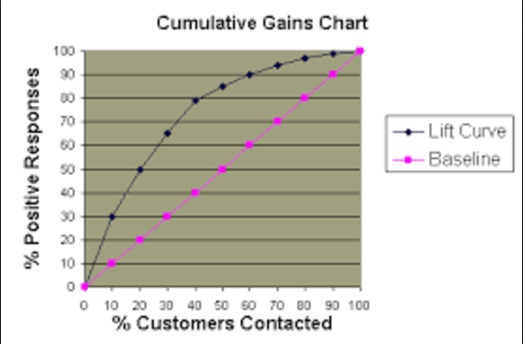
Model Performance -II

Slide 33
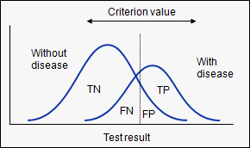
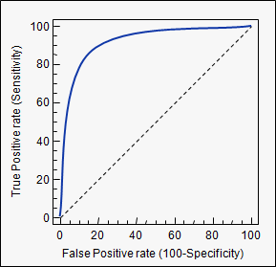
ROC

Slide 34
Model Tracking
Data Details | Total Sample | Total Customers Converetd | Predicted by Model for Review | % Cases to be reviewed | Correctly Predicted | % Hit Rate | Wrongly Predicted | % Predictions Identified by Model
Train | 4,44,582 | 9,609 | 17,555 | 4% | 9,568 | 55% | 7,987 | 99.6%
Test | 1,90,535 | 4,045 | 10,449 | 5% | 3,090 | 30% | 7,359 | 76.4%
Jan-17 | 37,790 | 751 | 2,363 | 6% | 534 | 23% | 1,829 | 71.1%
Feb-17 | 38,757 | 735 | 3,422 | 9% | 509 | 15% | 2,913 | 69.3%
Mar-17 | 48,915 | 786 | 4,097 | 8% | 514 | 13% | 3,583 | 65.4%
Apr-17 | 44,692 | 772 | 3,695 | 8% | 483 | 13% | 3,212 | 62.6%
May-17 | 50,368 | 822 | 3,892 | 8% | 486 | 12% | 3,406 | 59.1%

Slide 35
Assignment -1
Take any one dataset for Classification from Kaggle or any other open source datasets
Reference:
https://archive.ics.uci.edu/ml/datasets/bank+marketing
http://archive.ics.uci.edu/ml/index.php
Understand the Business Problem
Understand the Variable Used (Independent and Dependent )
Discuss about the Business Problem
What will be the benefit by implementing a classification algorithm

Slide 36
Assignment -2
Perform Data Cleansing and Data Exploration on the datasets as discussed in the class
Build a Logistic Model using the dataset available
Evaluate the Model

Slide 37
What is Artificial Intelligence?
Artificial intelligence focuses on building systems that can mimic human behavior.
It focuses on making machines intelligent
Broad Steps:
Collecting the right data
Cleansing the data
Processing the data using algorithms
Create Knowledge base
Provide expert support

Slide 38
Applications of Artificial Intelligence
Computer Vision
Natural Language Processing
Speech Recognition
Chabot's

Slide 39
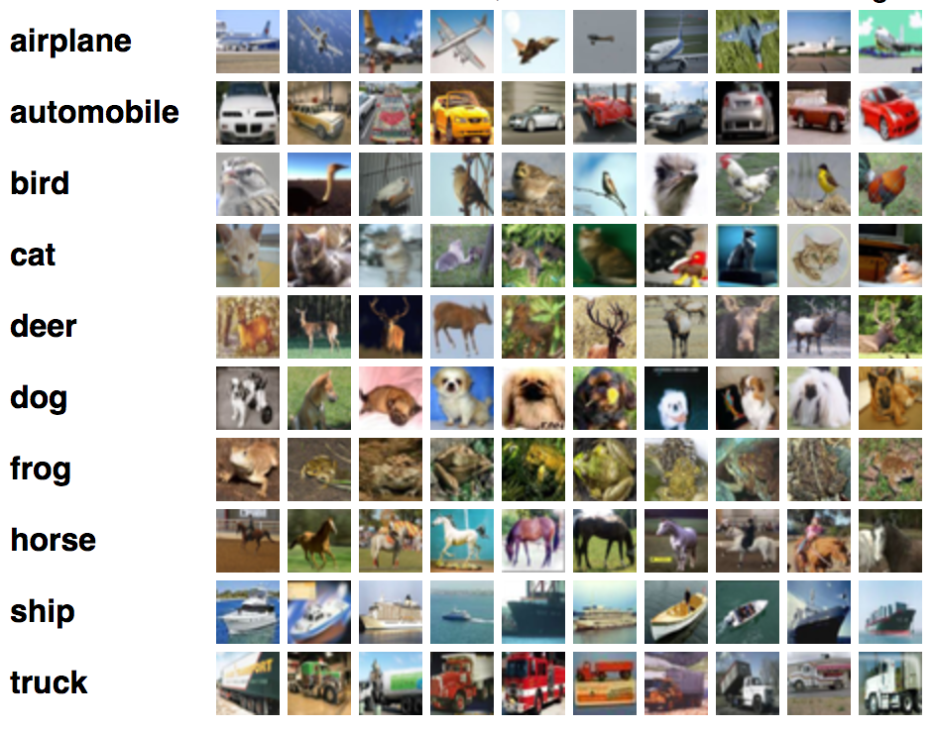
Image Recognition

Slide 40
Ethics & Errors
Don’t Share
Be sensitive to race or other sensitive information while preparing the insights

Slide 41



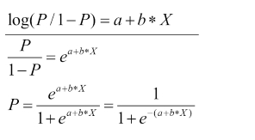
Logistic Regression -Derivation
This range will be between 0 and infinity
If a +bx is very small ?
If a +bx is very large?

Slide 42


Logistic Regression -Continued

Slide 43
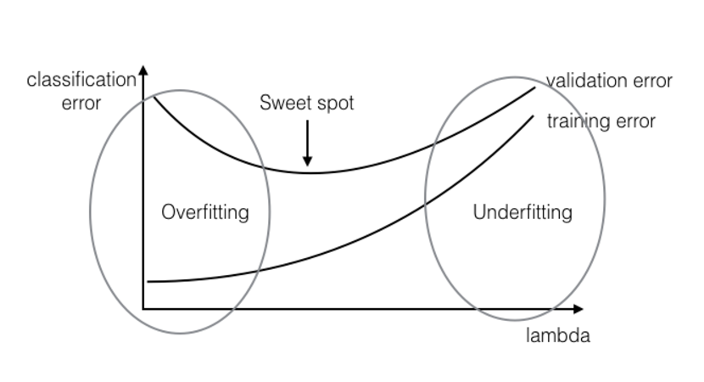
Under fitting vs Overfitting

Slide 44
Bias vs Variance
High Variance
Pays too much attention
Too accurate in train
Poor accuracy in test
Very superior model
High Bias -
Pays very little attention to data
High error on training data
Few features used
Very inferior model
Low Bias and High Variance –Overfitting
High Bias and Low Variance -Under fitting

Slide 45
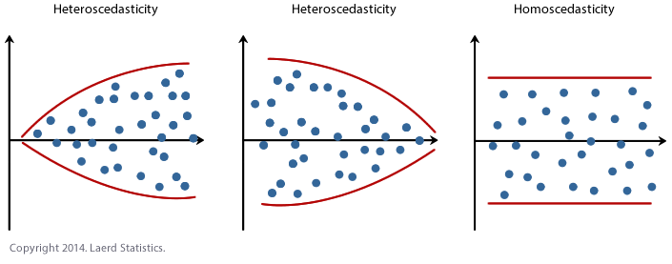
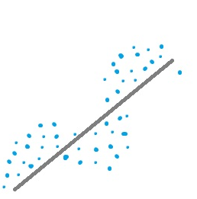
Model Performance Issues
Independence of Errors

Slide 46
Modelling Steps
Load a Dataset
View data summary
Remove Duplicates
Find Missing Values
Impute Missing Values
Find Outliers
Impute Outliers
Find Distributions
Do Binning if necessary
One Hot encoding
Standardization and Normalization
Build Model
Predict Output
Cross Validation

Slide 47
Data Cleansing
How many rows are there in the dataset
What is the conversion rate by each variable
What percentage of male married population converted
What is the missing values by each variable
What are the imputations you can perform
Which variables have a outlier
What variables can you derive from these

Slide 48
Key Points
Supervised and Unsupervised
Classification and Regression
What is RMSE and Accuracy
Different ways to impute the missing values
What is correlation
What is Lift chart
What are the broad steps for implementing a model from the Business Understanding Phase
How to track the benefits out of a model
What percentage of values lies within 1 standard deviation in a normal distribution
What is standardization and Normalization
What is confusion matrix in logistic regression
Which is more important
High accuracy
Low variance
Which is larger Adjusted R square or R square
When will Adjusted R square and R square be same
In which domain do we need to have very less false positives /false negatives

Slide 49
Key Points
What is cross validation
What is generalization error
When to use 5 fold /10 fold/leave one out fold cross validation
Steps to avoid overfitting and under fitting
Difference between Univariate ,multivariate, bivariate analysis
What are the different types of joins
Why is it necessary to remove duplicates from the data
What is the missing values by each variable
How to detect and impute outliers
What are the imputations you can perform
Which variables have a outlier
What variables can you derive from these
What is Bias and Variance (Under fitting and Overfitting)

