Slide 1
Probabilistic Retrieval Model --Binary independence model
Intuition
Given a query (Q) and a document (D), there is a probability of the document is retrieved (R)
P(R|(D,Q))
Can be calculated as the “similarity” figure for ranking
This idea come from bayesian network (bayesian probability)

Slide 2

P(R|(D,Q)) =
Based on Bayesian probability:
Evaluation (ranking) formula

Slide 3

Assume all words appear independently in a D
After some simplification and prove: (From internet)

Slide 4
Features
Theoretically:
It assume every words appear independently in the document, which is actually not the case
Implementary
It need relevance feedback to adjust itself to a convergence. This lead to problems in RF and time complexity for convergence.

Slide 5

Extended model – BM25
Widely adapted (by google etc.)
Don’t need RF
BM25 = VSM+Modified similarity function
Parameters:
K1: tunable, default 1.2
b: tunable, default 0.75
|D|: Doc length
Avgdl: average doc length

Slide 6
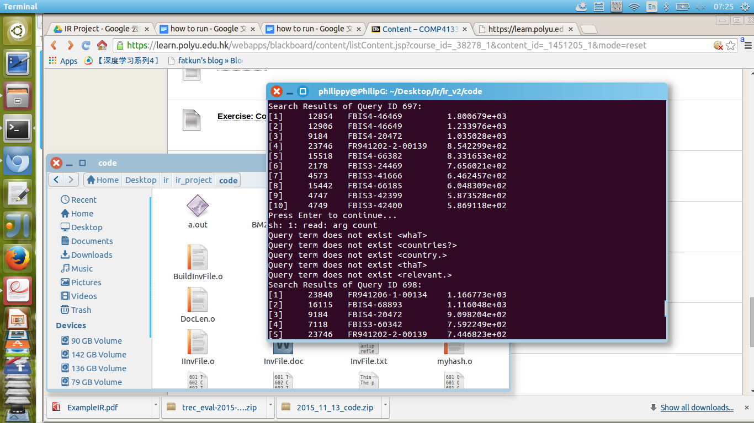
Stemmed word reconvert
Problem:
Words are not properly stemmed (punctuations)
Some words: <U.S.> <Country.> <Countries?> not found
Expected: <US> <Country> <Countries>

Slide 7
Stemmed word reconvert
Algorithm:
For <not found> words:
Remove punctuation and find() it again

Slide 8
Evaluation among three – Precision Recall curve
Interpolated by TREC evaluation system

Slide 9
Precision-Recall Curve
Evaluation:
BM25 model is far more advanced than VSM
Reconvert of stemmed words also help

Slide 10
Evaluation among three – Precision of top results

Slide 11
Precision of top N results
Focus on top retrieved results
For bottom results, irrelevant inevitably retrieved
BM25+reconvert > BM25 >>> VSM

Slide 12
Evaluation among three – Recall of top results

Slide 13
Recall of top N results
Focus on all retrieved results
What the portion of all relevant docs being retrieved
BM25 >> VSM
Reconvert slightly helps

Slide 14
Evaluation among three -- Overall
BM25 for more better than VSM
Reconvert will also help the performance

