Slide 1
Secure medical system
COMP3334 term project
12132031d GENG XU
13088783d TAI SHUNWA
12131354d ZHANG BEIBEI

Slide 2
Project requirements
Medical system
Store medical records including diagnosis, prescriptions etc.
Strict access control to protect privacy
Ensure secured network transformation
Secure enough to eliminate threads:
Brute force attack
Authentication encryption
SQL injection
Session hijacking
Secure server configuration

Slide 3
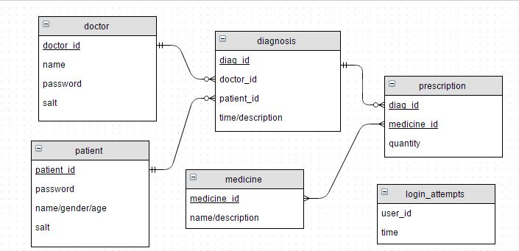
Database schema design

Slide 4
Strict access control
For patient:
Only access to his own diagnosis and prescription records
For doctor:
Only access to diagnosis and prescription belongs to patients that served by him

Slide 5
Secured network transformation
https protocol
contains SSL (secure socket layer)
Encryption in transport layer
An experiment: wireshark packet capture
Post (doctor_id = “D001”&password=“12345”)

Slide 6
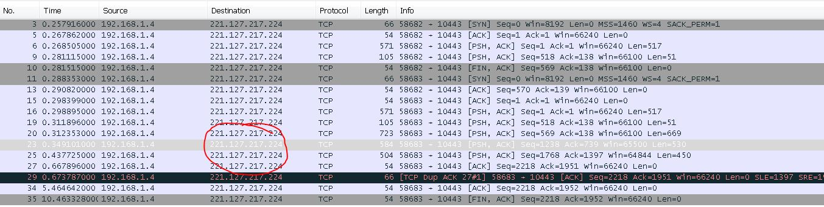
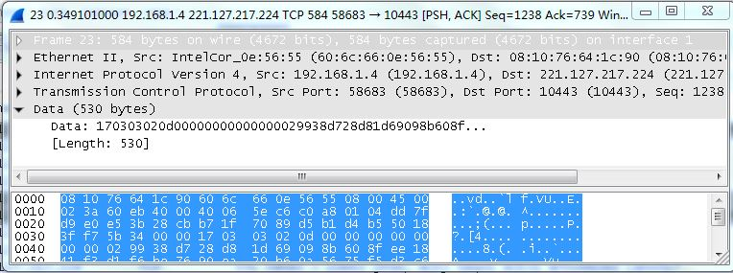

Slide 7
Brute force attack
Database login_attemps table
If an account have >5 login attemps in 2 minute
Lock the account
Demo in brute force attack

Slide 8
Authentication Encryption
Salt Hash
Store salt and hash(password+salt) in database
Authentication:
Hash($_POST[‘password’]+db_fetch(salt))
Compare with
Db_fetch(hash)

Slide 9
SQL injection
Using php prepare() function when dealing with the SQL

Slide 10
Session hijacking
$secure = SECURE
$httponly = true;
session_set_cookie_params(
$cookieParams["lifetime"],
$cookieParams["path"],
$cookieParams["domain"],
$secure,
$httponly);
$Httponly = true:
Only accept session id from cookie.
Hackers can not make up a session id in http header
$Secure = SECURE:
Stops JavaScript being able to access the session id.

Slide 11
Design of the security
defense in depth concept -
The system will be protected by multiple layers
file permission
networking
application

Slide 12

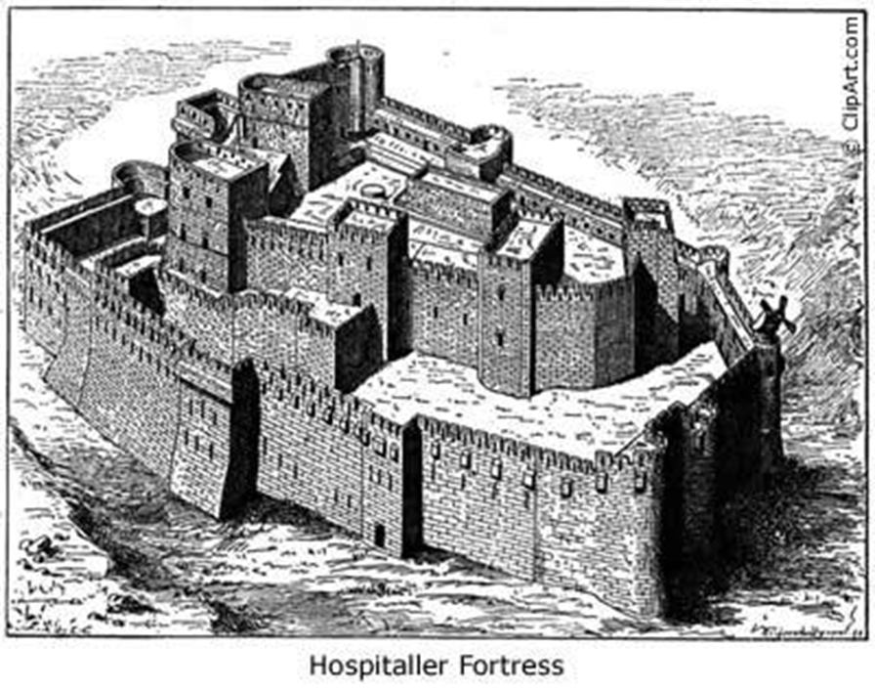
Analogy
moat
outer wall
inner wall
bridge and gate

Slide 13
Disable root account
To prevent the attacker to brute force the root account.
We only use a normal user to build the medical information system
$sudo passwd -l root

Slide 14
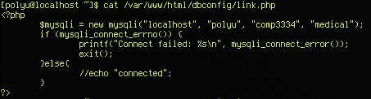

Discretionary Access Control(DAC)
This is the php file for connect to the database
we set the permission to 440

Slide 15
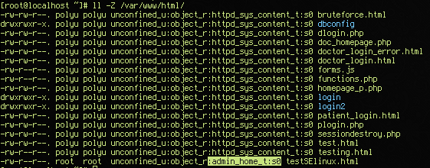
Mandatory Access Control(MAC) - SELinux Example

Slide 16
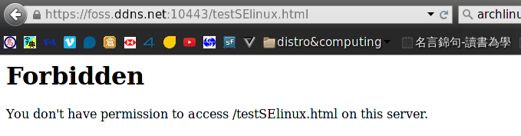
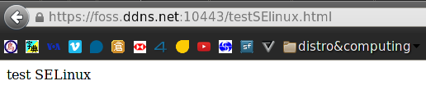
Mandatory Access Control(MAC) - SELinux Example

Slide 17
Firewall - iptables
iptables -P INPUT DROP
iptables -P OUTPUT ACCEPT
iptables -P FORWARD DROP
# allowed ports
iptables -A TCP -p tcp --dport 22 -j ACCEPT
iptables -A TCP -p tcp --dport 80 -j ACCEPT
iptables -A TCP -p tcp --dport 443 -j ACCEPT
# prevent ssh brute force
iptables -A INPUT -p tcp --dport ssh -m conntrack --ctstate NEW -j IN_SSH
iptables -A IN_SSH -m recent --name sshbf --rttl --rcheck --hitcount 3 --seconds 10 -j DROP
iptables -A IN_SSH -m recent --name sshbf --rttl --rcheck --hitcount 4 --seconds 1800 -j DROP
iptables -A IN_SSH -m recent --name sshbf --set -j ACCEPT

Slide 18
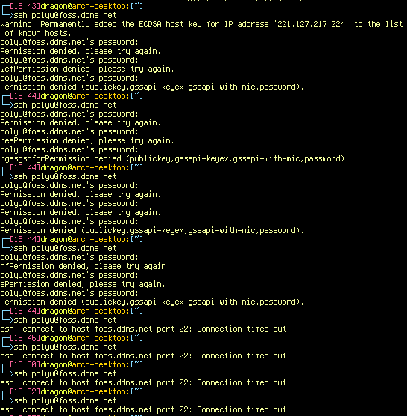
iptables - Test the SSH rules

Slide 19
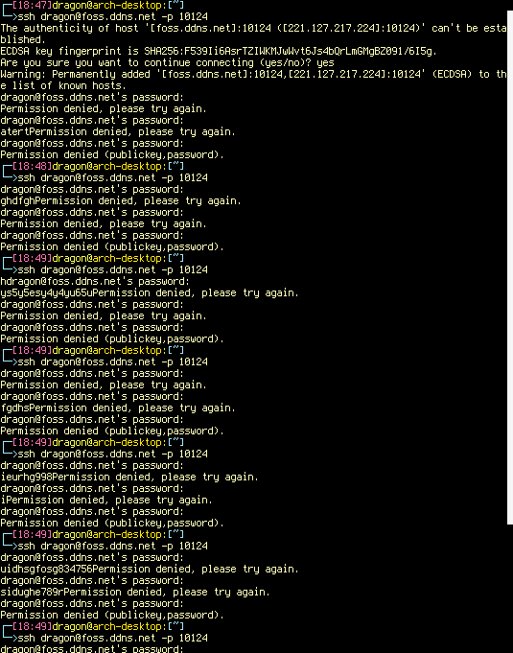

Slide 20
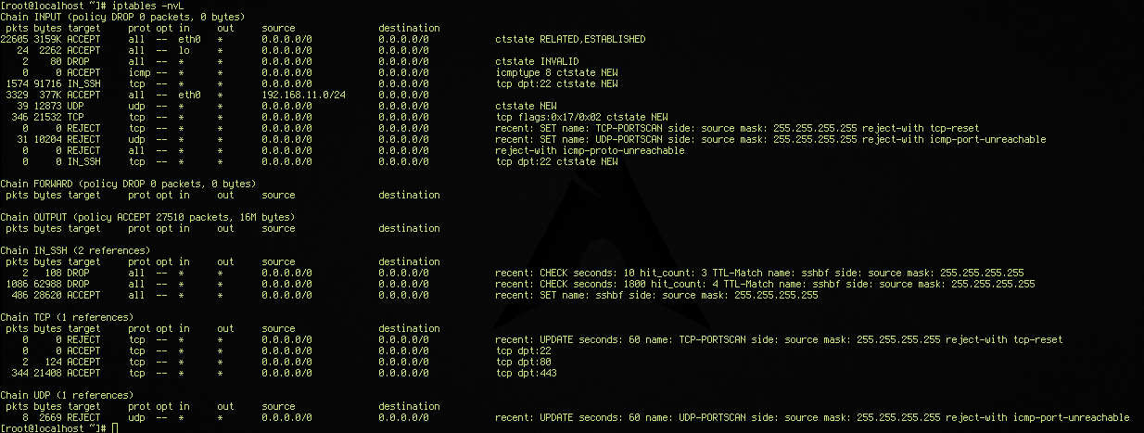
details of the iptables rules

Slide 21
HTTPS connection
We generated a self-signed certificate to establish a secured connection

Slide 22
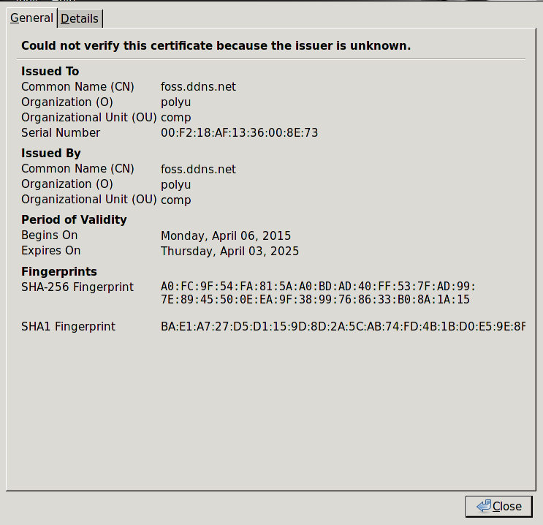

Slide 23
End of presentation
Thank you

