Slide 1
Smart home
https://www.youtube.com/watch?v=Cxu-oAttzS8
COMP3432 Term Project
12132031d GENG XU

Slide 2
Scenario
Suppose after this lecture you go back home:
You need to take a shower –
you need to wait for the water heater
You feel hungry –
you need to wait for the microwave oven
You are exhausted and want to take a nap
It’s already 2:00 pm and you have lecture @2:30
So you rush out from your home
Wait , you forget to turn off your lights!

Slide 3
Why not have these done AUTOMATICALLY
When you arrive home
Hot water is there
Lunch is there
You take a nap
Rush out from home and lights are automatically off

Slide 4
Project Scope
In a word, control your electronic appliances using various ways
Software – It works
Control functions implemented
No beautiful UI (Actually no need)
Hardware – infrastructure for demo only
No 220v appliances
LED + batteries instead

Slide 5
Architecture
Sina weibo Server
Hardware
Raspberry Pi
(CPU + 17GPIO + network adapter)
APP_KEY & SECRET_KEY
GPIO
IN
Mobile Phone client
Relay
(a switch controlled by electronic signal)
OUT
Home Circuits/ electronic appliance
csdoor server

Slide 6
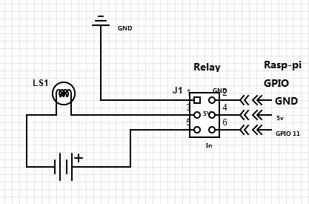
Hardware connection

Slide 7

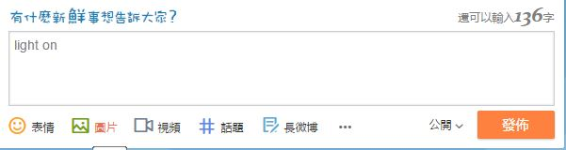

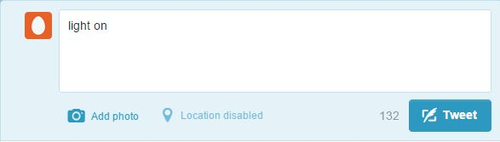

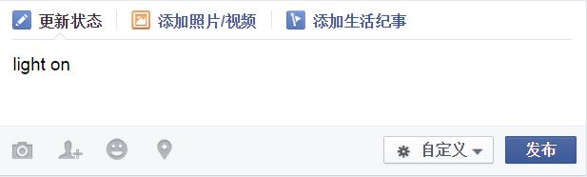
Function 1 Social network control
API
SDK

Slide 8
Function 1 weibo control
JSON
Raspberry Pi (light.py)
Pass weibo Authentication (App key, secret key)
while true
read weibo status
if(status == “light on”)
setGPIO(“on”)
if(status == “light off”)
setGPIO(“off”)
Sina weibo server
{ "statuses": [ { "created_at": "Tue Feb 17 17:46:55 +0800 2011", "id": 11488058246, "text": “light on"， "source": "<a href="http://weibo.com" rel="nofollow">新浪微博</a>”,…..
….
"previous_cursor": 0, "next_cursor": 11488013766, "total_number": 81655 }

Slide 9
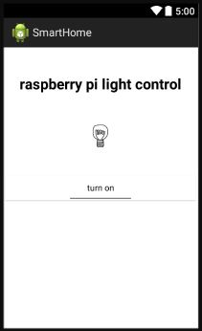
Function 2 Button control

Slide 10
Function 2 Button control
Mobile Phone
Press button
Send out httpRequest()
Raspberry Pi
Keep reading light.txt
If(on)
setGPIO(“on”)
else
setGPIO(“off”)
csdoor
If(httpReq == “on”)
lighton.php
(light.txt=on+timestamp)
If(httpReq == “off”)
lightoff.php
(light.txt=off+timestamp)

Slide 11
Function 3 Auto control
So you rush out from your home
Wait , you forget to turn off your lights!
automate
Fingerprint localization
Dynamic Training
Where you are
Fingerprint model/database

Slide 12
Function 3 Auto control
Mobile Phone (android)
// training
For (i : every 2 seconds in 20 seconds)// train indoor
model[indoor][i] = getWifiList();
For (i : every 2 seconds in 20 seconds)// train outdoor
model[outdoor][i] = getWifiList();
Save(Average(model));
//localization
Model = selectmodel();
For(time i in every 2 seconds)
fingerPrint = getWifiList();
judge(model,fingerprint) // indoor or outdoor?
wait_status_stable();
sendHttpRequest(indoor||outdoor);
Raspberry Pi (python)
Keep reading light.txt
If(on)
setGPIO(“on”)
else
setGPIO(“off”)
Csdoor (php)
If(httpReq == “on”)
lighton.php
(light.txt=on+timestamp)
If(httpReq == “off”)
lightoff.php
(light.txt=off+timestamp)

Slide 13
How to decide?
Given:
Sample = [<ssid1,-30>,<ssid3,-40>,<ssid4,-50>]
Indoor_model=[<ssid1,-20>,<ssid2,-30>,<ssid3,-40>]
Outdoor_model = [<ssid3,-50>,<ssid4,-20>,<ssid5,-30>]
 | ssid1 | ssid2 | ssid3 | ssid4 | ssid5
Sample | -30 |  | -40 | -50
Indoor_model | -20 | -30 | -40
Outdoor_model |  |  | -50 | -20 | -30
 | ssid1 | ssid2 | ssid3 | ssid4 | ssid5
Sample | -30 | -120 | -40 | -50 | -120
Indoor_model | -20 | -30 | -40 | -120 | -120
Outdoor_model | -120 | -120 | -50 | -20 | -30
D1 = avg( ∑ ( (ssid[i] – indoor_model[i]) ^2) )
D2 = avg( ∑ ( (ssid[i] – outdoor_model[i]) ^2) )
D1 ? D2 -> indoor ? outdoor

Slide 14
Analyze
Distributed
Networked
sure
Transparency
embedded and hidden
Extendable
Actually controlling a switch

Slide 15
Analyze
iHCI
Invisible
Can be
Proactive
Good
-- localization and control
Can be better
-- read your social network, short msg even phone call
-- do message analysis
-- safety problem

Slide 16
Analyze
Context-aware
Physical context
-- localization may perform better if also consider light, noise…
Human context
-- personalized dynamic training
ICT context
-- Big problem if network unstable

Slide 17
Analyze
Autonomous
Self management
-- can be better
Dynamic training can be:
-- learn from human habits
-- if at certain position, light should be on
More technology:
-- light sensor
-- blue tooth, RFID, infrared

Slide 18
Analyze
Intelligence
Long way to go

Slide 19
Thanks
Feedback?
Comments?
Q&A?
Anything?

