Slide 1
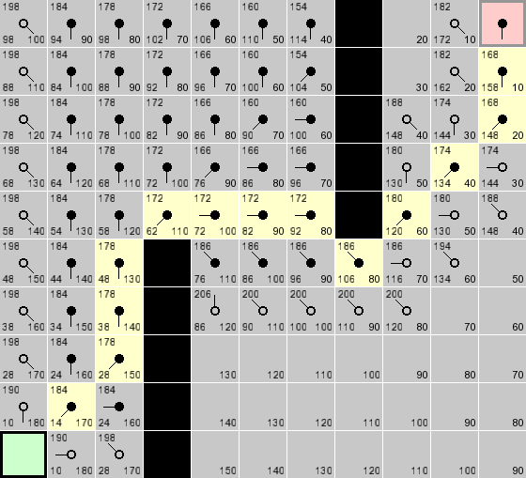
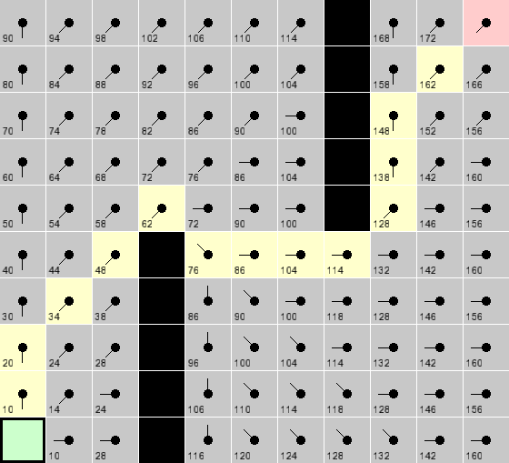
Data Structures and Algorithms 1
Pathfinding
A* vs. Dijkstra

Slide 2
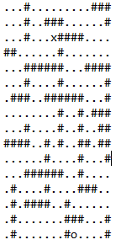
Generating the graph
I created a bitmap in a text file for the blueprint of the graph.
I read the file and stored the data in an array of strings for each row.

Slide 3
Reasons for choosing array:
I would always know the size the data structure would have to be.
I could allocate memory required before hand.
Order(1) in complexity assigning pointers.
Good locality.
I would not be manipulating the data at all.

Slide 4
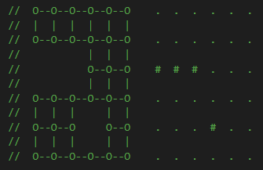
Generating the graph
I then created a vector of Node pointers for my graph by looping through the bitmap array and assigning new Node objects or nullptrs depending on the char.

Slide 5
Reasons for choosing vector:
Although I knew the size it would be (with nullptrs), I wanted it to be compatible with any shape graph.
vector’s push_back() function is Order(1) but at some point it has to allocate more memory to fit more objects. This process is up to Order(N).
I needed to access items in the middle of the data structure a lot. This is Order(1) with vectors.

Slide 6
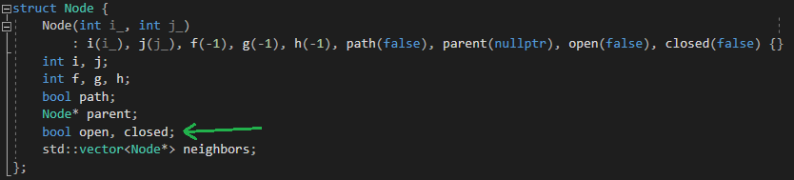
Open and closed sets
These data structures needed to be dynamic in size as I would be adding and removing Nodes from them constantly.
I compared vectors and priority_queues for my open and closed sets.
Eliminates need for
isInDataStructure()

Slide 7

Vector:
Dynamic in size.
Adding items is mostly Order(1).
vector’s erase() function is Order(N) in the number of items being deleted (I am only deleting one at a time so this is Order(1)) + Order(N) in the number items it has to loop through to get to the desired item. (Erasing the item at the end of the vector would be Order(1).)
However, I am also looping though the vector to make the comparison, this is also Order(N) in the number items it has to loop through.
So the time complexity would be Order(N) in the size of the vector.

Slide 8
Priority_queues:
It orders the items in order according to a functor parameter you pass it.
It’s push() function adds the item to the priority_queue (Order(log(N))) and sorts them (Order(N log(N))).
It’s top() function (Order(1)) returns the item at the top of the priority_queue.
It’s pop() function, to remove an item from the top of the priority_queue, is Order(log(N)).
Although using a priority_queue is more expensive to add and remove from, I am predicting that the time saved by not having to loop through the data structure will out weigh the cost of ordering it.

Slide 9



Empty map

Slide 10
Empty map
Dijkstra is linear.
A* is quadratic.

Slide 11

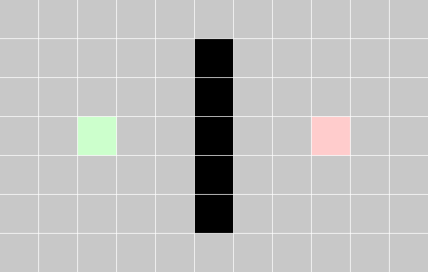

Single wall

Slide 12
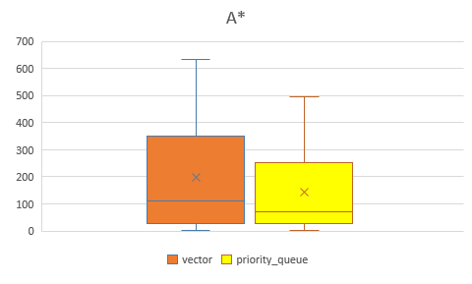
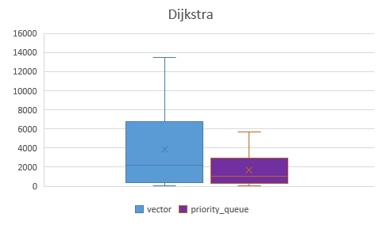
Single wall

Slide 13
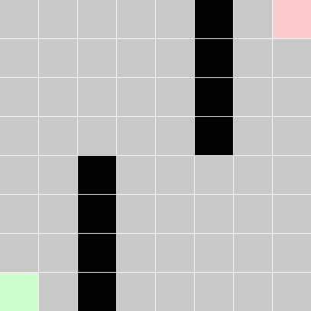
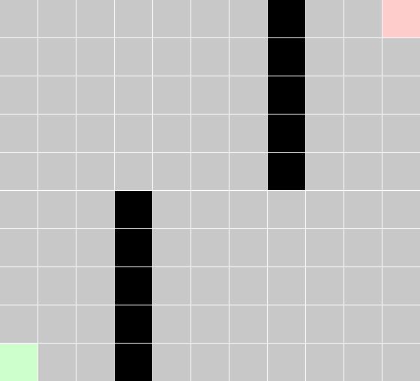
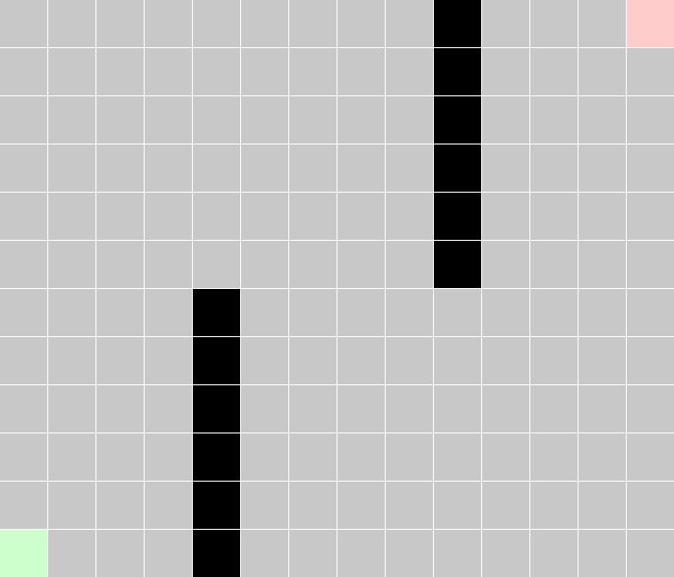
Two walls

Slide 14
Two walls
As the complexity of the map increases, the time difference between the algorithms decreases.

Slide 15
Conclusion
A* performs far better than Dijkstra with both data structures.
For both algorithms, priority queues were more efficient than vectors for the open and closed sets.

Slide 16
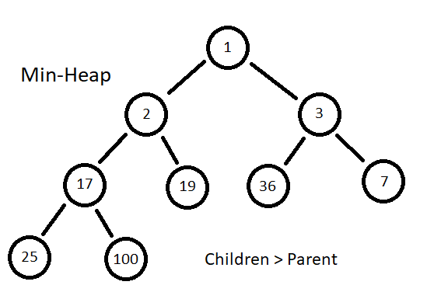
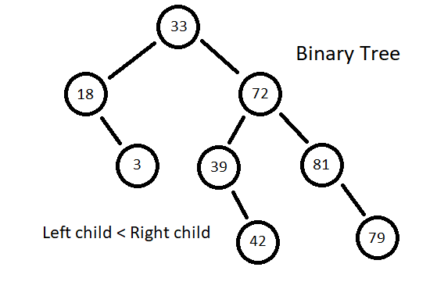
Other considerations for data structures:
I considered lists as inserting and deleting items anywhere in the list is Order(1). However, item lookup is Order(N) and they have bad locality as items are scattered in memory so they make poor use of the cache. Also they are memory intensive as each node stores its value and a pointer to the nodes either side of it.
I also considered sets instead of priority queues. They are very similar. Sets are generally backed by a binary tree where as priority_queues are backed by a heap. Building a heap is Order(N) where as building a set is Order(N log(N)).
Sets allow full access to the data structure in sorted order where as priority_queues only allow access to the first. But this is all I need!

Slide 17
External libraries:
I used SFML for my visual representation of my algorithms. All the code is written by myself.

