Slide 1
Interactive Mandlebrot
CMP 202 30/4/2019

Slide 2
Hardware used:
Intel(R) Core(TM) i7-6700 CPU @ 3.40GHz 3.41 GHz
32.0GB RAM
NVIDIA GeForce GTX 1080
Dedicated memory = 3 Mb
Intel(R) HD Graphics 530
Dedicated memory = 0.125 Mb

Slide 3
Purpose:
Application to explore the Mandelbrot set.
Ability to traverse the fractal with the mouse and zoom at any location in real time.
Experiment with different parallelisation techniques to achieve maximum performance.
Using AMP framework.
Using a resolution of 1920 by 1024 so the rows are easily divisible for task sizes.

Slide 4
GPU vs. CPU
Each pixel calculated independently.
No shared resources.
No data dependencies. (One part of a problem that depends on the output of another part of the problem.
Trivially parallel.
Few conditional statements. No need for branch prediction etc.
Lots of small, independent calculations.
Ideally suited to GPU.

Slide 5
GPU vs CPU
Making use of multiple GPUs.
Using task decomposition to split Mandelbrot into smaller tasks.
CPU thread for each GPU.
GPU thread for each pixel in the task, making use of many compute units / ALUs.
Use farming (scatter / gather) pattern to delegate tasks on the CPU.
Uses a fork / join pattern to create and in threads.
Not all tasks will be equally demanding so threads can grab new tasks as they are completed and not be waiting for other threads as much.
Creating and destroying threads is managed by OS and has an overhead.
Use map pattern on the GPU.
Ideal for trivially parallel programs.
Maps the tasks to the GPU threads.
Replaces iteration in non parallelised programs.
No need for reduction pattern (unfortunately).

Slide 6
Safe thread interaction
Protecting task queue with a mutex to avoid threads accessing the same tasks.
Make use of a unique lock when adding tasks. This unlocks when it goes out of scope.
Using std::Thread classes join() function to wait for all CPU threads before continuing.
Using a queue for the tasks.
First In First Out.
push() and pop() functions both O(1).

Slide 7
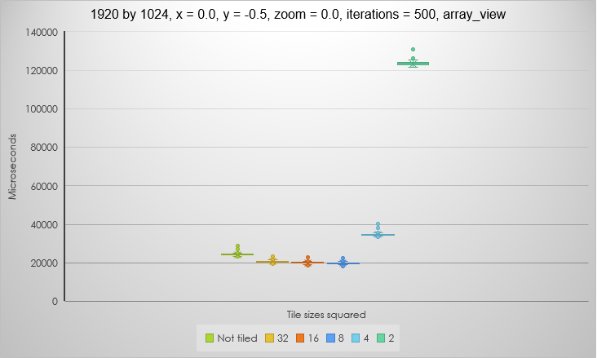
Tiled vs not tiled
As there are no shared resources required, it appears tile static is not utilized, so there is no need for tiling.
Result surprising as using some tile sizes is slightly faster.
With no tiling, AMP sets its own tile sizes but does not always get the optimal.

Slide 8
Tiled vs not tiled
It is very hard to predict what tile size is optimal. A lot of trial and error is required.
If tile sizes are too small, there is a lot of context switching which is expensive.
It takes a long time to go to global memory.
8 by 8 tiles are faster than with no tiling.

Slide 9
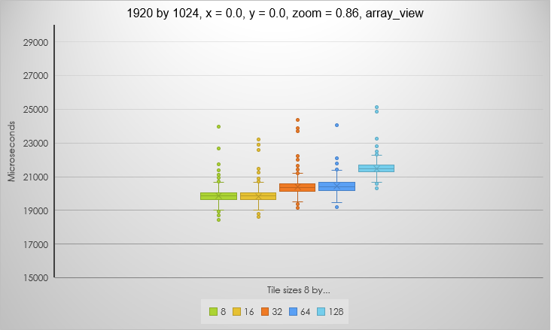
Variants on 8 row tiles
8 by 8 tiles were the fastest so I do some tests with rectangular tiles with 8 rows.
8 by 8 is still the fastest so I use this tile size for the rest of my benchmarking.

Slide 10
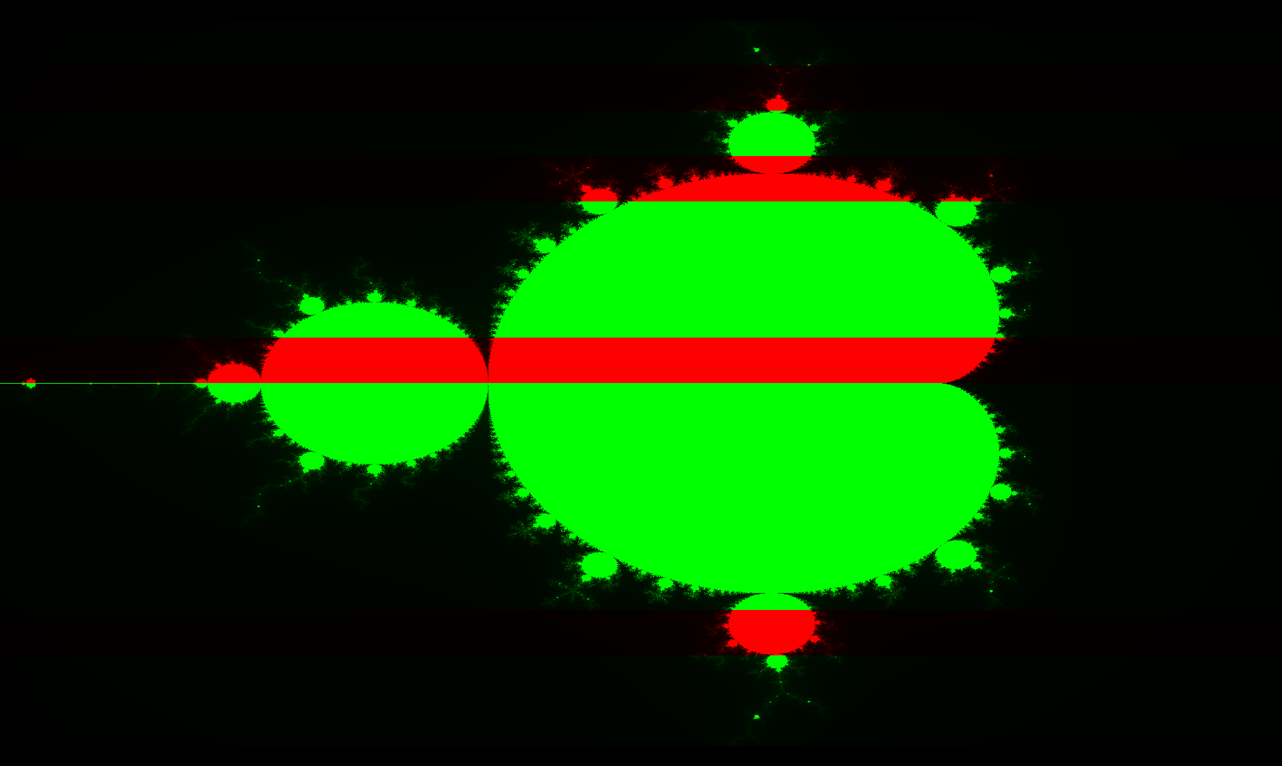
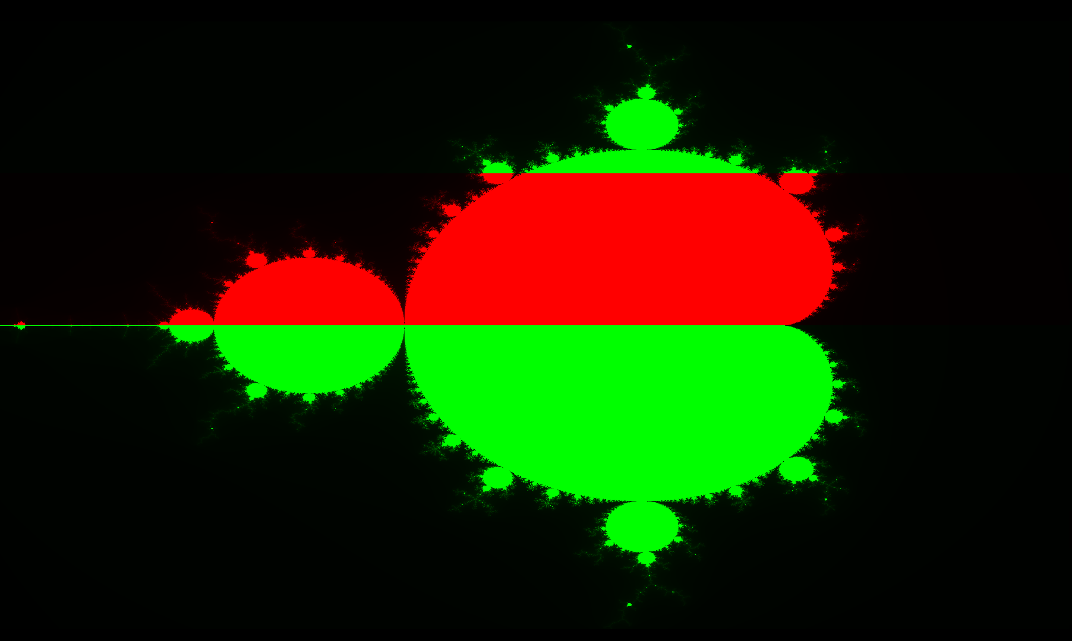
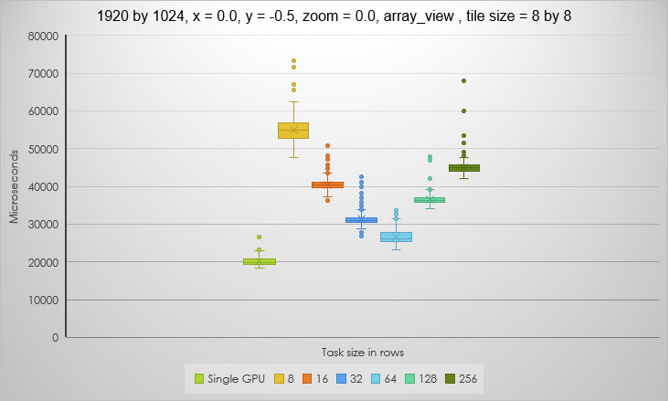
Single vs Multiple GPU(s)

Slide 11
Single vs Multiple GPU(s)
External GPU was a lot faster than the integrated GPU.
Using just the main GPU was faster than using both with all combinations of task sizes.
Disappointing but still interesting results.
If the tasks are too small:
There is a bottle neck in speed of getting data from the CPU to the GPU via the PCI bus. Over use of this will lead to worse performance.
If the tasks are too big:
Some GPUs may be waiting for others to complete.
This is not a completely fair test as not all task slices have the same amount of work to do, so I zoom in on a spot where all points tend to infinity.

Slide 12



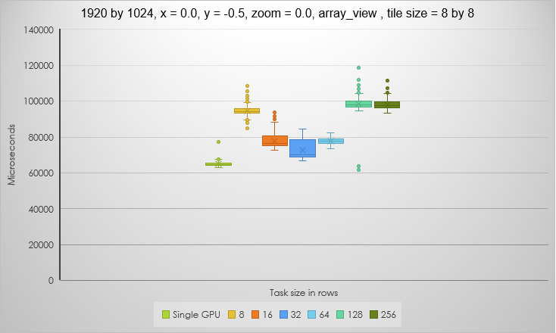
A fairer test

Slide 13

A fairer test
Similar results but task size 128 is interesting.
It has the fastest and the slowest times of all the tests.
Some frames the more powerful GPU grabs all but one task, others it gets all but two.
The frames it gets all but two are like the 256 test (the slowest average), except there are double the trips to the CPU so it is slightly slower.
The frames it gets all but one are faster than the single GPU test. It is possible to get a speed increase!

Slide 14
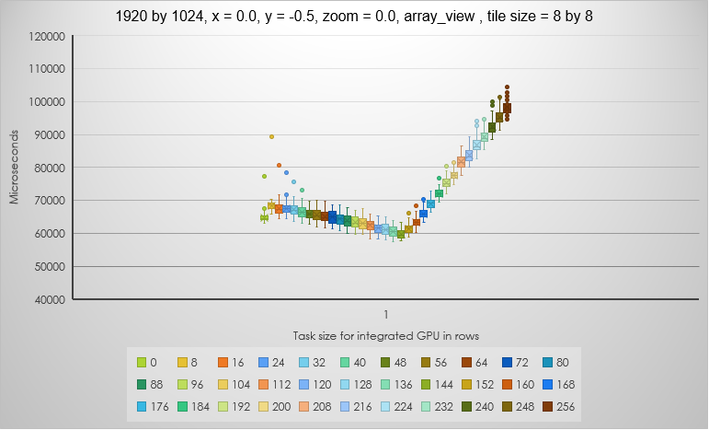
Hard coded task decomposition
Sweet spot is where integrated GPU has 144 rows out of 1024 and the dedicated has 880.
A ratio of 9 : 64.
This is only for the setup I was working with. The farming method would be better for portability. As would the default tile size arguably.
Another method of task decomposition could be to do a test on each GPU and allocate work accordingly.

Slide 15
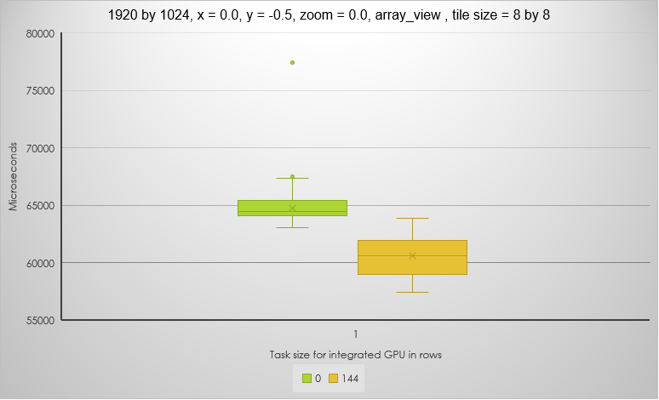
Hard coded task decomposition

