Slide 1

S.O.L.I.D.
Open/Closed Principle

Slide 2

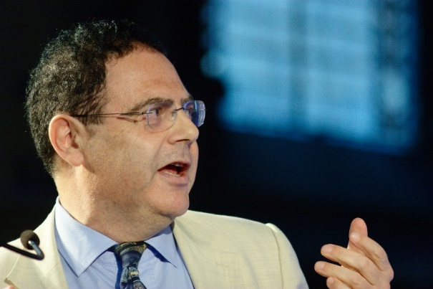
History
Originally credited to Bertrand Meyer in 1988
Open for extension, but Closed for modification
Redefined to advocate using abstract base classes
Continually evolving

Slide 3

What does it mean?
Concepts at odds with each other
Minimize changes to classes
Open for most probable changes
Notes:
Open means it’s an extension point. Need to strategically pick them.
Open for most probable changes refers to game-planning your classes for where you think changes will happen.
Talk about how you want to minimize code changes in the future.
Refer to a credit card example and how the swipe method would be something you’d want to change.

Slide 4

Benefits
Don’t have to change code once it works
Don’t have to rewrite tests
Doesn’t only apply to base classes
Notes:
In a perfect world, Tests and hopefully applying these principles on new code (not existing) but we are working on a clock here

Slide 5

How to implement
Abstract base classes!
Inheritance
Protected methods
Virtual and abstract methods

Slide 6
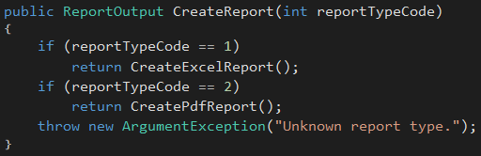
Example
What if we add another report type?
Class is cluttered with a lot of private methods
Single Reponsibility? Nope!

Slide 7
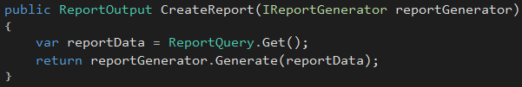
Example
Inheritance is not the only option…
Extend reporting functionality by introducing new IReportGenerator implementations
CreateReport never needs modified

Slide 8
Example
ReportEngine
+ CreateReport
ReportEngine
+ CreateReport
-CreateExcelReport
-CreatePdfReport
IReportGenerator
ExcelGenerator
PdfGenerator
Notes:
Old design required constant change to ReportEngine
New design only requires creation of new classes for new behavior

Slide 9
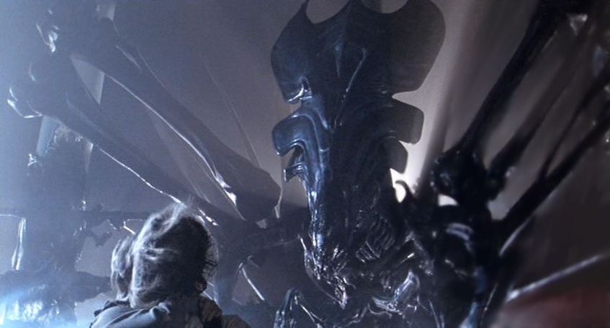
The Kata
Changed requirements for rover
Will be adding missiles
Why does a mars rover need a missile?
This thing →

Slide 10
Part One
Functionality (Already Implemented)
Rovers are equipped with 3 missiles and 3 mortars
Missile’s range is 5 spaces
Missile collides with obstacles in the way
Mortar’s range is 10 spaces
Mortar only collides with obstacles at landing
Collisions destroy obstacles
Non-collisions create indestructible obstacles
Exercise
Make Projectile class abstract
Create Missile and Mortar subclasses that inherit Projectile
Extract functionality out to classes based on IsMortar
Hint – Projectile should not have IsMortar
Booleans determining functionality are code smells
If a new projectile is added, then the FireProjectile has to be changed in Rover class
Notes:
SHOW THE APPLICATION!
Make sure to call out that cukes should all be green after they make changes and that these things are already working.
Call out that they should be able to build and run.
Mention that there are unit tests in the project, but only the final solution has good coverage.

Slide 11
Possible Solution
<abstract>
Projectile
MaxRange
Mars
PositionalAdjustments
IsCollisionDetected
Launch
Mortar
MaxRange
IsCollisionDetected
Missile
MaxRange
IsCollisionDetected

Slide 12
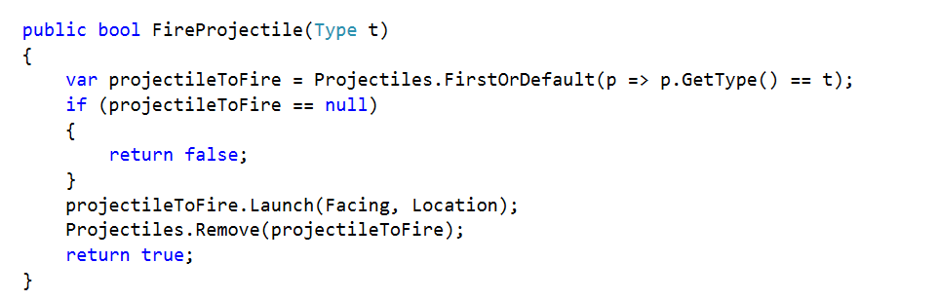
Possible Solution

Slide 13
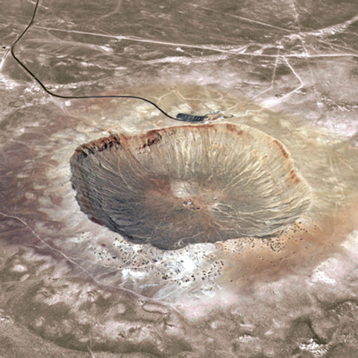
Part Two
Functionality
Obstacles created by a projectile must be indestructible
Exercise
Allow easily adding new obstacle types with additional characteristics
Create a new obstacle type
Hint – Look at picture →
Notes:
Again call out that everything should build and all tests should be green.

Slide 14
Possible Solution
Obstacle
Location
IsDestructable
Crater
IsDestructable

