Slide 1
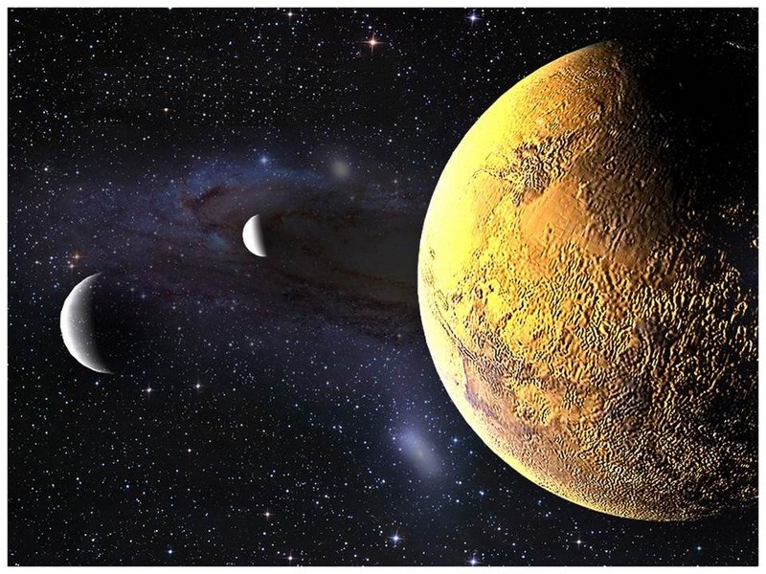
S.O.L.I.D.
Dependency Inversion Principle
Notes:
Introduction
It is common mistake to assume that this principle deals with Dependency Injection
Who is familiar with Dependency Injection?
The truth is that it does involve Dependency Injection but that is only part of the Principle
Understanding the other half of this principle is key to implementing it properly

Slide 2
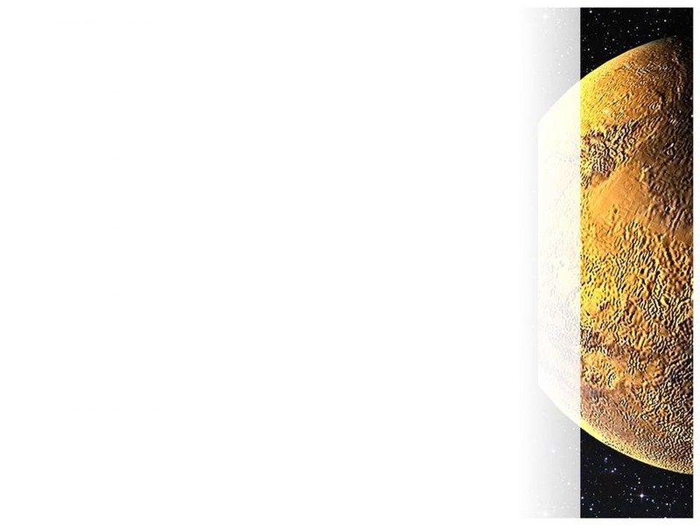
High-level modules should not depend on low-level modules. Both should depend on abstractions.
Abstractions should not depend on details. Details should depend on abstractions.
Notes:
So let’s begin with examining what the principle actually says
Read the principle out loud
But what does that mean?

Slide 3
High-level modules should not depend on low-level modules. Both should depend on abstractions.
Abstractions should not depend on details. Details should depend on abstractions.
Notes:
The first part speaks to Dependency Injection and the use of abstractions
So what does that look like?

Slide 4
Computer
Printer
Scanner
Notes:
In a “traditional” architecture, High level components often have a chain of low level dependencies which can have dependencies of their own.
This presents a problem when the chain gets long (or involved) enough that the higher level component only wants some of the functionality of the lower level modules.
They are highly coupled (a bad thing) and code reuse becomes impossible

Slide 5
Instead of this:
Computer
Printer
We want this:
Computer
Printer Interface
Printer

Slide 6
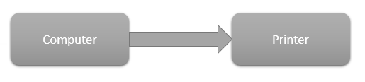
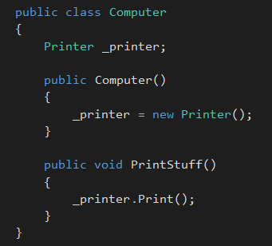
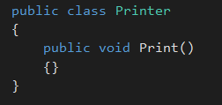
Notes:
Who has seen this type of thing in code they have worked on?
What is wrong with this?

Slide 7
Notes:
In the simplest sense, the internal variable should be an abstraction. This would start to break our dependency on the detail (implementation) but we would still have the concrete instance of the Printer class.

Slide 8
Notes:
One of the logical conclusions here is the need for Dependency Injection but it is important to note that this is not strictly a part of the Dependency Inversion Principle.
However, it is such a common implementation, I feel it is worth touching on here.
The warning signs of a dependency upon low level modules.
* the ‘new’ keyword being used
* variables of the type of implementation instead of an abstraction

Slide 9
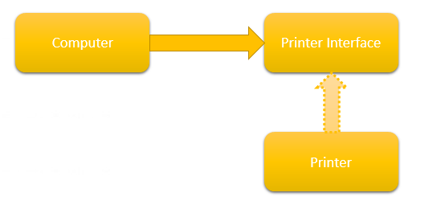
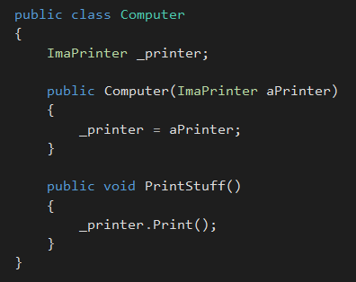

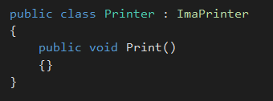
Notes:
So how do we fix this?
By injecting the abstraction into the class we break the hard dependency that it used to have on the implementation.
The implementation being used might still be the Printer class but we can only interact with it through its public interface.

Slide 10
High-level modules should not depend on low-level modules. Both should depend on abstractions.
Abstractions should not depend on details. Details should depend on abstractions.
Notes:
So let’s begin with examining what the principle actually says
Read the principle out loud
But what does that mean?

Slide 11
High-level modules should not depend on low-level modules. Both should depend on abstractions.
Abstractions should not depend on details. Details should depend on abstractions.
Notes:
So let’s begin with examining what the principle actually says
Read the principle out loud
But what does that mean?

Slide 12
Computer
Printer Interface
Printer
Notes:
It is a common & natural mistake to try to apply the interface based on the implementing class.
Most interfaces are born out of a need to have a common contract for existing items
But this is not correct

Slide 13
Computer
Printer Interface
Printer
Notes:
When we say that Details should depend on Abstractions what we are really saying is that the low level component (Detail) should get its marching orders from the high level component via an abstraction.
In short, the consumer of an abstraction is the component that dictates what that abstraction should look like.
In our example above, the COMPUTER (not the Printer) is the component that should dictate what the Printer interface should look like.

Slide 14
Notes:
So we have done some of the work for you on this one.

Slide 15
Notes:
So we have done some of the work for you on this one.

Slide 16
Notes:
So we have done some of the work for you on this one.

Slide 17
Create a new behavior.
Rules:
* Alien will move three spaces in one direction (chosen randomly)
* Alien will turn in random direction
* Alien will fire a rocket in that direction
Inject this behavior into any Alien that is added using the ‘Shooter’ option. Use Tracker and WallBuilder as a roadmap
Notes:
So we have done some of the work for you on this one.

