Slide 1

S.O.L.I.D.
Open/Closed Principle

Slide 2


History
Originally credited to Bertrand Meyer in 1988
Open for extension, but Closed for modification
Redefined to advocate using abstract base classes
Continually evolving

Slide 3

What does it mean?
Concepts at odds with each other
Don’t change classes
Open for most probable changes

Slide 4

Benefits
Don’t have to change code once it works
Don’t have to rewrite tests
Doesn’t only apply to base classes

Slide 5

How to implement
Abstract base classes!
Inheritance
Protected methods
Virtual and abstract methods

Slide 6
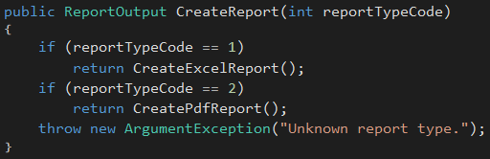
Example
What if we add another report type?
Class is cluttered with a lot of private method
Single Reponsibility? Nope!

Slide 7
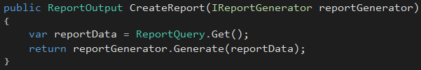
Example
Inheritance is not the only option…
Extend reporting functionality by introducing new IReportGenerator implementations
CreateReport never needs modified

Slide 8
Example
ReportEngine
+ CreateReport
ReportEngine
+ CreateReport
-CreateExcelReport
-CreatePdfReport
IReportGenerator
ExcelGenerator
PdfGenerator
Notes:
Old design required constant change to ReportEngine
New design only requires creation of new classes for new behavior

Slide 9

The Kata
Changed requirements for rover
Will be adding missiles
Why does a mars rover need a missile?
This thing →

Slide 10
Step One
Functionality (Already Implemented)
Rovers are equipped with 3 missiles and 3 mortars
Missile’s range is 5 spaces
Missile collides with obstacles in the way
Mortar’s range is 10 spaces
Mortar only collides with obstacles at landing
Collisions destroy obstacles
Non-collisions create indestructible obstacles
Exercise
Make Projectile class abstract
Create Missile and Mortar subclasses that inherit Projectile
Extract functionality out to classes based on IsMortar
Hint – Projectile should not have IsMortar
Booleans determining functionality are code smells
If a new projectile is added, then the FireProjectile has to be changed in Rover class
Notes:
SHOW THE APPLICATION!
Call out that they should be able to build and run

Slide 11
Possible Solution
<abstract>
Projectile
MaxRange
Mars
PositionalAdjustments
IsCollisionDetected
Launch
Mortar
MaxRange
IsCollisionDetected
Missile
MaxRange
IsCollisionDetected

Slide 12
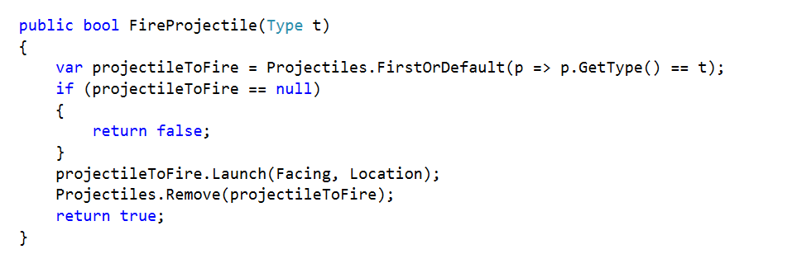
Possible Solution

Slide 13
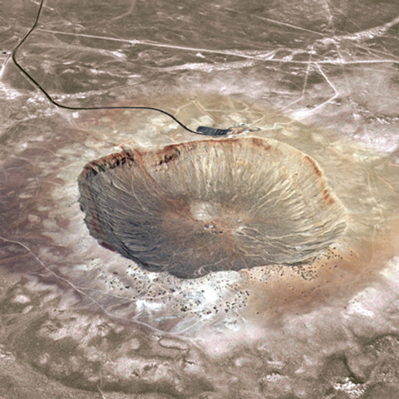
Step Two
Functionality
Obstacles created by a projectile must be indestructible
Exercise
Allow easily adding new obstacle types with additional characteristics
Create a new obstacle type
Hint – Look at picture →

Slide 14
Possible Solution
Obstacle
Location
IsDestructable
Crater
IsDestructable

