Slide 1
Server-Side!
Saturday, October 14, 2017

Slide 2

Server

Slide 3
Remind me again…
What is a server?
In modern web applications there is a constant back-and-forth communication between the visuals displayed on the user’s browser (frontend) and the data and logic stored on the server (backend).

Slide 4
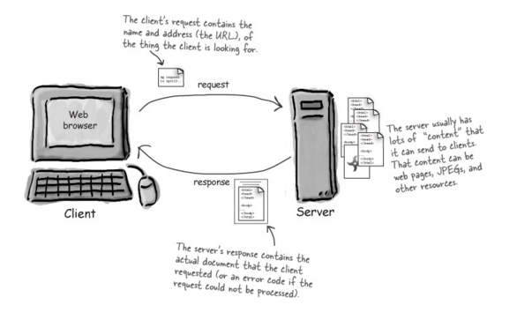
Server Definition
Server: The Machine and Software that handles requests and respond to them.

Slide 5
Remind me again…
What are examples of server-side functions?
In modern web applications there is a constant back-and-forth communication between the visuals displayed on the user’s browser (frontend) and the data and logic stored on the server (backend).

Slide 6
Server-Side Code in Action!
Visiting a URL and then being given an HTML page.
Visiting an API end-point that parses URL parameters to provide data as JSONs.
Clicking an invoice that provides a PDF report.
Storage analysis software that takes uploaded device log files, processes them, and presents the results as charts and graphs allowing you to intelligently manage your storage environment ☺
Google providing “results” relevant to your searches on other sites.

Slide 7
Remind me again…
What is a client?
In modern web applications there is a constant back-and-forth communication between the visuals displayed on the user’s browser (frontend) and the data and logic stored on the server (backend).

Slide 8
Client Definition
Client: The users’ personal machines that make “requests” of the server.

Slide 9
Bonus Question:
How do the client and server communicate with one another?
In modern web applications there is a constant back-and-forth communication between the visuals displayed on the user’s browser (frontend) and the data and logic stored on the server (backend).

Slide 10
HTTP Definition
Clients and Servers communicate back and forth using a series of understood communications defined by HTTP / HTTPs.

Slide 11
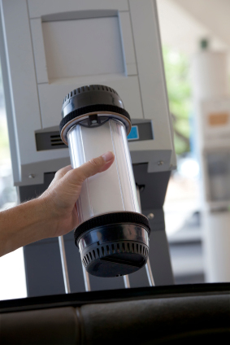
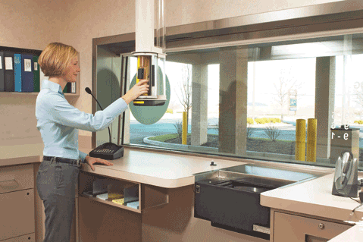
HTTP Definition
Request goes from client you to the server bank
The server bank has software people whose job it is to act as request handler.

Slide 12
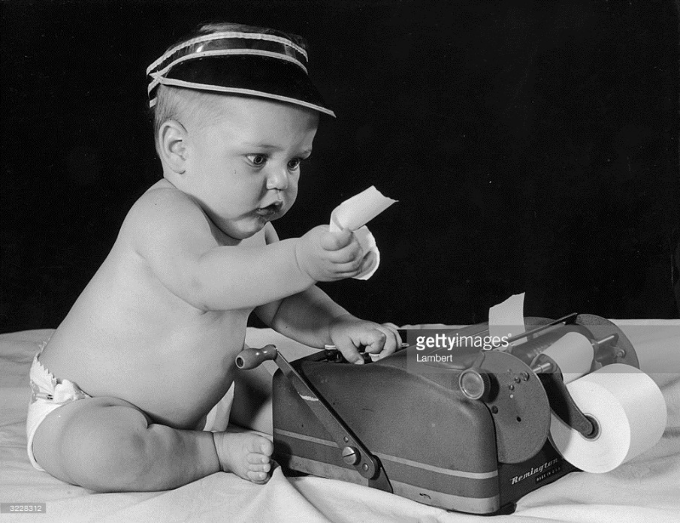
HTTP Definition
The server bank then processes the request. The request gets routed and processed based on what the request asked for.

Slide 13
HTTP Definition
Once the server software bank employee generates the proper response (receipt, cash, etc.), it they sends a response back to the client you.

Slide 14
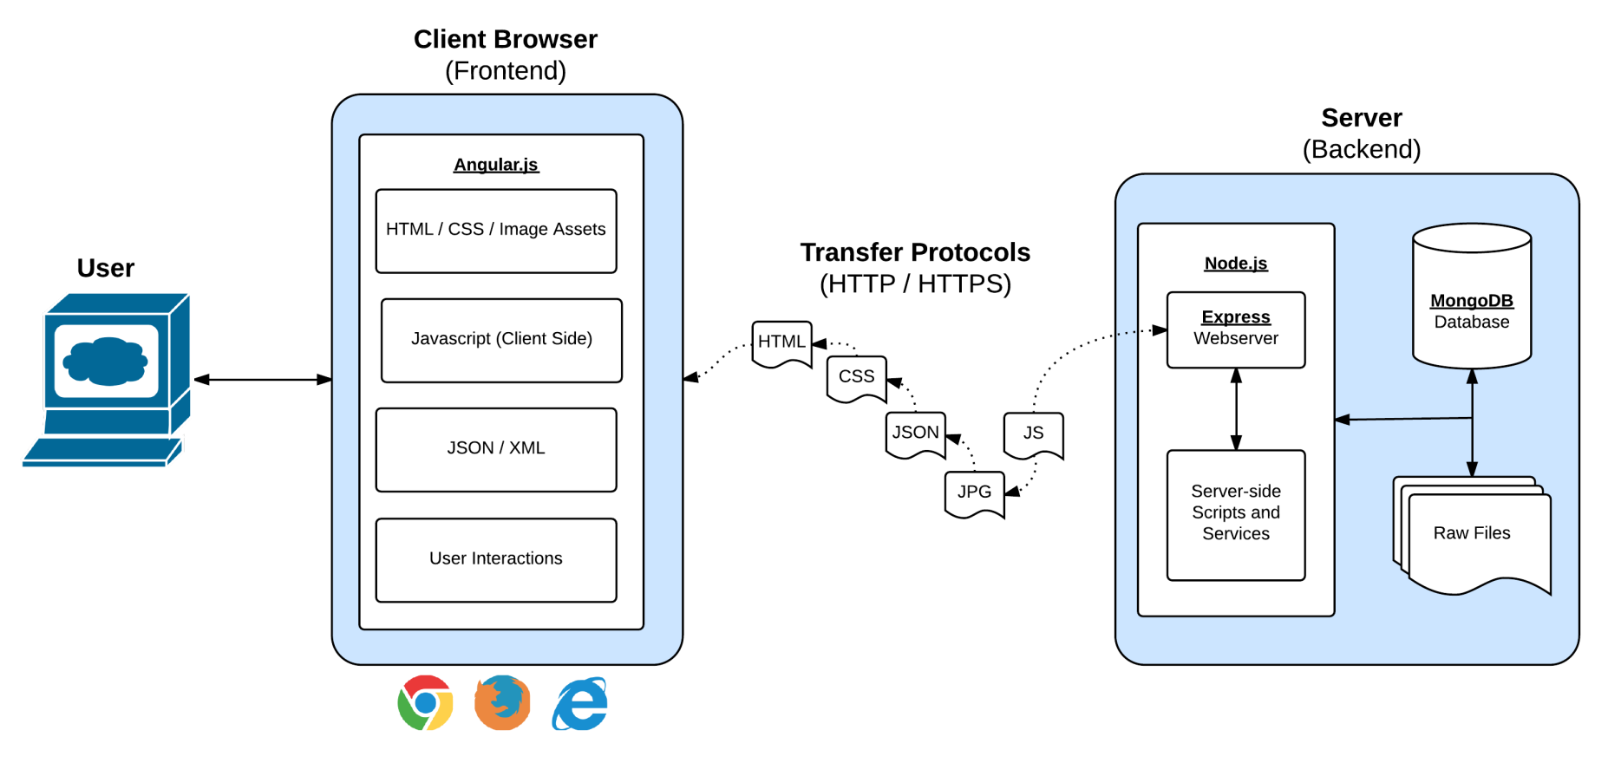
Full-Stack Development
In modern web applications there is a constant back-and-forth communication between the visuals displayed on the user’s browser (frontend) and the data and logic stored on the server (backend).

Slide 15
Full-Stack Development
In a way think of this as being two distinct machines.
A server is one machine and the client is a second machine.

Slide 16
Digging Deep into Server

Slide 17
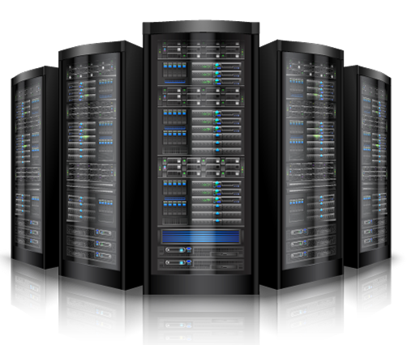
Visualizing Servers
Server Hardware look like large, ruggedized versions of desktop computers.

Slide 18

Visualizing Servers
These machines (and their respective code) handle all of the requests coming in from browsers accessing a website.

Slide 19
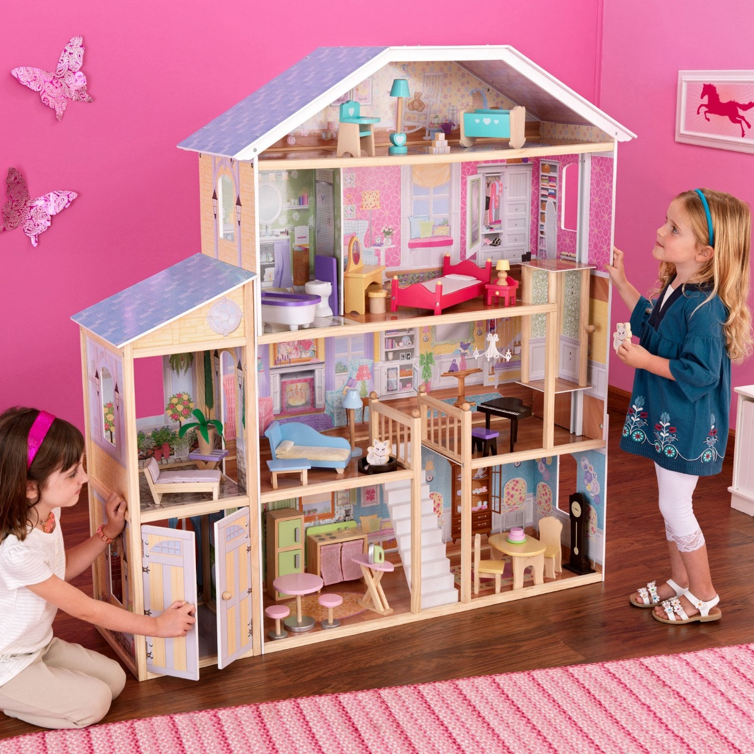
Visualizing Servers
Where does the server live?
In modern web applications there is a constant back-and-forth communication between the visuals displayed on the user’s browser (frontend) and the data and logic stored on the server (backend).

Slide 20






Where Do Servers Live?
Server hardware are housed in data centers which are provisioned with highly reliable power and telecommunications circuits.
Most companies have their own servers at some physical location with an appropriate environment.
Very small companies can just use a hosting company.
Another option is use server co-location.
Still another option is to use cloud services or Platform-As-A-Service (PaaS) offerings

Slide 21


Servers During Development
localhost
Important Note:
During development our personal computers run the server software.
We will create a “local dev server”
And then use our browser to interact with it.
browser

Slide 22
Building a “Server”

Slide 23
Creating a Server
For our purposes, “creating a server” equates to writing the code that handles what the server will do.
It’s important to note that even though you pay for server-side hardware, you still need to create the code that goes inside.
This code you create handles things like:
Connections to the database
Handling client-side URL requests
Performing server-side processes
Authenticating user requests
Logging client requests

Slide 24
A Big Box
Server
Throughout this week… imagine your server to be a big, empty box.
We will be adding code snippets and modules to give our big, empty box the powers to do stuff in response to all the requests that come in.

Slide 25
Inside the Box: Connections
Server
We’ll add listener such that the server can “begin” listening for requests.
Listen

Slide 26
Inside the Box: Parsing
Server
We’ll give our server the ability to “parse” URLs that the user requests.
Listen
URL Parse

Slide 27
Inside the Box: Routing
Server
Then based on the URL’s keywords, our server will be able to route (or direct the flow of logic to initiate other processes)
Listen
URL Parse
Route Handling

Slide 28
Inside the Box: Sending Files
Server
This subsequent process may be to send an HTML file to be rendered or to send a JSON file to be rendered…
Listen
URL Parse
Route Handling
Send HTML
Send JSON

Slide 29
Inside the Box: Receiving Posts
Server
We may also have a new module to handle receiving user’s POST requests (i.e. the data they send the server)
Listen
URL Parse
Route Handling
Send HTML
Send JSON
Receive POSTs

Slide 30
Inside the Box: Performing Logic
Server
We may also have complex server-side logic that we want to initiate in response to user’s visiting a route endpoint or sending us data.
Listen
URL Parse
Route Handling
Send HTML
Send JSON
Receive POSTs
Server Side Logic

Slide 31
Inside the Box: And More!
Server
But it doesn’t stop there!
We may add in functionality for authentication, logging requests, connecting to databases, and so much more.
But always remember… we’re coding these functionalities into our box!
Listen
URL Parse
Route Handling
Send HTML
Send JSON
Receive POSTs
Server Side Logic
And More!

Slide 32
Questions?

Slide 33
Let’s Get Coding!

