Slide 1

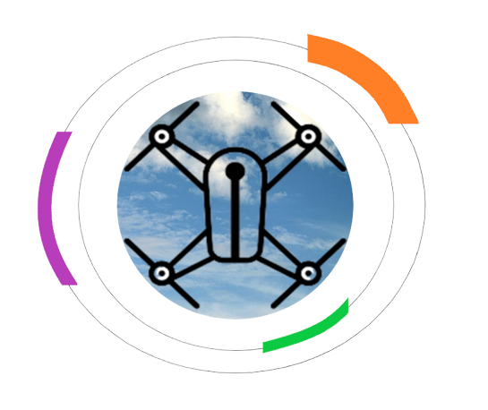
COMPUTE MODULE
Calculate UAV position
COMPUTE MODULE
Estimate UAV velocity
AI Cam
Estimate accuracy of position comparing real time image with satelitar view
SENSOR
Get inertial data
OFF LINE
OPTIONAL

Slide 2
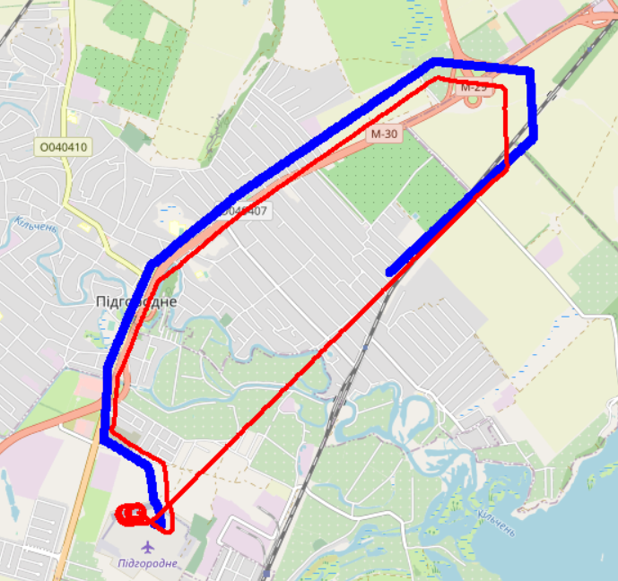
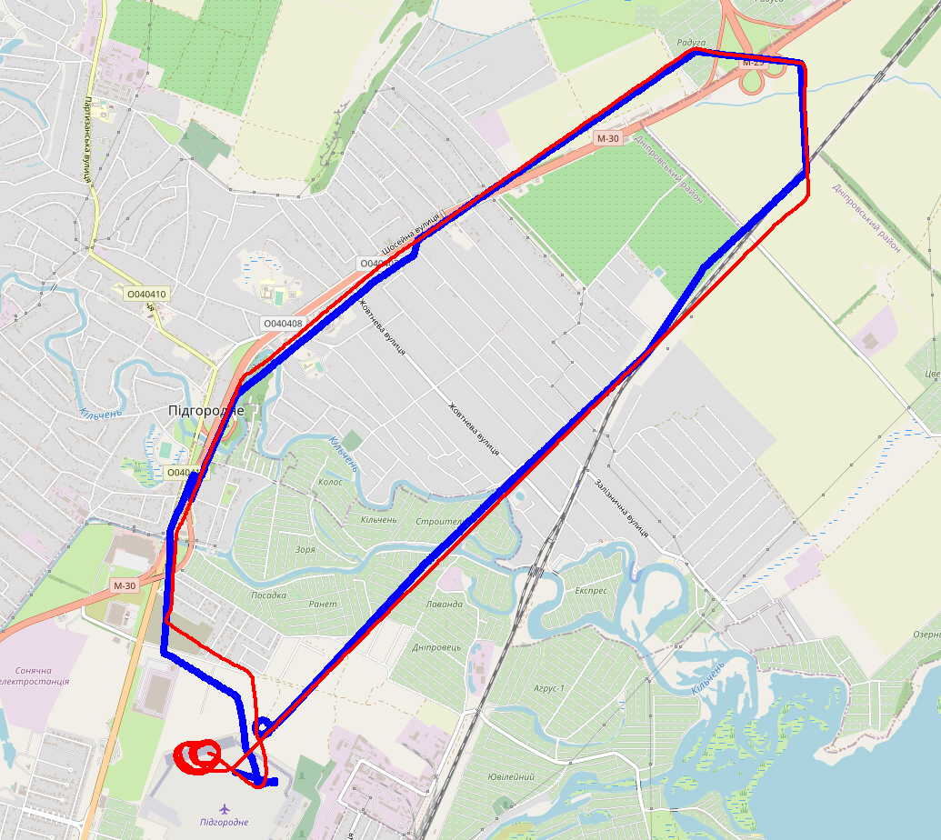
Tests results
Totally offline path compared with GPS
Hybrid path with GPS check with 15 s time interval

