Slide 1
Tkinter GUI

Slide 2
Brief Description
A GUI (graphical user interface) makes the programme easier to use. It allows you, to create screens, text boxes and buttons to help the user navigate through the programme in a more user-friendly way.
Tkinter is a library of features in Python that allows you to create a GUI

Slide 3
Tkinter Widgets
Button:- Button widget is used to place the buttons in the tkinter.
Canvas:- Canvas is used to draw shapes in your GUI.
Checkbutton:- Checkbutton is used to create the check buttons in your application. You can select more than one option at a time.
Entry:- Entry widget is used to create input fields in the GUI.
Frame:- Frame is used as containers in the tkinter.
Label:- Label is used to create a single line widgets like text, images, etc..,
Menu:- Menu is used to create menus in the GUI.

Slide 4
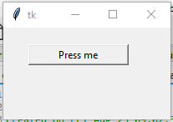
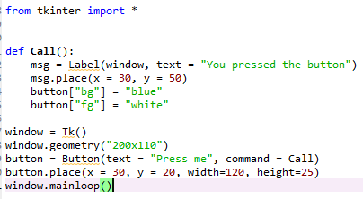
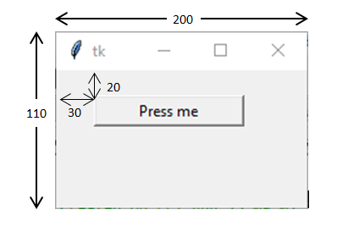
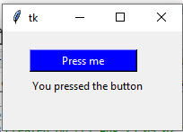
Geometry and Place
Look at the code and in particular the measurements that are used in the window.geometry and button.place lines.
The geometry line in the code determines the size of the window
The place line in the code determines the position of the individual item on the window
Now look at the window that the code produces
Once the button is pressed, it will run the “Call” function and change the window to look like this

Slide 5
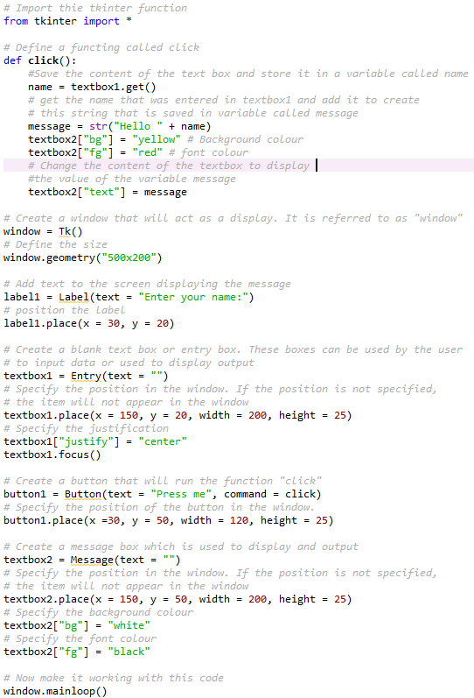
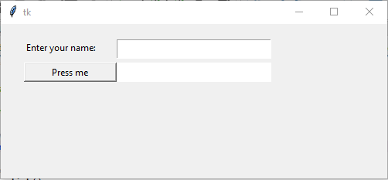
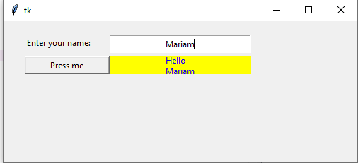
This creates a window that asks the user to enter their name. When they click on a button it should display the message “Hello” and their name and change the background and font colour of the message box
The comments in the code explain what each line of code does.

Slide 6
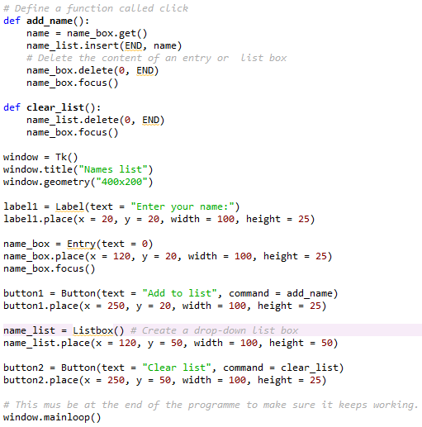
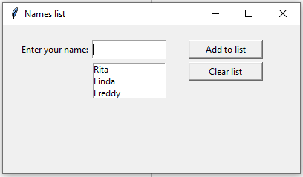
Basic Tkinter GUI – more example
This programme creates a window that asks the user to enter a name in a text box. When they click on a button, it adds it to the end of the list that is displayed on the screen. There is another button that clears the list.

Slide 7
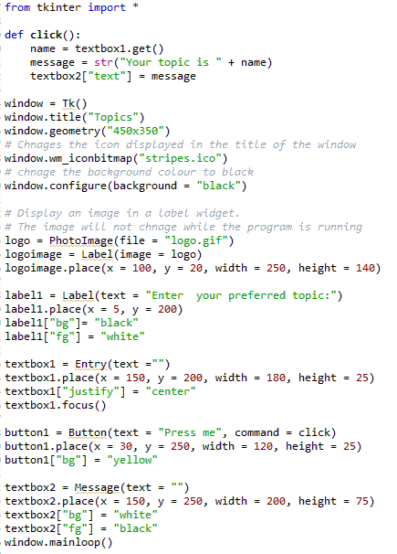
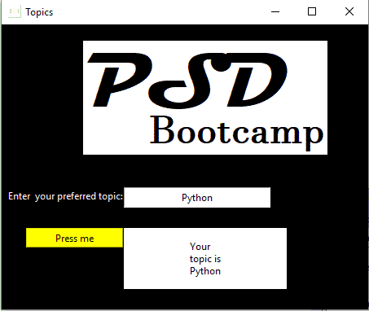
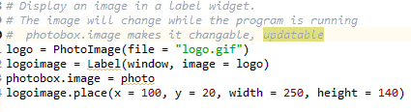
More Tkinter
When using images in your programme, it is easier if they are stored in the same folder as the programme. Otherwise you need to include the entire location of the files.
See next slide for a complete example of a program where images are changed while the program is running,

Slide 8
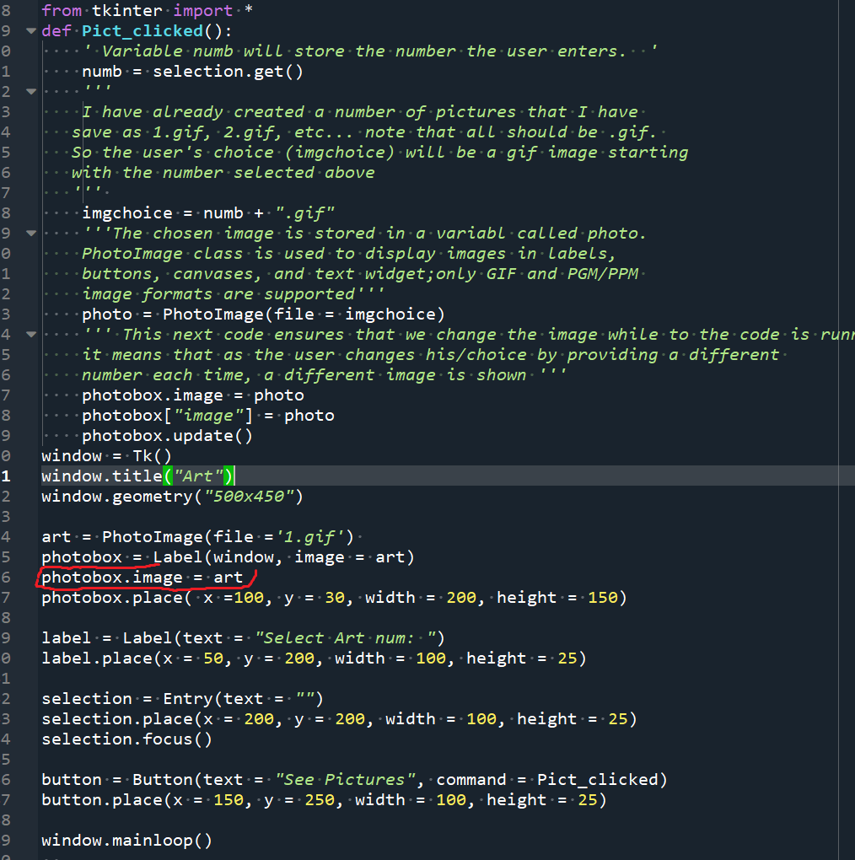
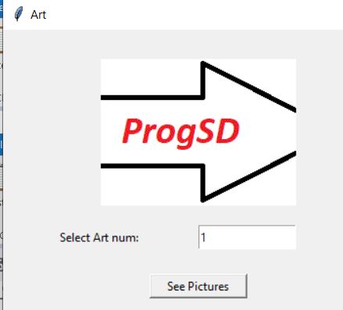
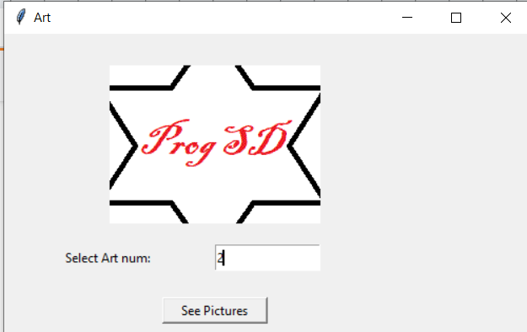
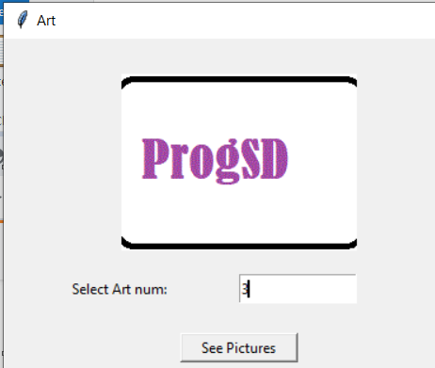
More Tkinter
Outputs

