Slide 1
8.1 Lesson Plan – Github Collaboration & Project Week (6:30 PM)

Slide 2
PreClass Challenge

Slide 3
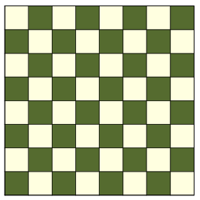
Calculate N’th Square – Math Fun (6:00 – 6:20)
Given a chessboard, calculate the ROW and COL of the ‘N’th square
Col 0 1 2 3 4 5 6 7
Row 0
Row 1
Row 2
Row 3
Row 4
Row 5
Row 6 Row 7
0
1
2
3
4
5
6
7
9
Given:
N = 19
Return:
Row = 2
Col = 3
8
10
11
12
13
14
15
16
17
18
X

Slide 4
Calculate N’th Square – Math Fun (6:20-6:30)
You COULD do it with a couple LOOPS
function findSquare(n) {
var square = 0; for(var irow=0; irow<8; irow++) { for(var icol=0; icol<8; icol++) {
if (square === n) {
return {row: irow, col: icol }
}
square++;
}
}
return undefined;
}

Slide 5
Calculate N’th Square – Math Fun (6:20 – 6:30)
BUT – Math is faster … and clearer
function findSquare(n) {
var irow = n / 8;
var icol = n % 8;
return {row: irow, col: icol};
}

Slide 6
Admin Items
jQuery $(Begins)

Slide 7
Administration… (6:30 – 6:35 PM, 5 mins)
Homework #7 (Train Times)
Due Tuesday, July 2nd, @11:59pm
Turn in whatever you have!
No Video Guide for this week
Use Tutors if you need them
When you get a SURVEY, be BRUTALLY HONEST!
Sign into BootCampSpot and mark your attendance
Any Questions from Last Time?
Holiday Thursday, July 4th, 2019
jQuery $(Begins)

Slide 8
Week 8 Project Week

Slide 9
Class Objectives
Project groups will create a project repo and add members as collaborators.
Students will understand the significance of pull requests and code review.
Students will have an understanding of feature branches in Git.
Students will submit a preliminary project idea by the end of class.

Slide 10
1. Instructor Do: Welcome Students (6:30 PM - 6:45 PM, (15 mins)
See Project Week Slides…

Slide 11
3. Groups Do: Create a Repository (6:45 PM - 6:55 PM, (10 mins)
08-project-1/01-Activities/01-Stu_Create-Repository
One group member should create a new Github repository.
Don't worry about the project name now, this can be changed later.
From the repo's main page, click the "Settings" tab.
Once in the repo's settings, select the "Collaborators" menu item on the left.
From the "Collaborators" page invite your group members to be project collaborators by entering their Github usernames one at a time.
Each invited group member should receive an email they must open to accept the invitation.

Slide 12
4. Instructor Do: Pull Requests and Code Review (6:55 PM – 7:00 PM, (5 mins)
Explain that when working with others on the same repo, it’s important to make sure that all of the new code gets reviewed by at least one other team member before getting merged into the master branch.
Assure the class that we’ll go into further detail about how this is done, but ask the class: “Why would we want to get code reviewed before merging it into master?”
Reviewing new code decreases the chances that a breaking change will accidentally be introduced into the master branch.
Code review helps group members who didn’t write the code understand how it works.
Explain that the next step of setting up our project repos for group collaboration is to protect the master branch.
Protecting the master branch means we will configure the repo to prohibit any team members from pushing code up into master directly or merging it in without another team member’s review.

Slide 13
5. Groups Do: Protect Master Branch (7:00 PM - 7:05 PM, (5 mins)
08-project-1/01-Activities/02-Stu_Protect-Master
Only one member per project group needs to complete this activity.
Navigate back to the repo's "Settings" page and then select "Branches" from the left sidebar.
Under "Branch Protection Rules" select "master" from the dropdown.
You should be presented with some options, check off the following:
"Protect this branch"
"Require pull request reviews before merging"
"Include administrators"
If completed successfully, no one should be able to push directly to the master branch. Instead, all changes must be made in the form of pull requests that are to be reviewed by another group member.

Slide 14
6. Instructor Do: Branching (7:05 PM - 7:15 PM, (10 mins)
Every Git repo starts off with a master branch.
This is there to hold the production version of the repo’s code.
But when we want to work on the code, we start by creating a new feature branch off of master.
If we create a new branch from master, it essentially creates a self-contained copy of all of the master branch’s code for us to work in.
When we’re satisfied with our work in the new feature branch,
we submit a pull request from the feature branch to the master branch.

Slide 15
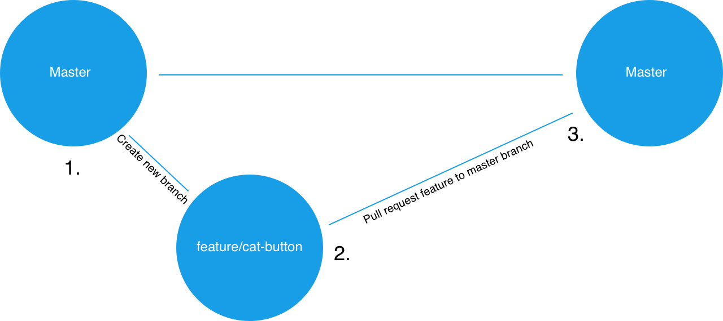

Slide 16
6. Instructor Do: Branching (7:05 PM - 7:15 PM, (10 mins)
A pull request is a request to merge the diffs or changes from the source branch (the feature branch) to the target branch (master).
With the way our repos are set up now, another group member must look at and approve the pull request before its changes can be merged into master.
Once a feature branch has been merged into master, we delete it and then check back out to the master branch. From there, we’d check back out to a new feature branch and repeat the process for each feature we add.

Slide 17
7. Everyone Do: Git Branching/Pushing 7:15 PM - 7:30 PM, (15 mins)
08-project-1/01-Activities/03-Stu_Branching-Pushing
Part I: Branching and Submitting a Pull Request
We will create a branch, add a feature, and submit a pull request.
Only one group member should complete this section, everyone else should observe.
Clone the project repo onto your computer and cd into it.
git checkout -b add-html-skeleton
You should now be on a new branch named “add-html-skeleton”.
In order to verify this worked, run the following command in your terminal:
git branch
You should see two branches listed: master and add-html-skeleton. The add-html-skeleton branch should have an asterisk to the left of it. This indicates that this is the branch you’re currently on.

Slide 18
7. Everyone Do: Git Branching/Pushing 7:15 PM - 7:30 PM, (15 mins)
At the root of the repo, create a new file named index.html. Inside this file, add code for a basic HTML skeleton and save.
In your terminal, add and commit the changes. Then push up your code by running following in your terminal:
git push origin add-html-skeleton
This should push up your code to to GitHub on a branch with the same name (add-html-skeleton).
Go to the main repo page at github.com and you should see an button that says “Compare & pull request” – click this.
On the next screen, add a description of the work that was done in the textarea and click the “Pull Request” button.
If completed successfully, you should see the pull request listed under the repo’s “Pull request” tab.

Slide 19
7. Everyone Do: Git Branching/Pushing 7:15 PM - 7:30 PM, (15 mins)
Part II: Reviewing a Pull Request
In this section we will review the pull request from Part I and merge it into master.
A different project member should complete this section while others observe.
Clone the repo to your computer if you haven’t already done so and cd into it.
First you will want to test the changes introduced by the add-html-skeleton branch locally.
In order to examine the new branch on your local machine, run the following commands in your terminal:
git fetch
git checkout -b add-html-skeleton origin/add-html-skeleton

Slide 20
7. Everyone Do: Git Branching/Pushing 7:15 PM - 7:30 PM, (15 mins)
This code should bring the copy of the add-html-skeleton branch that’s on GitHub onto your computer.
Make sure this worked by verifying that there’s an index.html file in your local repo.
Normally you’d run the code here to make sure everything works properly.
Check back out to your local master branch by running the following in your terminal:
git checkout master

Slide 21
7. Everyone Do: Git Branching/Pushing 7:15 PM - 7:30 PM, (15 mins)
Now go to your GitHub repo’s main page and go to the “Pull request” section. Select the add-html-skeleton pull request from the list.
At the next page select the option to see the “Files changed”.
You should be presented with all of the files that were changed in this PR along with line numbers for any code added/removed.
If there are any changes you would like made, you can click the line number to leave a comment the PR author will see and should address before approval. Otherwise click “Review changes” and approve the PR. You should be taken to a screen with an option to “Merge pull request” – click this button.
Once complete you can delete the feature branch from your machine by running the following in your terminal:
git branch -D add-html-skeleton

Slide 22
8. Students Brainstorm (7:30 PM – 8:00 PM, (30 mins)
Here’s a free mockup tool
pencil project is a free open-source desktop GUI prototyping tool.
http://pencil.evolus.vn/Default.html
In Day 2 of Project Instruction
We will be showing you how to use GitHub Projects.
We let you know this ahead of time so you don't use Trello or another board.

Slide 23
8. Students Brainstorm (7:30 PM – 8:00 PM, (30 mins)
Students begin work within groups to identify ideas,
research APIs, and create project designs.
Instructor/TA should begin hosting “workshops” to help steer groups in the right direction.

Slide 24
10. Students Do: Brainstorm (8:15 PM - 9:15 PM, (60 mins)
Students continue working with groups to identify ideas, research APIs, and create project designs.
Instructor / TAs should continue their workshop series.

Slide 25
11. Instructors Do: Answer Remaining Questions (9:15 PM - 9:30 PM, (15 mins)
Review any overarching questions and offer closing thoughts.

