Slide 1
8.3 Lesson Plan – Project Week (6:30 PM)

Slide 2
PreClass Challenge

Slide 3
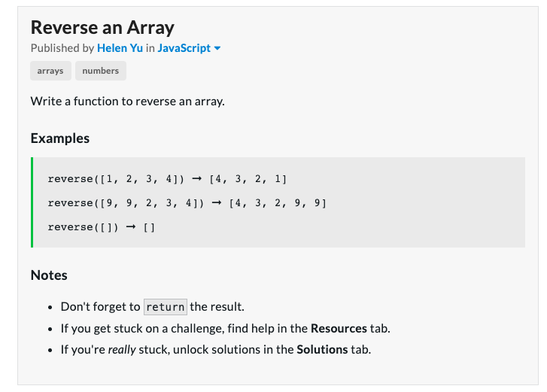
Reverse an Array (6:00 – 6:20 pm)
https://edabit.com/challenge/kJQYTCCWSnzhXG9dn
Don’t use the Array.reverse() function
Hint: Iterate over the array backwards
Hint: Create a second array to return
Extra: Reverse the array in place

Slide 4
Reverse an Array
function reverse(arr) {
let result = [];
for(let i=arr.length-1; i>=0; i--)
result.push(arr[i]);
return result;
}

Slide 5
REVERse An Array – In Place
function reverse(arr) {
// in place
for(let i=0; i<arr.length / 2; i++){
// swap - remember tmp var
let tmp = arr[i];
arr[i] = arr[arr.length -i -1];
arr[arr.length -i -1] = tmp;
}
return arr;
}

Slide 6
Admin Items
jQuery $(Begins)

Slide 7
Administration… (10:00 – 10:05 AM, 5 mins)
Homework #7 (Train Times)
Due Tonight, July 2nd, @11:59pm
Turn in whatever you have!
No Homework #8 – Work on Projects
No Video Guide for this week
Use Tutors if you need them
When you get a SURVEY, be BRUTALLY HONEST!
Sign into BootCampSpot and mark your attendance
Holiday Thursday, July 4th, 2019
Any Questions from Last Time?
jQuery $(Begins)

Slide 8
Class Objectives
Students will work on projects
Students will present their MVP with their group
Students will deploy their projects
Students will have a clearer understanding of how to complete their projects

Slide 9
1. Instructor Do: Presentations! (6:30 PM - 6:35 PM, (5 mins)
Inform the class that at any given point they should be ready to give a micro-presentation of their apps in progress.
Practicing presentations will help students better understand how to describe their applications as well as get them in the habit of never having broken code in their master branches.
By the end of class, students should present their project concepts, particularly their MVPs (Minimum Viable Product). Each presentation should cover:
Their application’s target audience
The problem the application solves
The absolute minimum functionality they’re working towards.
Inform students that they should finish their MVPs before working on less essential, nice to have features.
Each presentation should be limited to three minutes. Instructional staff should signal to presenters when time is up.

Slide 10
2. Instructor Do: Deployment (6:35 PM - 6:40 PM, (5 mins)
In conjunction to always having at least part of their applications in a presentable state, students should have always have the latest working versions their apps deployed to Github Pages.
It’s common for project groups to spend time building and polishing their applications only to run into issues on presentation day when attempting to deploy for the first time or for the first time in a while.
By deploying early and often students ensure they:
Have something they can demo at all times.
Are in the mindset of only merging code that works and has been reviewed into the master branch.
Make sure the class understands how to continuously deploy their master branches to Github pages.
From the repo’s “Settings” page, navigate to “Options” from the left sidebar, scroll down to “Github Pages” and select “master branch” from the “source” dropdown.

Slide 11
2. Instructor Do: Deployment (6:35 PM - 6:40 PM, (5 mins)
Github Pages
With this setting enabled, any code merged into master is automatically deployed to Github Pages.
Reiterate importance of protecting master. Explain that every time it’s updated, deployed project will update as well (continuous deployment!)
There are a few common issues students run into with their deployed applications they may not see locally. Slack out the following tips for students:
Use https instead of http for API calls. Locally either may work, but once deployed to Github Pages, https is required.
Make all file and folder names lower-cased from the start. Both Windows and Mac are case insensitive when it comes to file/folder names. But the web and Linux machines are case-sensitive.
e.g. Sample.png can be referenced as sample.png on Windows or Mac machines, but this will not work on GitHub pages.
Make sure you have an index.html in the root directory. Github Pages looks for this file to serve first when the website is loaded. The file must be named index.html and must be located in the root directory.

Slide 12
3. Students Do: Continuous Deployment (6:40 PM - 6:50 PM, (10 mins)
08-project-1/09-Stu_Continuous-Deployment
Instructions:
Part I**: Protect Master Part II**: Set Up Continuous Deployment **Hints**: * Ensure the there's an `index.html` file at the root of the repo.

Slide 13
4. Instructor Do: Finish MVP (6:50 PM – 7:00 PM, (10 mins)
Explain to the class that in order to ensure that they have something they can demo on presentation day,
it’s advised that they stop adding features two days beforehand.
No longer adding features days before presentations may seem counter-productive,
but explain that it’s to help ensure that any features that they already have pushed up to master are working properly.
Historically, it’s common for project groups to break their applications on or shortly before presentation day
trying to squeeze in last minute functionality.
Inform the class that groups should test every bit of functionality that has been completed so far and polish up all existing functionality.
Groups should also begin to prepare their project presentations.
Groups should have a Powerpoint (or similar) presentation prepared.
Every member of each group should be prepared to speak during the presentation.
Groups should not expect to demonstrate their actual code, instead they should be ready to tell a story about their applications. E.g. motivations for the project idea, issues they ran into, next steps, etc.

Slide 14
5. Groups Do: Project Work! (7:00 PM – 8:30 PM, (90 mins)
Students should continue working on projects.

Slide 15
8. Groups Do: Micro Presentations! (8:30 PM – 9:00 PM, (30 mins)
Spend the last part of class having students give quick micro-presentations of their projects.
Make sure each group can tell you the absolute minimum they hope to have done by presentation day.
Manage expectations around any project ideas which feel overly ambitions.
Once each group has presented their overall idea, give the rest of the class an opportunity to ask questions. If there are none, feel free to ask any of the following:
How do you plan to split up the work?
Who’s group leader?
How are things going so far?
How did you come up with the idea?

Slide 16
Micro Presentation:
Team Name
Team Members
Project Name
Project Description
Two APIs
Minimum Viable Product

Slide 17
NO CLASS THURSDAY See you 9:30 am Saturday, July 6th

