Slide 1
10.2 Lesson Plan - (6:30 PM)

Slide 2
PreClass Challenge

Slide 3
Calculate N’th Square – Math Fun (6:00 – 6:20)
Write a function that takes in an array of integers and the array with duplicates removed Ex: Input: [1,2,2,3] Output: [1,2,3] Input: [4,5,4,4,7,5] Output: [4,5,7] Input: [1,2,3,5] Output: [1,2,3,5]

Slide 4
Calculate N’th Square – Math Fun (6:20-6:30)
You COULD do it with a couple LOOPS
func var deduper = function (numArr){ var newArr = []; for (var i = 0; i < numArr.length; i++){ if(!newArr.includes(numArr[i])){ newArr.push(numArr[i]); } } }

Slide 5
Admin Items
jQuery $(Begins)

Slide 6
Administration… (6:30 – 6:35 PM) 5 mins)
Portfolio Updates Due Thursday, 7/18/19 by 11:59pm
Homework 10 Due Thursday, 7/25/19 by 11:59pm
Video Guide: 10-nodejs/VideoGuide.md
Use Tutors if you need them
When you get a SURVEY, be BRUTALLY HONEST!
Sign into BootCampSpot and mark your attendance
Any Questions from Last Time?
jQuery $(Begins)

Slide 7
1. Students Do: Command Line Equality (6:31 PM - 6:41 PM) (10 mins)
10-nodejs/01-Activities/10-CommandLineArg
Instructions:
Starting from a blank JavaScript file, create a Node application that takes in two command line arguments and checks if they are equal.
If the two numbers are equal then output: “true”. Otherwise output: “false”.
Bonus: Check if the two numbers are both multiples of 7.
Again output “true” if they are and output “false” if they are not.
Hint: console.log(process.argv) as a starting point if you are completely lost.

Slide 8
2. Instructor Do: Review Command Line Equality (6:41 PM - 6:48 PM) (07 mins)
Open the file solution1.js (10-CommandLineArg) and walk students through the solution. Use the comments to guide the conversation.
Then open the file solution2.js (10-CommandLineArg) and walk students through the re-factored (minified/simplified) solution. Again use the comments to guide the conversation.
In discussing the solution, be sure to point out that “re-factored solutions” oftentimes only become apparent after creating the more manual way first.

Slide 9
13. Students Do: CommandSort Refresher (6:48 PM - 7:03 PM) (15 mins)
Slack out the following:
Files:
commandSortUnsolved.js (20-CommandSort > UNSOLVED)
Instructions:
Starting from a blank file, create a Node-based command-line application that takes in a series of numbers from the user and returns the numbers sorted in ascending order.
Note: Feel free to use Stack Overflow or Google to find the code for sorting integers numerically.

Slide 10
14. Instructor Do: Review CommandSort (7:03 PM - 7:08 PM) (05 mins)
Review the solution with your students. In discussing the solution be sure to mention the following:
The use of process.argv to hold all of the arguments.
The conversion of the arguments into an array using a for-loop. Note how the for-loop skips the first two Node arguments.
The use of the JavaScript .sort method with an associated function that specifies how the sort should work. 01-CommmandSort.png
Then slack out the solution and proceed to the next example.

Slide 11
3. Instructor Do: Write a File (7:08 PM - 7:23 PM) (15 mins)
10-nodejs/01-Activities/11-WriteFile
As an internal Node package, fs does not require you to install anything prior to running.
Use the comments in the code to guide the conversation.
Then run the program using node write.js.
Point out that if the file did not exist,
then the command writeFile would create one for us
with the expected text contained within it.

Slide 12
4 Everyone Do: Guess readFile (7:23 PM - 7:24 PM) (01 mins)
“If the Node method for writing files is writeFile,
what do you think the Node method for reading files would be?”

Slide 13
5. Instructor Do: Read a File (7:24 PM - 7:34 PM) (10 mins)
10-nodejs/01-Activities/12-ReadFile
Then open the read.js code, and use the comments to guide the conversation.
Be sure to point out how readFile returns two parameters (err, data).
readFile is effectively “making” the values and assigning these variables via a callback.
We’ll cover those in more depth next week.
Run the code using node read.js.
Point out how the contents of the file were all console logged.
Change the contents of the movies.txt file and re-run to show that the new contents were read as well.

Slide 14
6. Instructor Do: Show FS Docs + Stack Overflow (7:34 PM - 7:41 PM) (07 mins)
Node documentation https://nodejs.org/api/fs.html.
Scroll through the documentation and point out the list of methods fs provides us.
Specifically search for and show the documentation for fs.readFile.
Sometimes it’s easier just to search in Google a term like: “How to read files in Node”.
The first website is not the Node documentation
but a tutorial website that more easily shows the method implemented.
There is no shame in going to Google first as new developers.

Slide 15
7. Partners Do: Best Things Ever (7:41 PM - 7:56 PM) (15 mins)
10-nodejs/01-Activities/13-BestThingsEver
Create a Node application that reads the best_things_ever.txt file,
parses the comma separated elements, and ultimately console logs each element in the file on separate lines.
HINT: If you are struggling to figure out how to loop your way through the text,
look into the .split() method. This could make your life a whole lot easier.
GREGS ADVICE: Start with the read.js file from 12-ReadFIle

Slide 16
8. Instructor Do: Review Best Things Ever (7:56 PM – 8:06 PM) (10 mins)
Review the activity using the solved file readBest.js and use the comments as a guide.
Be sure to point out how we use data.split(',')
to separate the elements by commas.
Explain that .split breaks the elements and stores the contents into an array.
We then loop through this generated array and
console.log each element one element at a time

Slide 17
9. Break (8:06 PM - 8:21 PM) (15 mins)

Slide 18
10. Instructor Do: AppendFile (8:21 PM - 8:28 PM) (07 mins)
10-nodejs/01-Activities/14-AppendFile
writeFile simply erases the contents of the file before writing the replacement content.
This is not exactly ideal in most situations since, more often than not, we do not want to delete data like that.
If we would append data use appendFile method.
Ask a student in class to explain the code to everyone using the comments as a guide.
Point out how appendFile works effectively the same as writeFile.
In fact, it will also create a new file if one does not already exist.
Unlike writeFile, however, appendFile won’t clear the contents of a file if that file already exists.
Run the application using node appendFile.js foo-bar-baz a few times to demonstrate this.

Slide 19
11. Partners Do: Bank.js (8:28 PM - 8:58 PM) (30 mins)
10-nodejs/01-Activities/15-BankJS
Starting from scratch, build a Node application called bank.js which allows takes in user inputs via the command line to register bank transactions.
The transactions possible are:
total - this should tally up all of the money in the bank balance and display it for the user.
deposit <number> - this should add a positive amount to the bank balance. (No need to display the total here)
withdraw <number> - this should add a negative amount to the bank balance. (No need to display the total here)
lotto - this should subtract an amount from the bank balance, but if a random number is hit it should add back a larger amount into the bank balance.
For all deposits, withdrawals, or lotto purchases the transaction should be registered in the bank.txt file.

Slide 20
12. Instructor Do: Review Bank.js (8:58 PM – 9:05 PM) (07 mins)
Capture the “transaction type” and “value” via process.argv[2] and process.argv[3].
Use if-else or switch-case to route the user to specific functions relevant to the given transaction type.
If the transaction type is total then we will use readFile read the contents of bank.txt and combine the numbers
If the transaction type is deposit, withdraw, or lotto we will instead use appendFile to add a numeric value to the textfile.

Slide 21
16. BONUS: Discuss Sync vs Async Reading (9:05 PM - 9:20 PM) (15 mins)
If you have time and think you can cover this topic, one additional instructional opportunity is included.
If you explore the folder 19-SyncVAsync there are two files (asyncAppend.js and syncAppend.js) that look nearly identical. However, they differ in one significant way. One uses appendFileSync and the other uses appendFile. If you run each of these applications, you will find that the order by which the variable secondNumber prints is reversed.
syncAppend displays the secondNumber AFTER the append function prints SAVED
asyncAppend displays the secondNumber BEFORE the append function prints SAVED.

Slide 22
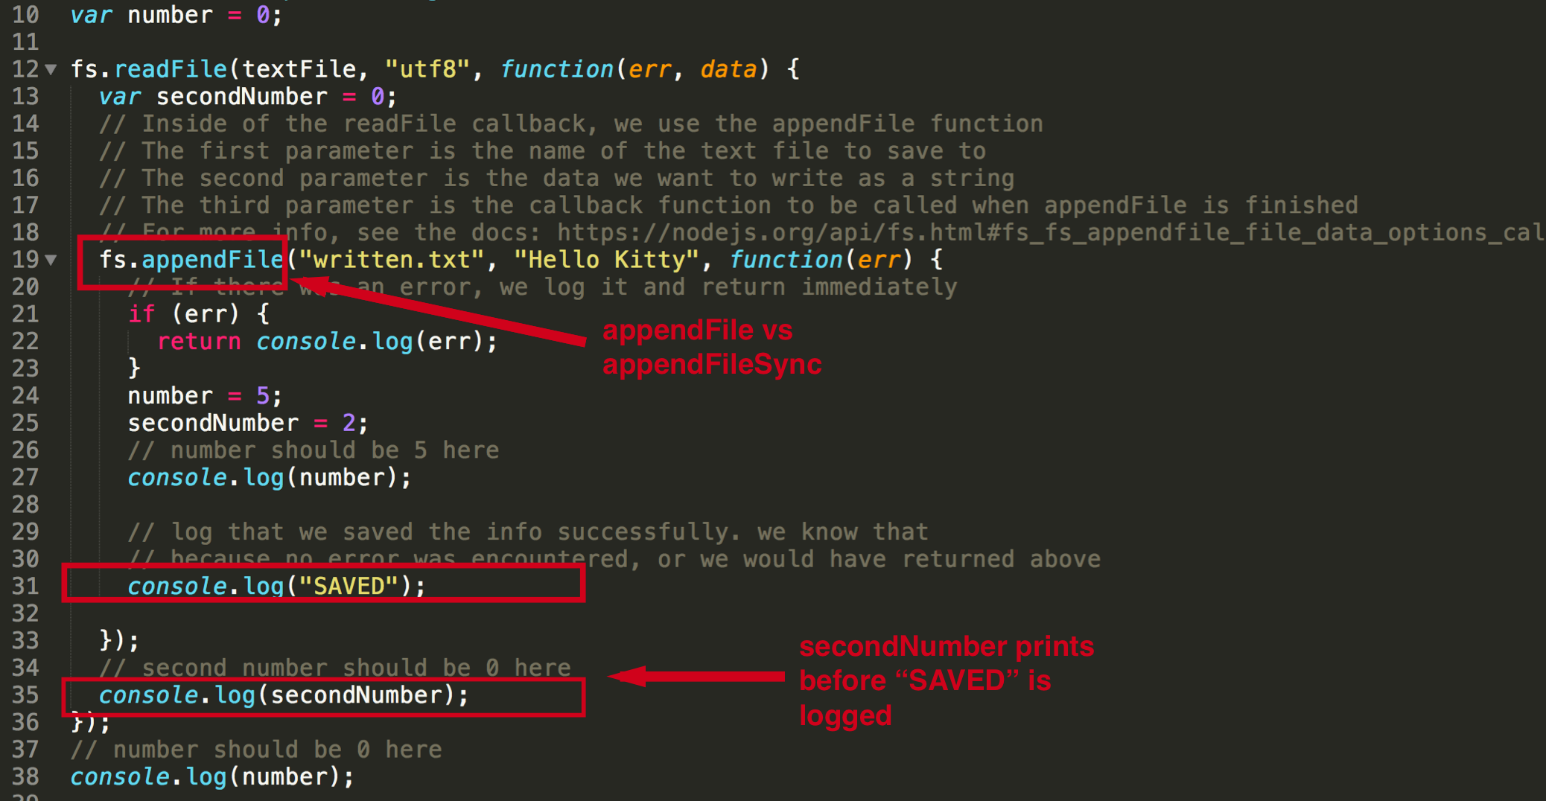
/12-AsyncVsSync.png

