Slide 1
20. Partners Do: Giphy Documentation (9:10 PM - 9:20 PM)
Next point students to the Giphy API Documentation.
Then slack out the following instructions:
Instructions:
As partners, using the Giphy API Documentation, try to research answers to the following questions:
How would you return back a single gif tied to a search term?
How would you return five gifs tied to a search term?
How would you return the trending gifs back from this API?
Let students know that their homework will use the Giphy API Documentation

Slide 2
21. Instructor Do: Giphy API Demo (9:20 PM - 9:30 PM)
Finally, go over 19-giphy-api.html in 04-Giphy_API. Point out the API key that needed to be appended to the end of your query URL.
Slack out the video review for this activity.

Slide 3
22. Instructor Do: Homework Intro (9:30 PM - 9:35 PM)
Go over the upcoming homework assignment. You can play the homework demo file or showcase the final solution file in the browser.

Slide 4
22. Students Do: Homework Intro (9:35 PM - 9:40 PM)
If any time remains, have students create their own AJAX calls to the Giphy API. Have them try to create a website with buttons that launch searches for Gifs associated with specific terms.

Slide 5
23. Instructor Do: API Key Reminder For Next Class (9:40 PM - 9:41 PM)
Next classes Weather in Bujumbura Activity will require students to use an API key from OpenWeatherMap API. Please have them apply for one before our next class starts in order to have it approved and activated in time for the activity.
Lesson Plan Feedback
How did today’s class go?
Went Well
Went Poorly

Slide 6
Pre-class Drills
Let students know that it’s time for the preclass drill of the day. Remind them that interviewing is a skill that is in some ways separate from practical coding, and that they need to work hard to hone this skillset during this course. The class is designed to make them great developers, and these pre-class questions are designed to make them awesome interviewers.
Encourage students to begin by pseudo-coding. Remind them that many companies are judging more on problem solving skills than coding chops, so having strong pseudo-coding skills to fall back on may just land them their dream job one day. You should encourage some white boarding from students (when relevant) and explain why it’s beneficial for them to do it in the classroom rather than wait for their first time to be during interviews, but move on if there are no volunteers. Discourage heavy pressure for students.
20 min before class starts write the following problem on the board or Slack it out:
Run the following code and explain the output:
var sample = function(){ var a = b = 3; } sample(); console.log("Is a defined?", typeof a !== "undefined"); console.log("Is b defined?", typeof b !== "undefined");
Tell students that this is a bit different from the problems we’ve seen so far. Explain that:
There are a few different types of interview problems that they’ll see as developers.
Some focus on logic, like the ones we’ve seen so far, and some focus on measuring understanding of the language.
JavaScript has a lot of quirks that make it unique from other languages. Understanding those quirks will make them stronger JavaScript developers.
After 15 minutes explain the following points:
var a = b = 3 is equivalent to writing:
b = 3; var a = b;
This means that b is created globally (unless you use strict mode) because there is no var keyword in the variable definition.
After b is created globally, b is assigned the value 3. Then a is created locally inside the function and assigned the value of b, which is 3.
Because a is created locally, it doesn’t exist outside the function.
Take a couple of student questions, if time permits, before moving on.
Overview
In this class, students will be building upon their knowledge of AJAX to retrieve data via the OMDb api and display data onto an HTML page.
Summary: Complete activities 5-11 in Unit 6
Instructor Priorities
Instructor should offer a thorough overview of APIs, JSONs, and AJAX using the provided slides.
Students should complete the Weather in Bujumbura Activity
Students should complete the Working Movie App Activity
Make sure students sign up and obtain THEIR OWN PERSONAL API KEY for any APIs we might use, as the publics keys that we provide could be deactivated at any time.
Instructor Notes
Use the slideshow as an initial starting point for your conversation on APIs. Make sure that students see the power of APIs and understand how APIs provide a link between front-end (what they’ve learned so far) and backend (what they will soon be learning).
Today’s activities will feel pretty challenging and confusing to the majority of your students. Use your best judgment and adjust as necessary. If you need to cut the Bands In Town exercise by all means do so. Offer ample support and let students know that things will “click” eventually – even if it doesn’t quite click just yet.
Today’s Weather in Bujumbura Activity will require students to use an API key from OpenWeatherMap API. Please have them apply for one before class starts in order to have it approved and activated in time for the activity.
TAs should reference 02-Day-TimeTracker to help keep track of time during class.
Sample Class Video (Highly Recommended)
To view an example class lecture visit (Note video may not reflect latest lesson plan): Class Video

Slide 7
6.2 Lesson Plan - Advanced AJAX (9:00 AM)
Slideshow
This lesson’s slides are available on Google Drive here: 06-2 Advanced AJAX
To add slides to the student-facing repository, download the slides as a PDF by navigating to File > “Download as” and choose “PDF document.” Add the slide PDF file to your class repository along with other necessary files.
Note: Editing access is not available for this document. If you wish to modify the slides, please create a copy by navigating to File > “Make a copy…”.

Slide 8
Admin Items
jQuery $(Begins)

Slide 9
Administration… (9:00-9:05)
Homework #5 (Trivia Game)
Due Tuesday, June 18, @11:59pm
Turn in whatever you have!
Homework #6 (GIPHY.COM)
Due Tuesday, June 25th, @11:59pm
Turn in whatever you have!
Use Tutors if you need them
When you get a SURVEY, be BRUTALLY HONEST!
Sign into BootCampSpot and mark your attendance
Any Questions from Last Time?
Sam… Homework Description
jQuery $(Begins)

Slide 10
Class Objectives
To solidify understanding of APIs, JSONs, and their roles in full-stack web development
To increase comfort working with APIs and AJAX calls in data-rich applications

Slide 11
1. Instructor Do: API and AJAX Slide Show (9:05 AM - 9:12 AM)
Begin class by welcoming students and asking if there are any lingering questions.
Then open up the slide deck 06-2 Advanced AJAX and begin presenting the slides. Encourage students to answer questions and ask questions. Draw upon your own insight regarding APIs to try and further solidify their understanding of the role APIs play in web development. Show the videos included in the slide deck when appropriate.
Just be sure to keep focused and stay on track of time!

Slide 12
2. Students Do: The Weather in Bujumbura (9:12 AM - 9:27 AM)
Then open the file 05-Bujumbura/Solved/bujumbura-solved.html in your Browser. Explain to them them that this application uses the OpenWeatherMap API to retrieve live snippets of weather information about Bujumbura (the capital of Burundi (which is a city in Africa)).

Slide 13
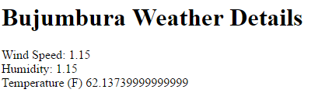
1-Bujumbura_1

Slide 14
Then slack out the following folder and instructions to students.
Folder:
05-Bujumbura/Unsolved
Instructions:
Using either bujumbura-easier.html or bujumbura-harder.html as a starting point, add in the missing code necessary to accomplish the following:
Query the OpenWeatherMap API for the current weather data on Bujumbura, Burundi.
Log the retrieved data from this query to console.
Parse the retrieved data to display wind speed, humidity, and temperature information into the HTML.
HINT: You will need to request an API key from the website.
BONUS: Figure out how to convert the Kelvin temperature provided into Fahrenheit.
NOTE: Don’t worry if this feels hard. Push yourself!
Instructor / TAs:
Walk around and help students accomplish this task as necessary.

Slide 15
3. Instructor Do: Review Activity (9:27 AM - 9:32 AM)
Open the file 05-Bujumbura/Solved/bujumbura-solved.html in your editor and walk students through the code.
During your explanation, be sure to point out each of the following:
That we retrieved an API key from the OpenWeatherMap API site.
That we then used this APIKey as part of our queryURL along with the city parameter (in this case Bujumbura)
2-Bujumbura_2
That we then passed this queryURL into our AJAX call.
Then inside the .then method of the AJAX call, we are capturing data inside of a variable called response.
And that we parse this response JSON to retrieve individual properties like wind.speed, main.humidity, and main.temp. This was then dumped using jQuery into the HTML.
Finally, point out that when it came to the bonus we converted the temperature value by incorporating the Kelvin data into a formulaic conversion.
3-Bujumbura_3
Ask students how you would recycle the code shown to instead find the weather in London. (Answer: Just change the queryURL)
Ask students why all of the code needed be inside the .then function. (Answer: Otherwise, we might not have data yet.)
Check if there are any other questions about this application before moving on.

Slide 16
4. Instructor Do: Working Movie App Demo (9:32 AM - 9:37 AM)
Next open the file 10-WorkingMovieApp/Solved/working-movie-app-solved.html in your browser. Let students know that in today’s class we will be working towards building this.
In demonstrating this application:
Click on the existing buttons to show that movies are displayed.
Create a new movie to the listing, point out that a button was generated dynamically, and that this button becomes a clickable AJAX caller of its own.

Slide 17
5. Students Do: Movie App JSON Dump (9:37 AM - 9:47 AM)
Then open the file 06-MovieJSONDump/Solved/movie-json-dump-solution.html in your browser. Demonstrate that this application takes in a user input then uses the OMDb API to retrieve movie in the form of a JSON. This movie is then appended directly into the HTML as is.

Slide 18
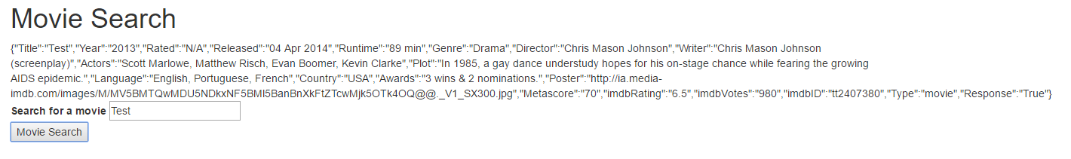
2-JSONDump_2

Slide 19
Then slack out the following folder and instructions.
Folder:
06-MovieJSONDump/Solved
Instructions:
Using movie-json-dump.html in 06-MovieJSONDump as starter code, add functionality such that clicking Movie Search triggers an AJAX call to the OMDb database and the JSON response to be appended onto the page.
If you finish early, begin reading about the Bands In Town API. Try to understand how to search for a specific artist.

Slide 20
6. Instructor Do: Review Activity (9:47 AM - 9:52 AM)
Review the JSON Dump activity. In your discussion be sure to point out:
The standard AJAX syntax of capturing both queryURL and GET method.
Point out the use of JSON.stringify(response) for converting the retrieved JSON into a string that can be put placed into text.
2-JSONDump_1

Slide 21
7. Students Do: Dynamic Movie Button Layout (9:52 AM - 10:17 AM)
Next demonstrate the file movie-button-layout-solved.html in 07-MovieButtonLayout in your browser. Point out that this application allows users to create new buttons dynamically when a user clicks Add a Movie Yo.
Then slack out the following files and instructions.
Folder:
07-MovieButtonLayout/Unsolved
Instructions:
Using either movie-button-layout-easier.html or movie-button-layout-harder.html as a starting-point, replicate the functionality of the application just demonstrated to you.
Your final code should:
Dynamically generate the initial buttons using jQuery
Allow users to create new buttons upon entering text in the textbox and clicking Add a Movie Yo.
If you finish early, begin reading about the Bands In Town API. Try to understand how to search for a specific artist.

Slide 22
8. Instructor Do: Review Activity (10:17 AM - 10:27 AM)
Next, review the solution provided in 07-MovieButtonLayout/Solved/movie-button-layout-solved.html. In discussing the solution be sure to point out:
That the renderButtons function is looping through the movies array and creating a jQuery element for each.
Pay special attention to the syntax for jQuery’s creation of dynamic elements.
Point out that the .on("click") event tied to the button is what triggers re-rendering of the movies array
Ask students why the #buttons-view needed to be emptied in the renderButtons function(Answer: otherwise content will get replicated each time you click a button).

Slide 23
9. Students Do: Log Movie JSON & Click JSON Data Attribute (10:27 AM - 10:47 AM)
Demonstrate 08-LogMovieName/Solved/log-movie-name-solved.html in the browser.
Point out that, with this app, clicking any of the buttons — either new or old — will trigger an alert message listing out the movie name.
Demonstrate 09-ClickJSON/Solved/click-json-solved.html in the browser.
Point out that, with this app, clicking any of the buttons — either new or old — will cause a JSON dump of the movie to appear. Be sure to point out that the code works for both the original buttons and the newly created buttons.
Slack out the following files and instructions.
File:
08-LogMovieName/Unsolved/log-movie-name.html
09-ClickJSON/Unsolved/click-json.html
Instructions:
Using the starter code provided, create the missing code snippets inside the alertMovieName function necessary to capture the movie name for both the original and new buttons.
Using the Starter code provided, create the missing code snippets inside the displayMovieInfo() function necessary to display JSON data about each movie.
HINT: You should use HTML data- attributes.

Slide 24
10. Instructor Do: Review Activity (10:47 AM - 10:57 AM)
Review the solution provided in 08-LogMovieName/Solved.
Review the solution to the last activity provided in 09-ClickJSON/Solved/click-json-solved.html.
Be sure to emphasize how we used the same stringify method in both solutions.
In your discussion, be sure to point out
How we used data attributes to retrieve the “name” of each movie;
4-ConsoleLog_1
Also point out how we used an alternative .on("click") event. Instead of using an .on("click") event associated with our buttons, we created one that was associated with the document. This was necessary to ensure that the dynamically created elements were bound to jQuery.
Demonstrate how the app would function with both sets of event syntax.
4-ConsoleLog_2

Slide 25
11. BREAK (10:57 AM - 11:12 AM)

Slide 26
12. Students Do: Complete Working Movie App (11:12 AM - 11:37 AM)
Finally, open the working file: 10-WorkingMovieApp/Solved/working-movie-app-solved.html in your browser and demonstrate what the final application will look like.
Then slack out the following folder and instructions.
Folder:
10-WorkingMovieApp/Unsolved
Instructions:
Using either version of the starter code provided to you, complete the application so that various snippets of information about your movie are displayed underneath. As a suggestion, display at least each of the following:
Movie Poster
Rating
Release Date
Plot

Slide 27
13. Instructor Do: Review Activity (11:37 AM - 11:42 AM)
Review the final application’s code as shown in 10-WorkingMovieApp/Solved.
Point out how this application’s code basically consists of an AJAX call which retrieves data from the OMDb API, parses it, then displays it inside of an HTML element.

Slide 28
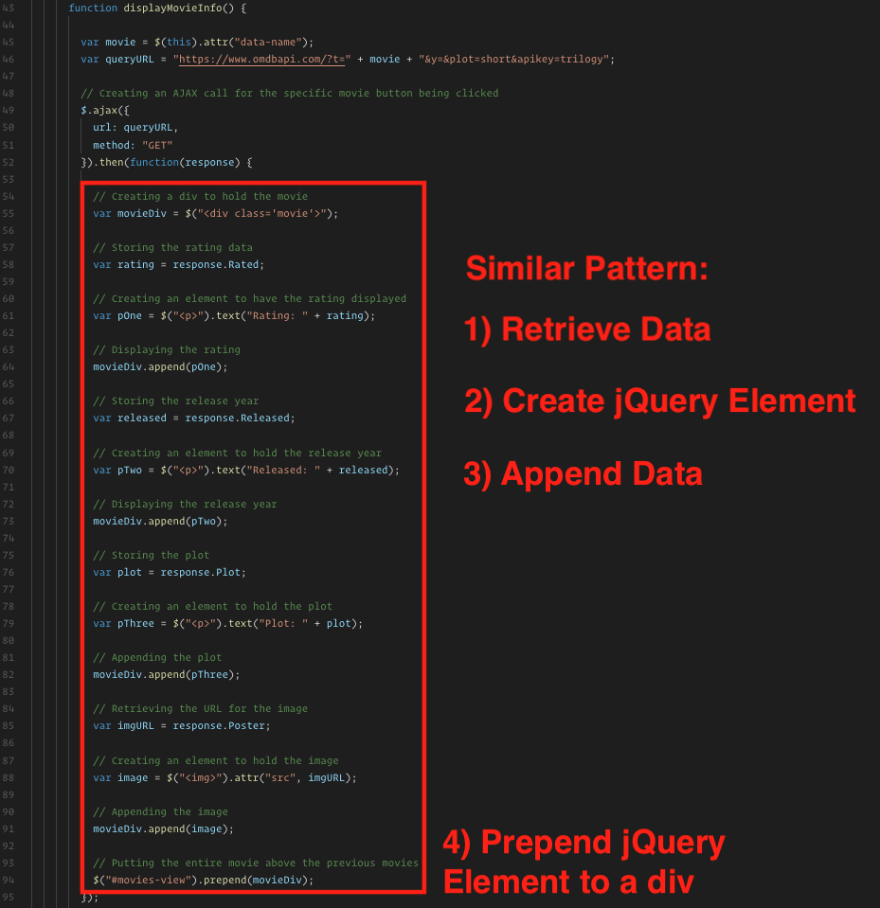
5-WorkingApp_1

Slide 29
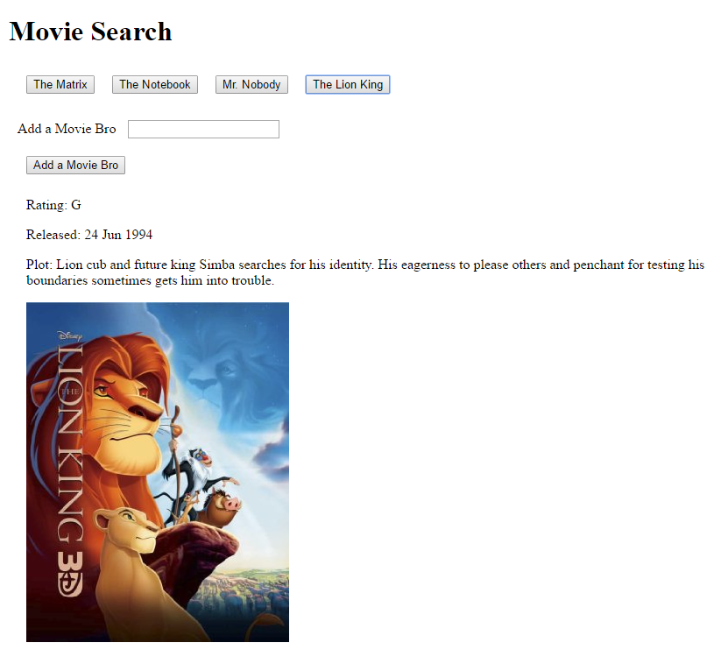
5-WorkingApp_2

Slide 30
14. Students Do: Bands In Town App (11:42 AM - 12:02 PM)
If you have any extra time, then proceed with the Bands In Town application.
Slack out the following folder and instructions to students.
Folder:
11-BandsInTownApp/Unsolved
Instructions:
Using the starter code provided to you, complete the application such that your code will search the Bands In Town API for the artist specified in the search box.
Bands in Town is a service for finding out when and where bands and artists are scheduled to tour.
Information on how to use query the Bands In Town API can be found here
Note: This is a free public API and you will not need to sign up for anything.
HINT: Scroll down the API docs and study the examples. See if you can figure out how to query for an artist’s information. You will need to use the /artists/{artistname} endpoint.
HINT: The app_id parameter described in the docs is required, but can be set to anything you wish.

Slide 31
15. Instructor Do: Review Bands In Town App (12:02 PM - 12:07 PM)
Review the Bands In Town code. Be sure to point out how the app_id is required but can be anything, and point out how the logged JSON response relates to the new HTML on the page.

Slide 32
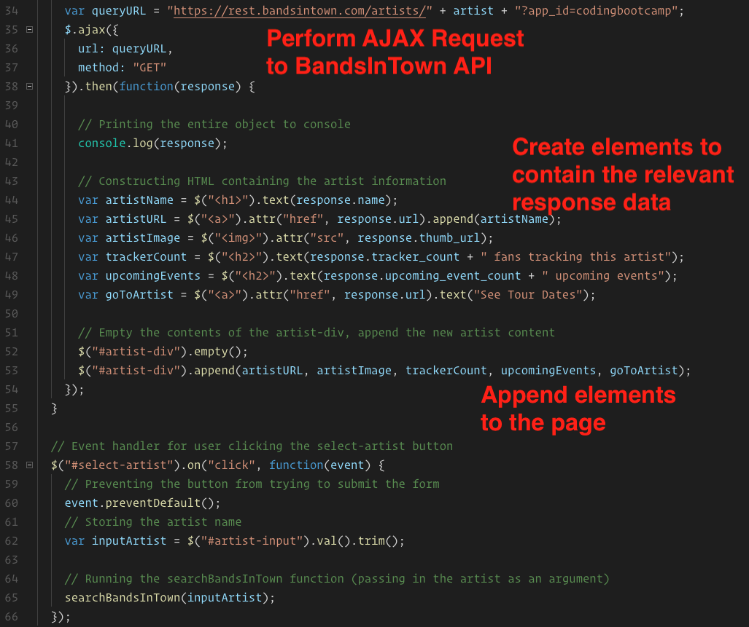
6-BandsInTown_1

Slide 33
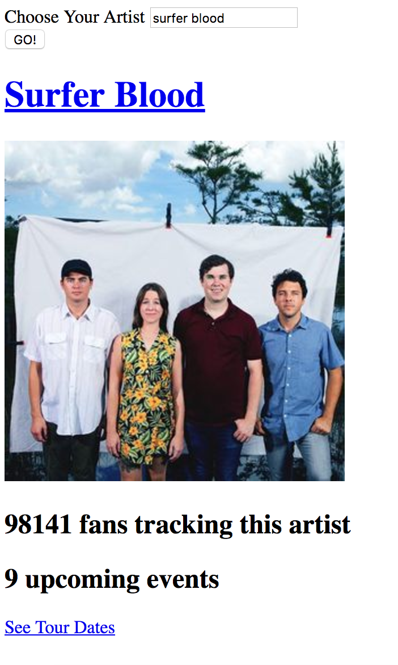
6-BandsInTown_2

Slide 34
Lesson Plan Feedback
How did today’s class go?
Went Well
Went Poorly

