Slide 1
12.2 Lesson Plan – Node Gets a SQL (6:30 PM)

Slide 2
12.2 Lesson Plan – Node Gets a SQL (6:30 PM)
Pre-class Drills
Instructor’s Notes
IMPORTANT: If you are using MySQL 8, you will need to have your class run the following query in the MySQL Workbench
ALTER USER 'root'@'localhost' IDENTIFIED WITH mysql_native_password BY 'yourRootPassword'
Failure to do so will result in
Error: ER_NOT_SUPPORTED_AUTH_MODE: Client does not support authentication protocol requested by server; consider upgrading MySQL client
MySQL in Node is VERY particular about the syntax that it uses and will return an error if it finds something isn’t right. Tell your students to be on the lookout for small issues with their syntax before thinking there is anything else wrong with their code.
Those students who struggled with either MySQL or Node might find today’s class difficult as well since it is built upon both of those concepts. If you can, try to help them catch up during the longer assignments if it looks as if they are having trouble.
Sample Class Video (Highly Recommended)
To view an example class lecture visit (Note video may not reflect latest lesson plan): Class Video

Slide 3
PreClass Challenge

Slide 4
PRECLASS Challenge
Write a function that takes an array of numbers and a function as parameters. The function parameter should do something to a numbers (increment, double, decrement, etc) and return the result. Your function should return the array that results from applying the function parameter to each element in the number array. var map = function(arr, callback){ }
Ex: Input: [1,2,3] function(num){return num * 2} Output: [2,4,6] Input: [1,2,3] function(num){return num + 1} Output: [2,3,4] Input: [1,2,3] function(num) {return num /2} Output: [.5, 1. 1.5] Input: [1,2,3] function(num) {return num - 2} Output: [-1, 0, 1]

Slide 5
PrecLASS CHALLENGE
var map = function(arr, callback){ var newArr = []; for (var i = 0; i < arr.length; i++){ var newNum = callback(arr[i]); newArr.push(newNum); } return newArr; }

Slide 6
Admin Items
jQuery $(Begins)

Slide 7
Administration… (10:00 – 10:05) 5 mins)
Homework 11 Due Saturday, 8/03/19 by 11:59pm
(NOTE: It’s Optional – but I recommend you do it anyway)
Video Guide: 12-mysql/VideoGuide.md
Use Tutors if you need them
When you get a SURVEY, be BRUTALLY HONEST!
Sign into BootCampSpot and mark your attendance
ALTER USER 'root'@'localhost' IDENTIFIED WITH mysql_native_password BY 'yourRootPassword’
Any Questions from Last Time?
jQuery $(Begins)

Slide 8
Class Objectives
To create a connection to a MySQL database using Node
To create, read, update, and delete data from a MySQL database using Node
To work with a group in taking a basic concept for a server side application and creating a working prototype for that application within a given time frame

Slide 9
1. Instructor Do: Welcome Class (6:30 PM - 6:32 PM) (2 mins)
Welcome your students to day 2 of MySQL!
Tell them that today we will be returning to JavaScript with our newly acquired SQL skills and combining them to create back-end applications that utilize MySQL data. In this way, they will essentially be learning how to manipulate back-end data through applications.

Slide 10
3. EVERYONE Do: Creating a Database (6:30 PM - 6:40 PM) (10 mins)
Instructions
Throughout this class we are going to be working on creating an application that takes in music data to create personalized playlists
Make sure to get as far as you can over the course of these assignments as the coding you do here will be extremely useful to you when you begin working on the homework
For now we will simply be creating your database in MySQL and then creating a connection to said database using Node. Remember, you must create a database before attempting to connect to it. Doing otherwise will return an error.
BONUS: Using MySQL Workbench, create a table in your database with four columns…
Primary Key of “ID” which auto-increments
A column called “title”
A column called “artist”
A column called “genre”
BONUS: Using MySQL Workbench, populate your table with a few rows of dummy data
BONUS: Start looking into how you can use the MySQL package to read data from a MySQL database

Slide 11
3. EVERYONE Do: Creating a PLAYLIST Database (6:30 PM - 6:40 PM) (10 mins)
DROP DATABASE IF EXISTS playlist_db;
CREATE DATABASE playlist_db;
USE playlist_db;
CREATE TABLE playlist(
id INTEGER AUTO_INCREMENT NOT NULL,
title VARCHAR(100),
artist VARCHAR(100),
genre VARCHAR(100),
PRIMARY KEY (id)
);

Slide 12
3. EVERYONE Do: ADDING DATA TO a PLAYLIST Database (6:40 PM - 6:50 PM) (10 mins)
INSERT INTO playlist (title, artist, genre) values (‘Rock Lobster’, ‘B-52s’, ‘New Wave');
INSERT INTO playlist (title, artist, genre) values (‘Old Town Road’, ‘Lil Nas X’, ‘Rap');
INSERT INTO playlist (title, artist, genre) values (‘Shake it Off’, ‘Taylor Swift’, ‘Swifty’);
ALTER USER 'root'@'localhost' IDENTIFIED WITH mysql_native_password BY ‘yourpassword'

Slide 13
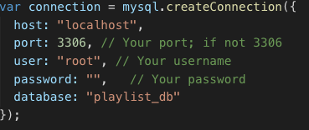
3. EVERYONE Do: Create Connection (6:50 PM – 7:00 PM) (10 mins)
12-mysql/01-Activities/08-playlistRead/
npm install mysql

Slide 14

4. EveRYONE DO Do: Connecting to a Database (7:00 PM – 7:10 PM) (10 mins)

Slide 15
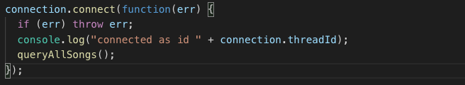
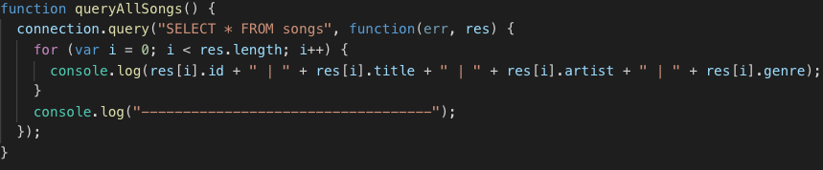
4. Everyone Do: Reading Data From a Database (7:10 PM – 7:20 PM) (10 mins)

Slide 16
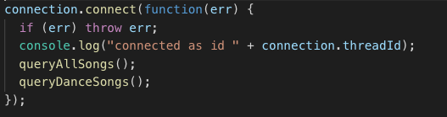
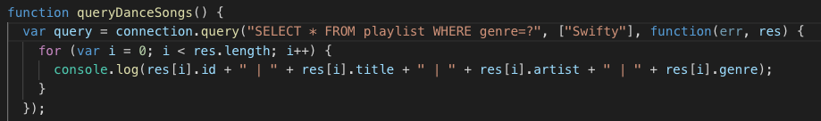
5. Everyone Do: Collecting Data From a Database (7:20 PM - 7:30 PM) (10 mins)

Slide 17
7. EVERYONE Do: CRUD Using Node (7:30 PM - 7:45 PM) (5 mins)
When creating programs that deal with databases, there is a rather fun acronym which a lot of programmers use in order to remind themselves which functions they have available to them. This acronym is CRUD :
C - CREATE
INSERT INTO pets (name, type, age) VALUES ("fido", "dog", 3);
R - READ - SELECT * FROM pets;
U - UPDATE - UPDATE pets SET name="under dog" WHERE type = "dog";
D - DELETE - DELETE FROM pets WHERE type = "mouse";

Slide 18
7. EVERYONE Do: CRUD: Using Node (7:30 PM - 7:45 PM) (15 mins)
function createSong() { console.log("Inserting a new song into playlist...\n"); var query = connection.query( "INSERT INTO playlist SET ?", {title: "Shake It Off", artist: ”Taylor Swift", genre: ”Swifty”}, function(err, res) { console.log(res.affectedRows + " songs inserted!\n"); // Call updateSong AFTER the INSERT completes // updateSongs(); } ); // logs the actual query being run console.log(query.sql); }

Slide 19
7. EVERYONE Do: CRUD: Using Node (7:30 PM - 7:45 PM) (15 mins)
function updateSong() { console.log("Updating all Taylor Swift songs...\n"); var query = connection.query( "UPDATE products SET ? WHERE ?", [{artist: ”Taylor Swift”}, {genre: "Pop Rock"}], function(err, res) { console.log(res.affectedRows + " products updated!\n"); // Call deleteProduct AFTER the UPDATE completes // deleteProduct(); } ); // logs the actual query being run console.log(query.sql); }

Slide 20
7. EVERYONE Do: CRUD: Using Node (7:30 PM - 7:45 PM) (15 mins)
Deleting MySQL data through Node is almost entirely identical to a READ query that includes a WHERE statement within it. Not much else to it other than that.
function deleteSong() { console.log("Deleting ‘New Wave’...\n"); connection.query("DELETE * FROM playlist WHERE genre=‘New Wave’", function(err, res) { if (err) throw err; console.log(res.affectedRows + " products updated!\n"); // Call console.log(res.affectedRows + " products updated!\n"); // Call deleteProduct AFTER the UPDATE completes AFTER the UPDATE completes }); }
Students should already be familiar with reading data at this point but ask your class if they have any questions and answer them as best you can before moving onto the next activity.

Slide 21
7. EVERYONE Do: CRUD: Using Node (7:30 PM - 7:45 PM) (15 mins)
Deleting MySQL data through Node is almost entirely identical to a READ query that includes a WHERE statement within it. Not much else to it other than that.
function readSongs() { console.log("Selecting all products...\n"); connection.query("SELECT * FROM products", function(err, res) { if (err) throw err; // Log all results of the SELECT statement console.log(res); connection.end(); }); }
Students should already be familiar with reading data at this point but ask your class if they have any questions and answer them as best you can before moving onto the next activity.

Slide 22
8. Students Do: CRUD Playlist (7:37 PM - 7:57 PM) (20 mins)
Slack out the following instructions.
Instructions
It’s time to start making our playlist application a little more functional through including all four C.R.U.D elements within it.
Add in some pieces of code that CREATE, UPDATE, and DELETE specific pieces of data from your MySQL database. Make sure to include a READ statement at the end as well to ensure that the changes you are making are working properly.
BONUS: After successfully adding CRUD to your application, it’s time to test your mettle and see if you can make it so this app is more dynamic. Add the ability for users to dynamically input their own data into the database using the Inquirer NPM package.
HINT: Recall that you can create MySQL queries which include variables using question marks. Proper usage of this will help you quite a bit.
HINT: Remember to take into account the scope of Inquirer package when putting your application together.

Slide 23
9. BREAK (7:57 PM - 8:12 PM) (15 mins)

Slide 24
10. Groups Do: Great-Bay (8:12 PM - 9:12 PM) (60 mins)
12-mysql/01-Activities/10-GreatBay
Instructions
Create a sign up and login system that prompts users for a username and password upon loading up the app. Do not worry about setting up a truly secure database if you choose to tackle this addon. Just worry about building working sign up and login features.
Create a system on the “POST AN ITEM” which allows users to look at the auctions they have created. On this screen they can add new auctions, modify previous auctions, or close bidding on an auction.
Create a system which allows users to view all of the auctions of which they are the leading bidder.
Create a third option on the main screen which allows administrators to modify the database as they see fit.
Create visually appealing tables. This means making dynamic console code and it is a lot harder than it might seem at first so do not think this one is so simple.
Create a search function that allows users to look through the database of available auctions to find those that share the specified keyword or username.

