Slide 1

Employee Retention Optimization via A.I.
Scott Daniel Ellis (AR33133)
Philip Appiah (DW76815)

Slide 2
Overview
Issue: It can be difficult to identify when an employee is leaving.
Objective: Identify what factors lead to this.
Data-based decision-making
Constraints: Limitations in data (scale and scope)
A.I. predictions on historical data
Constraints: Accuracy of A.I. predictions
Emphasis on employees who are leaving
Our predictions are reasoning-agnostic
We don’t know why employees left; not even whether they were fired or quit

Slide 3
Data
Based on 300,000 records, we have data covering the following fields:
Left
AnnualLeaveDays | JobEngagementScore | PhysicalActivityScore | SupervisorReview*
AttendanceRate | JobInvolvement | PreviousSalary | TeamSize
Certifications | MentalWellbeingScore | ProjectComplexity | TechSkillLevel
DepartmentCode | MentorshipReceived | Salary | TrainingHours
Dependents | NumOfProjects | SelfReview* | WorkLifeBalance
Distance* | OnsiteOpportunities | SkillDevelopmentCourses | WorkSatisfactionScore
Gender | PeerFeedbackScore | StressLevel | YearsWorked
*Note: Some (<0.1%) distances and reviews were missing and had to be imputed

Slide 4
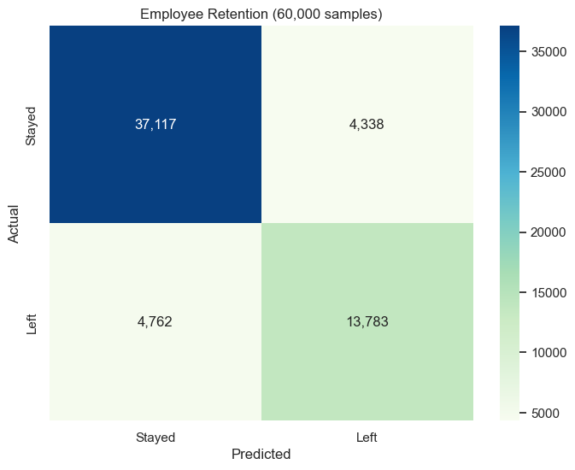
Model Performance
Balanced Accuracy (F1-score): 83%
“Left” prediction accuracy (recall): 74%
This indicates that our model is fairly well-performing; it is good at predicting whether an employee has left or not, given the supplied data.
Since our model has strong results here, it is likely that it’s decision-making process will be useful.

Slide 5
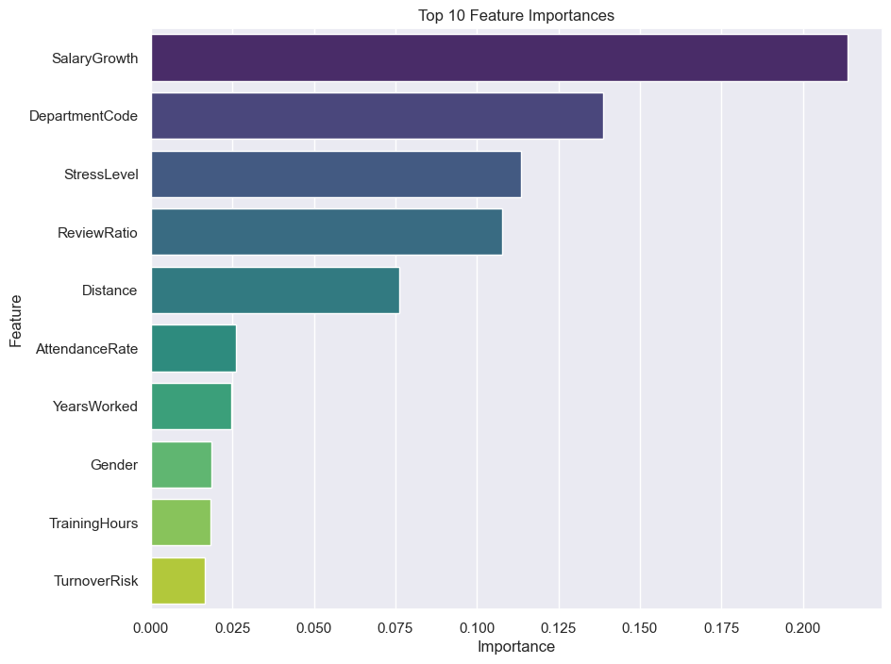
Feature Importance
SalaryGrowth: Percentage growth of current salary from previous salary.
DepartmentCode: Categorical code representing different departments within the company.
StressLevel: Quantitative measure of an employee's reported stress at work.
ReviewRatio: Ratio of self-evaluation scores to supervisor evaluation scores.
Gender: Categorical variable indicating the employee's gender.
AttendanceRate: Proportion of days attended over possible workdays.
YearsWorked: Total number of years an employee has worked for the company.
Distance: Geographical distance from employee’s residence to workplace.
TrainingHours: Number of hours an employee spent in training sessions.
TurnoverRisk: Calculated risk of an employee leaving, based on stress and engagement scores.

Slide 6
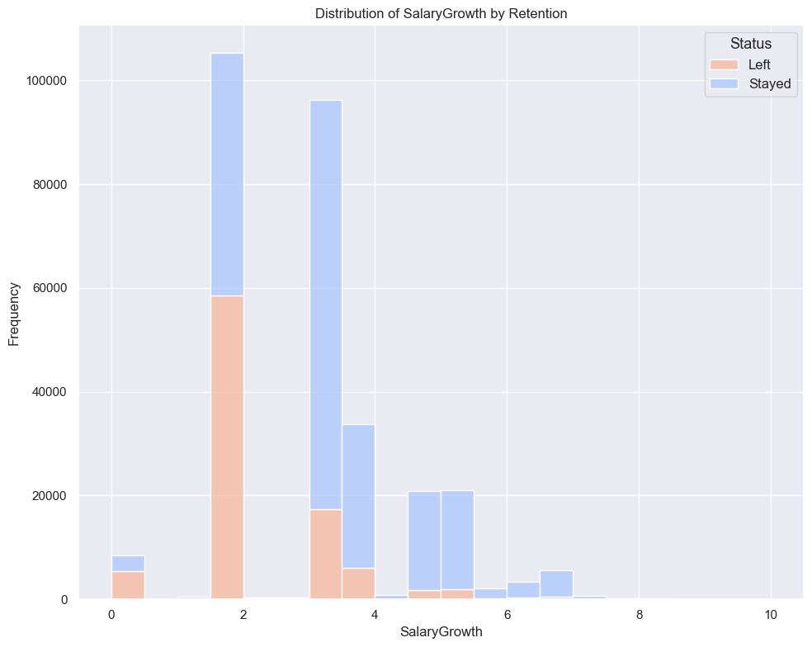
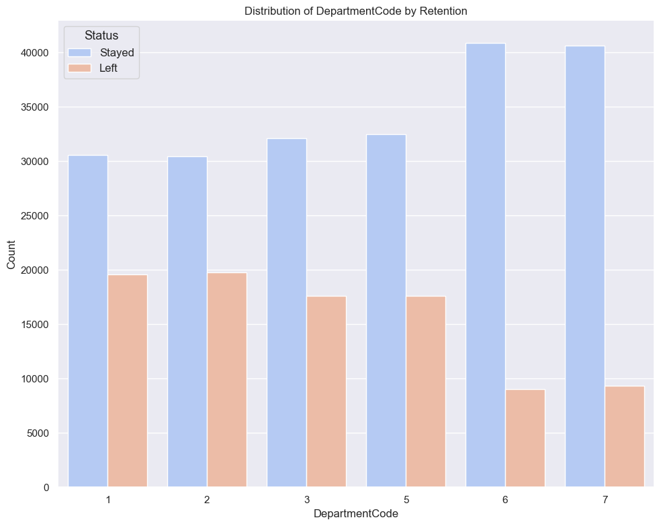
Actionable Features

Slide 7
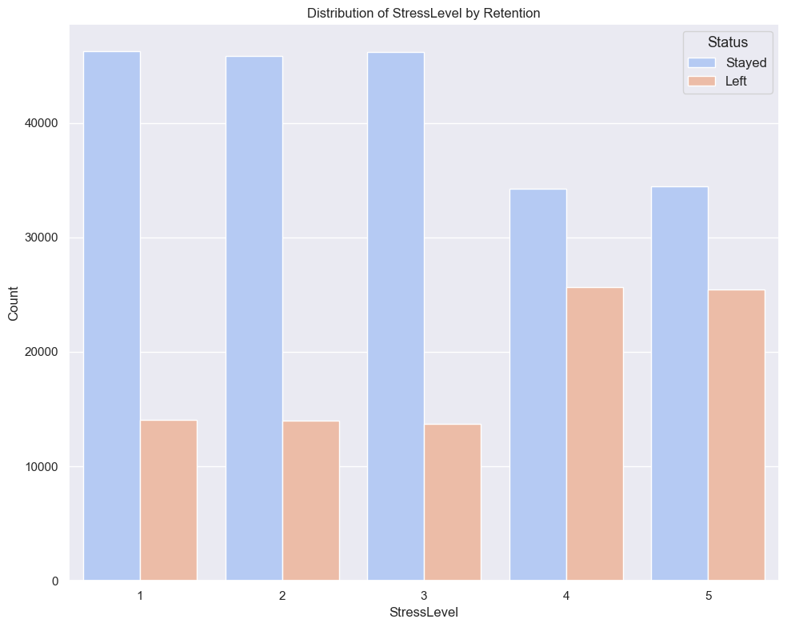
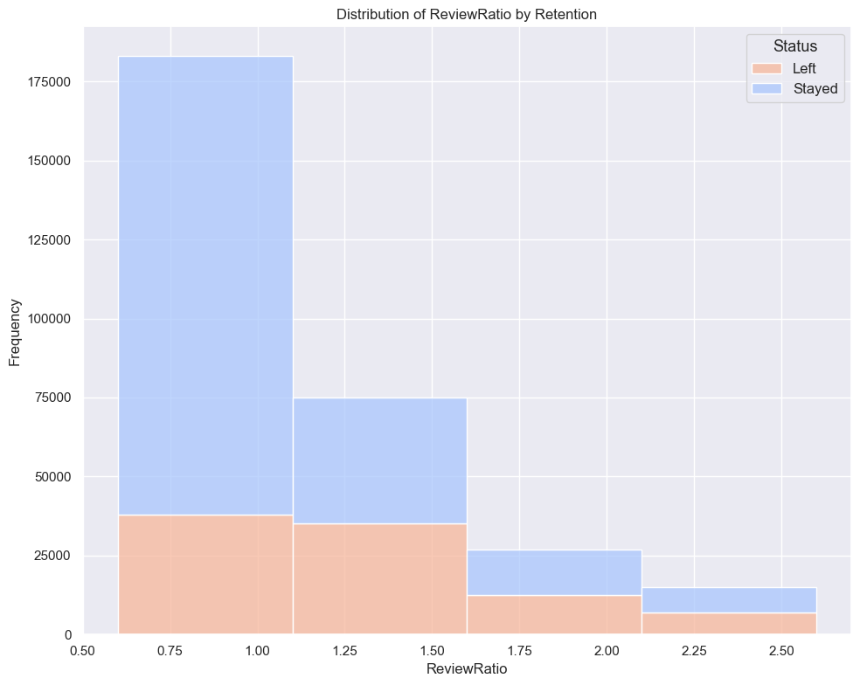
Indirectly Actionable Features

Slide 8
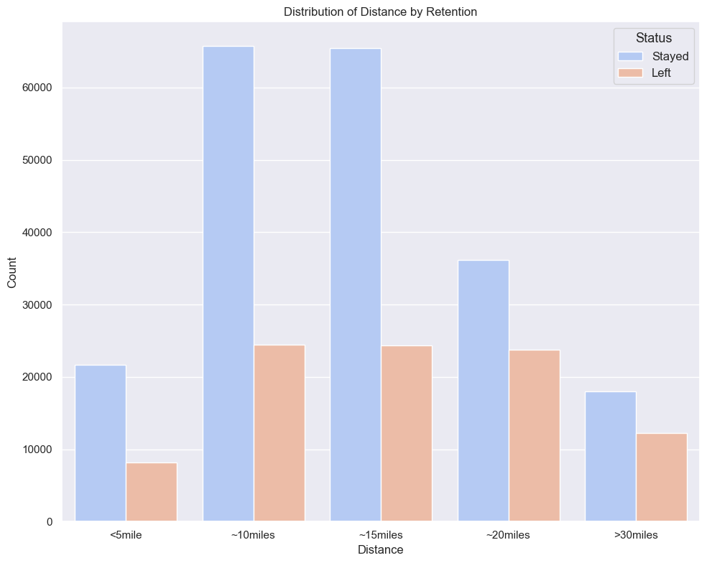
Other Features
“Low Importance” Features | Importance
AttendanceRate | 2.62%
YearsWorked | 2.46%
Gender | 1.85%
TrainingHours | 1.83%
TurnoverRisk | 1.65%
DependentsImpact | 1.52%
OverallHealthScore | 1.32%
FeedbackToSatisfactionRatio | 1.30%
NumOfProjects | 1.29%
TeamSize | 1.29%
TrainingParticipationRate | 1.29%
TrainingEngagementScore | 1.23%
StressEngagementInteraction | 1.11%
AnnualLeaveDays | 1.06%
MentalWellbeingScore | 1.05%
PhysicalActivityScore | 0.98%
EngagementIndex | 0.93%
LeaveUtilizationRate | 0.89%
WorkLifeBalance | 0.82%
AverageEngagementScore | 0.79%
TechSkillLevel | 0.77%
Certifications | 0.76%
JobInvolvement | 0.75%
ProjectComplexity | 0.73%
JobEngagementScore | 0.66%
PreviousSalary | 0.65%
Salary | 0.63%
Dependents | 0.55%
WorkSatisfactionScore | 0.50%
PeerFeedbackScore | 0.45%
OnsiteOpportunities | 0.28%
MentorshipReceived | 0.28%
SelfReview | 0.27%
SupervisorReview | 0.27%
SkillDevelopmentCourses | 0.22%

Slide 9
Questions?

