Slide 1


Group ace
Ismael kipkoech
Samira mohammed
Philip mwasi
Violet momanyi
Fredrick ndenga

Slide 2
introduction
In the realm of HIV care, uninterrupted continuation of Antiretroviral Treatment(ART) plays a pivotal role in ensuring positive health outcomes for patients. To address this, our challenge is to develop an advanced predictive model utilizing both machine learning and deep learning techniques.
Statement of the Problem.
To develop a predictive model using machine learning and deep learning techniques to stratify HIV patients into high, medium and low risk groups based on their likelihood to discontinue Antiretroviral Treatment(ART).
This model aims to facilitate targeted interventions and resource allocations by healthcare providers to patients, improving patient outcomes and reducing the burden on the health care system.

Slide 3
Project objectives
Resource allocation optimization - to ensure targeted interventions and personalized care plans for high-risk patients.
Early intervention planning - enable healthcare providers plan early interventions for high risk patients to reduce treatment interruptions hence improving overall health and wellbeing of patients.
Integration with healthcare systems - design the model to seamlessly integrate into existing healthcare information, making it practical for use by healthcare professionals.
Continuous model improvement - regularly updating of the model to maintain relevance and accuracy, with ongoing data collection and evolving patient profiles.

Slide 4
Dataset overview
We used a synthetic dataset. It contains 15 variables of study, each offering valuable insight into which factors that may influence the likelihood of discontinuation of ART, but the key variables include;
Viral Load(VL) – the amount of HIV cells in the patients body.
CD4 – a type of white blood cells that help the immune system fight infections.
Base drug combo – the initial drug combination prescribed to the patient.
Comp INI(Completion of Initial Treatment), Comp NNRTI(Non-Neucloside Reverse Transcriptase Inhibitor Component), Extra PI( Extra Protease Inhibitor) – components of drug regimen, additional inhibitors and pharmacokinetic considerations.

Slide 5
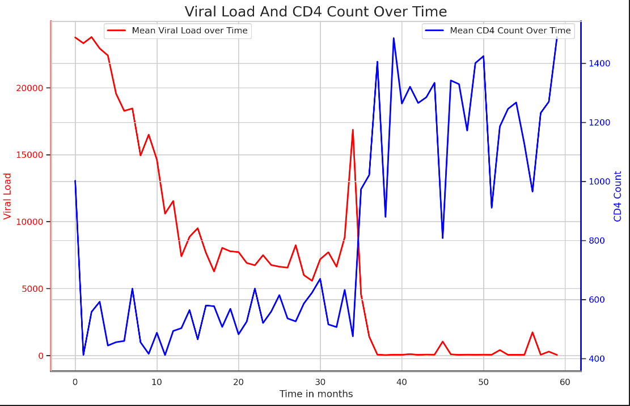
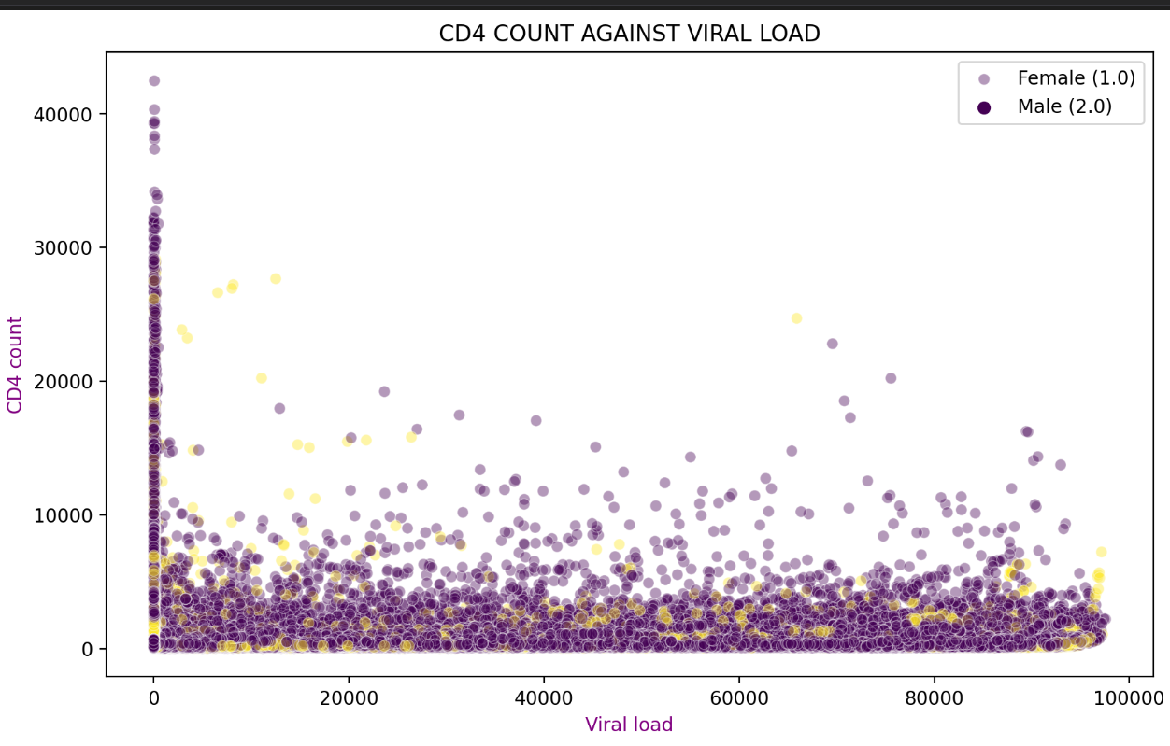
METHODOLOGY
EXPLORATORY DATA ANALYSIS
The scatter plot helps us gain insights about the prevalence of HIV patients based on their gender as well as the relationship of the CD4 count with the viral load. There is an inverse relationship between the viral load and CD4 count.
The plot shows that as the patient regularly takes medication ,the viral load gradually decreases while the CD4 count increases hence improving the patient health status.

Slide 6
Data preprocessing – there were no missing values nor duplicates in the dataset, therefore the data was ready for modelling. We split the data into training and testing sets. This ensures that you train your data on one subset of data and evaluate its performance on another unseen subset of data.
Feature Engineering – a new column of ‘discontinuation likelihood’ was created from viral load, CD4, and Comp. INI(Completion of Initial Treatment).
Modelling – we used machine learning models and deep learning models. The following is an illustration of the machine learning models that we used;

Slide 7

Machine Learning Models
Support Vector Machine:
Good for finding the hyperplane that best separates different classes.
Logistic Regression:
It provides the probability of a patient discontinuing treatment, and coefficients can indicate the influence of different features.
Random Forest
Captures complex relationships and interactions between features.
Gradient Boosting:
They excel in capturing subtle patterns in the data.
It can handle both structured and unstructured data effectively
t

Slide 8
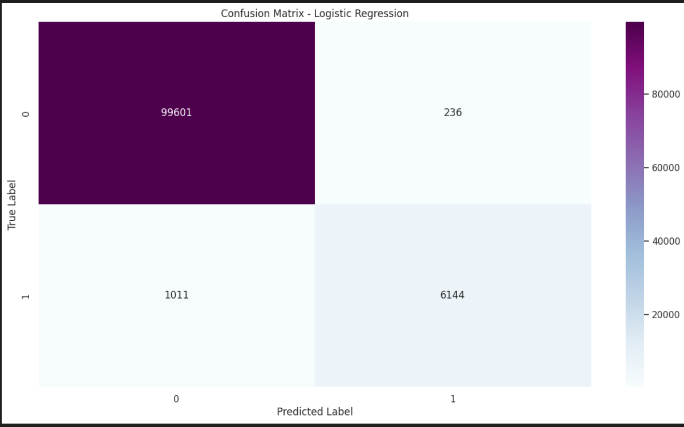
LOGISTIC REGRESSION
Predicting ART Discontinuation: A Machine Learning Approach
High Accuracy (98.38%) - The model effectively classifies patients at risk of stopping HIV treatment.
Precise Interventions (97.29%) - Most patients flagged for discontinuation truly stop treatment, minimizing unnecessary interventions.
Room for Improvement (77.89% Recall) - The model misses some patients who actually discontinue therapy. This highlights the need to capture more at-risk individuals.
Strong Overall Performance (F1 Score: 0.865) - Despite the lower recall, the model balances precision and completeness well.
Next Steps: We can improve the model to better identify all high-risk patients, ensuring timely interventions and improved patient outcomes.
Accurate: Catches most at-risk (high accuracy).
Sharp: Avoids unnecessary interventions (low false positives).
Room to Improve: Misses some who stop treatment (high false negatives).
Focus Here: Improve recall to ensure all high-risk patients get help.

Slide 9
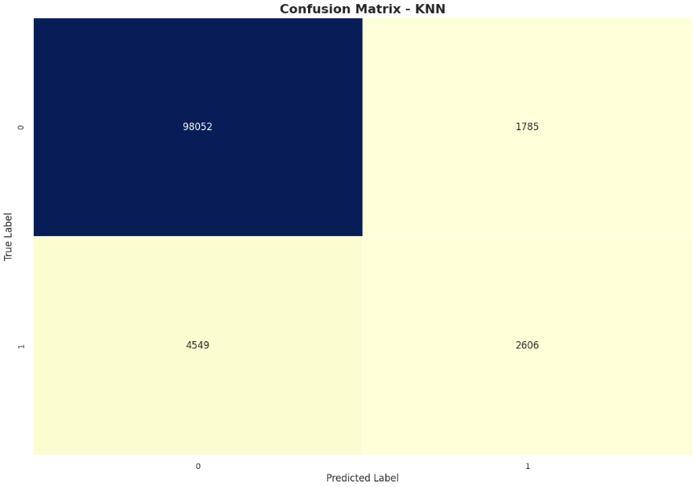
KNN -NEIGHBOURS
True Positives (TP): The model correctly identified patients at risk of discontinuing ART, which is crucial for intervention and support.
True Negatives (TN): The model correctly identified patients who are not at risk of discontinuing ART, ensuring they receive appropriate care without unnecessary interventions.
False Positives (FP): While there are some false positives, indicating instances where the model predicted discontinuation incorrectly, it's essential to consider the consequences of false positives, such as potentially unnecessary interventions or additional healthcare costs.
False Negatives (FN): Similarly, false negatives represent instances where the model failed to identify patients at risk of discontinuing ART. While this could lead to missed opportunities for intervention, it's crucial to balance false negatives with false positives and overall model performance.

Slide 10
Deep Learning Models
01
02
03
04
Feedforward Neural Network:
It learns complex relationships in the data. It's suitable for capturing non-linear patterns and dependencies
Convolutional Neural Network:
Automatically learns hierarchical features if the dataset involves any form of spatial data(images)
Recurrent Neural Network :
Captures sequential dependencies if there is temporal aspect to the data, providing insights into how changes over time influence the likelihood of discontinuation.
Ensemble Models :
Combining predictions from various modelsfor example machine learning and deep learning models often yields superior results.

Slide 11
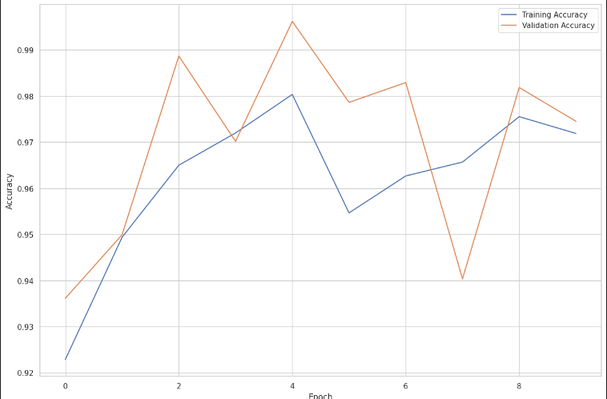
BASELINE MODEL
This model has an accuracy of 94.44% which means that the model correctly predicts the discontinuation likelihood for the vast majority of the cases in the data set.
The business implication is that the model can potentially assist businesses in identifying cases where discontinuation is probable. By leveraging the predictions provided, businesses can take proactive measures to mitigate the factors contributing to discontinuation thereby enhancing customer satisfaction.
Limitations of the model
While the accuracy is very high, there may be some cases where the predictions are incorrect. Further analysis of misclassified cases(false positives and false negatives), can provide more insights into areas where the model struggles.

Slide 12
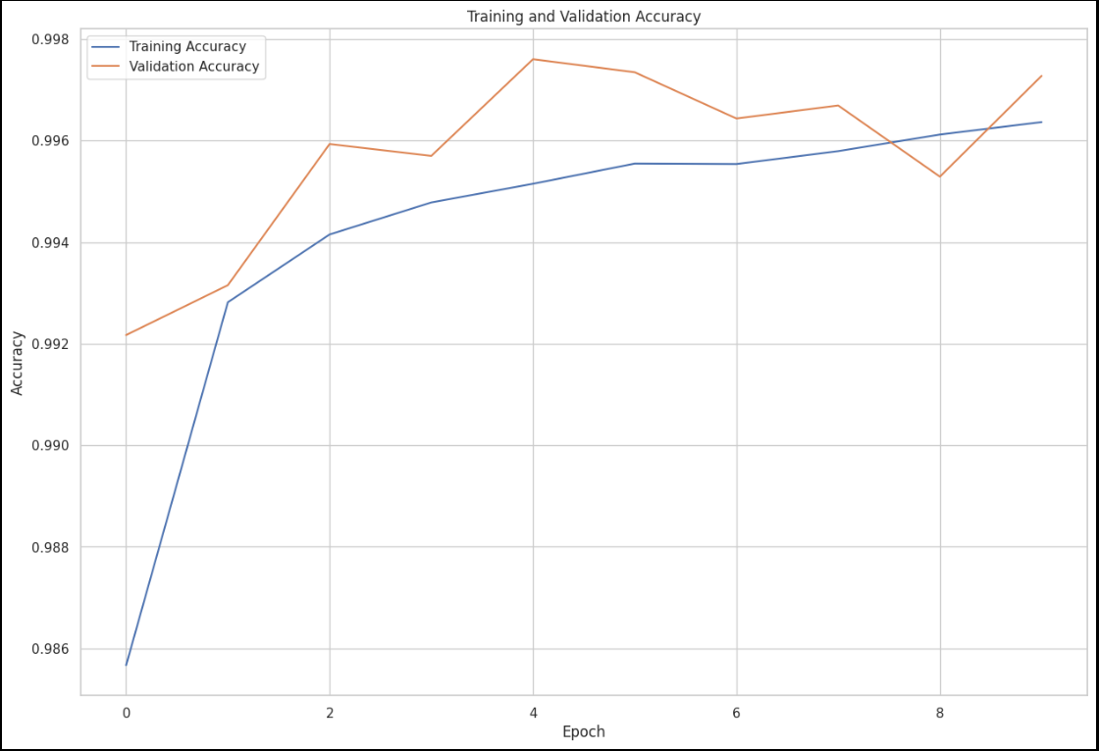
Feedforward neural network
This model has an accuracy of 93.31%, therefore indicates that it performs well in classifying the data. This accuracy suggests that the model is effective in predicting the target variable(discontinuation likelihood), which in business context means that it can identify cases of potential discontinuation with high accuracy.
Limitations of the model
It has a considerably high loss(22004.02), which indicates that the model might not be optimized effectively. A high loss value suggests that there is a discrepancy between the actual and predicted values which could affect the reliability of the models predictions.
Compared to the LSTM & GRU models which achieved much higher accuracy and lower loss, the performance of feedforward neural network model is relatively inferior and it may not be able to capture the complex relationships present in the data.

Slide 13
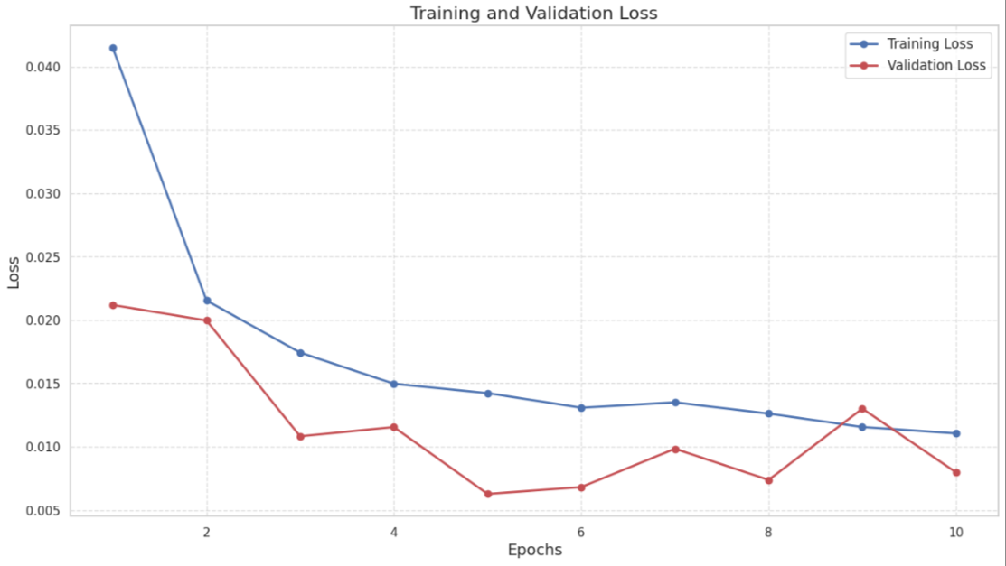
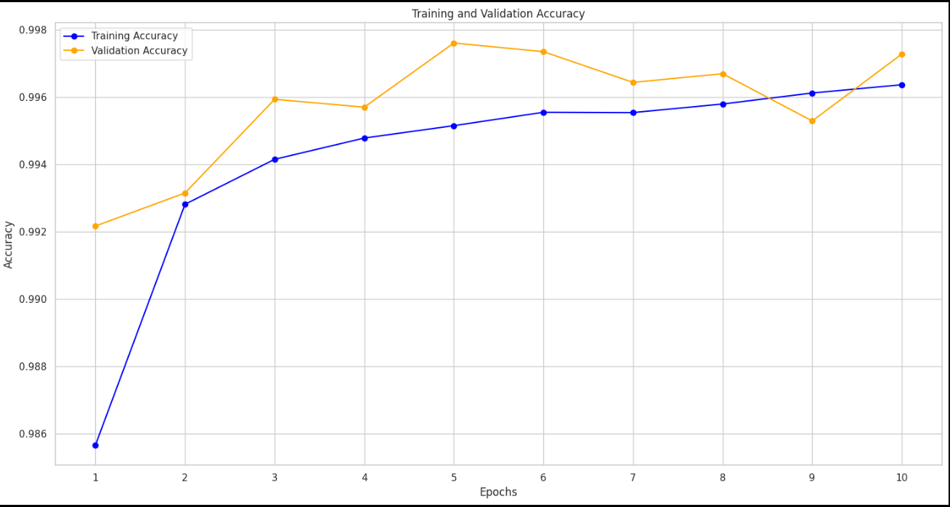
Long short-term memory network(lstm) and a gated recurrent unit(gru)
Long Short-Term Memory Network
Gated Recurrent Unit

Slide 14
The LSTM model has an accuracy of 99.92% and a loss value of 0.0023. The GRU has an accuracy of 99.92% and a loss value of 0.00229. Both have generally high accuracy, therefore they can accurately classify the data during validation.
They demonstrate strong generalization are likely to be reliable for making predictions in practice.
Limitations of the LSTM & GRU models.
Potential overfitting – the small difference between training and validation accuracy(99.92%) suggests that there is little to no overfitting. However, low validation loss(0.0023) indicates that the models are not memorizing training data but instead capturing general patterns.

Slide 15
Overall limitations
Data quality - we didn’t have enough data so we had to simulate others.
Assumptions - we made some assumptions in our dataset which may not fully capture the real world clinical scenarios.
Ethical considerations and privacy issues.
Generalizability - our data is limited to the population represented in the dataset.
Recommendations
More data so that we can make more accurate predictions about real world data.
Using domain knowledge we need an expert in the field for guidance.
More time to make consultations, to ensure that the model performs exceptionally.
Longitudinal data analytics, techniques like temporal trends, time dependent covariates and sequential patterns in HIV treatment and disease progression.

Slide 16
Project outcomes
Stakeholder outcomes:
Enable health care providers to deliver more personalized and targeted interventions, enhancing the quality of care of HIV patients.
Patients to benefit from tailored interventions and to promote better adherence to treatment plans.
Optimized resource utilization in healthcare institutions, leading to improved efficiency.
Societal outcomes:
Improved patient adherence to treatment reduces the viral load in the body, and consequently reduces the risk of transmission within the community.
Enhanced risk stratification ensures that healthcare resources are distributed equitably, addressing health disparities among different groups.
Reduced costs associated with management of HIV patients due to fewer hospitalizations.
Successful implementation and adoption of advanced technologies in healthcare.

Slide 17
conclusion.
In conclusion, the development and implementation of predictive models offers benefits to the society at large. This innovative approach has the potential to revolutionize patient care and contribute to broader public health objectives.
The successful implementation of this project can transform healthcare delivery, leveraging data-driven insights to tailor interventions and improve overall wellbeing of HIV patients.
The collaborative efforts and advancements made in healthcare analytics can pave way for similar initiatives, shaping the future of healthcare toward a more personalized, efficient and equitable system.

