Slide 1
Meeting vom 14.08.

Slide 2
Formrekonstruktion
Conditioning with crossattention blocks in the U-net
One version with direct tokenization on the shape waypoints with convolution layers
Second version with spectral fourrier projection and tokenization with spectral coefficients

Slide 3
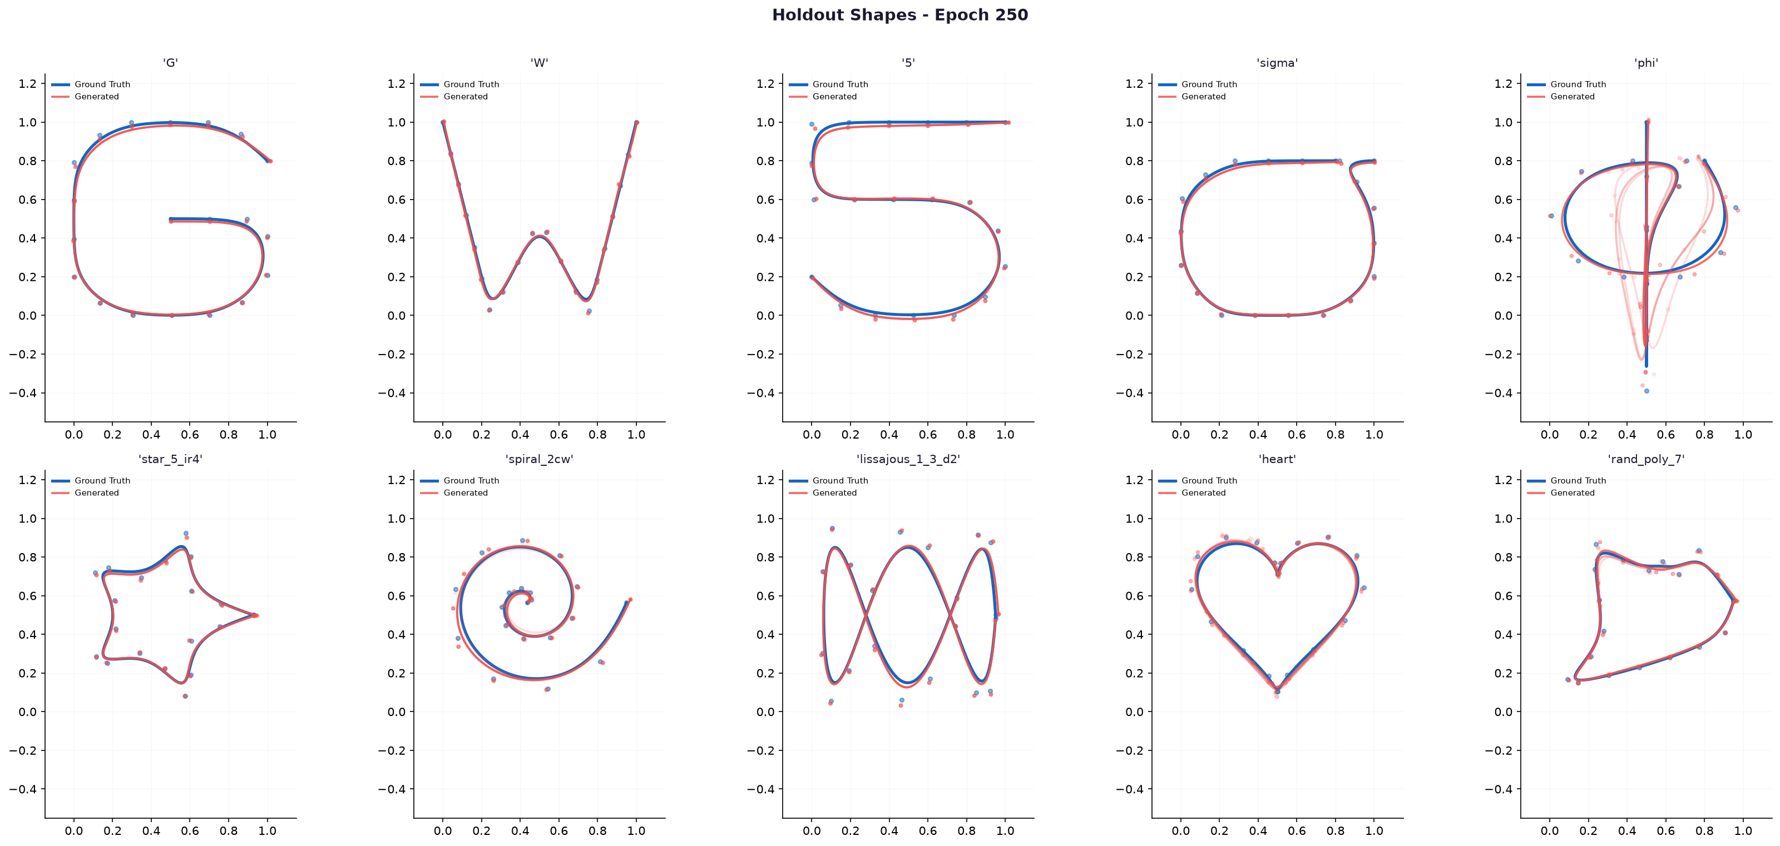
Waypoints

Slide 4
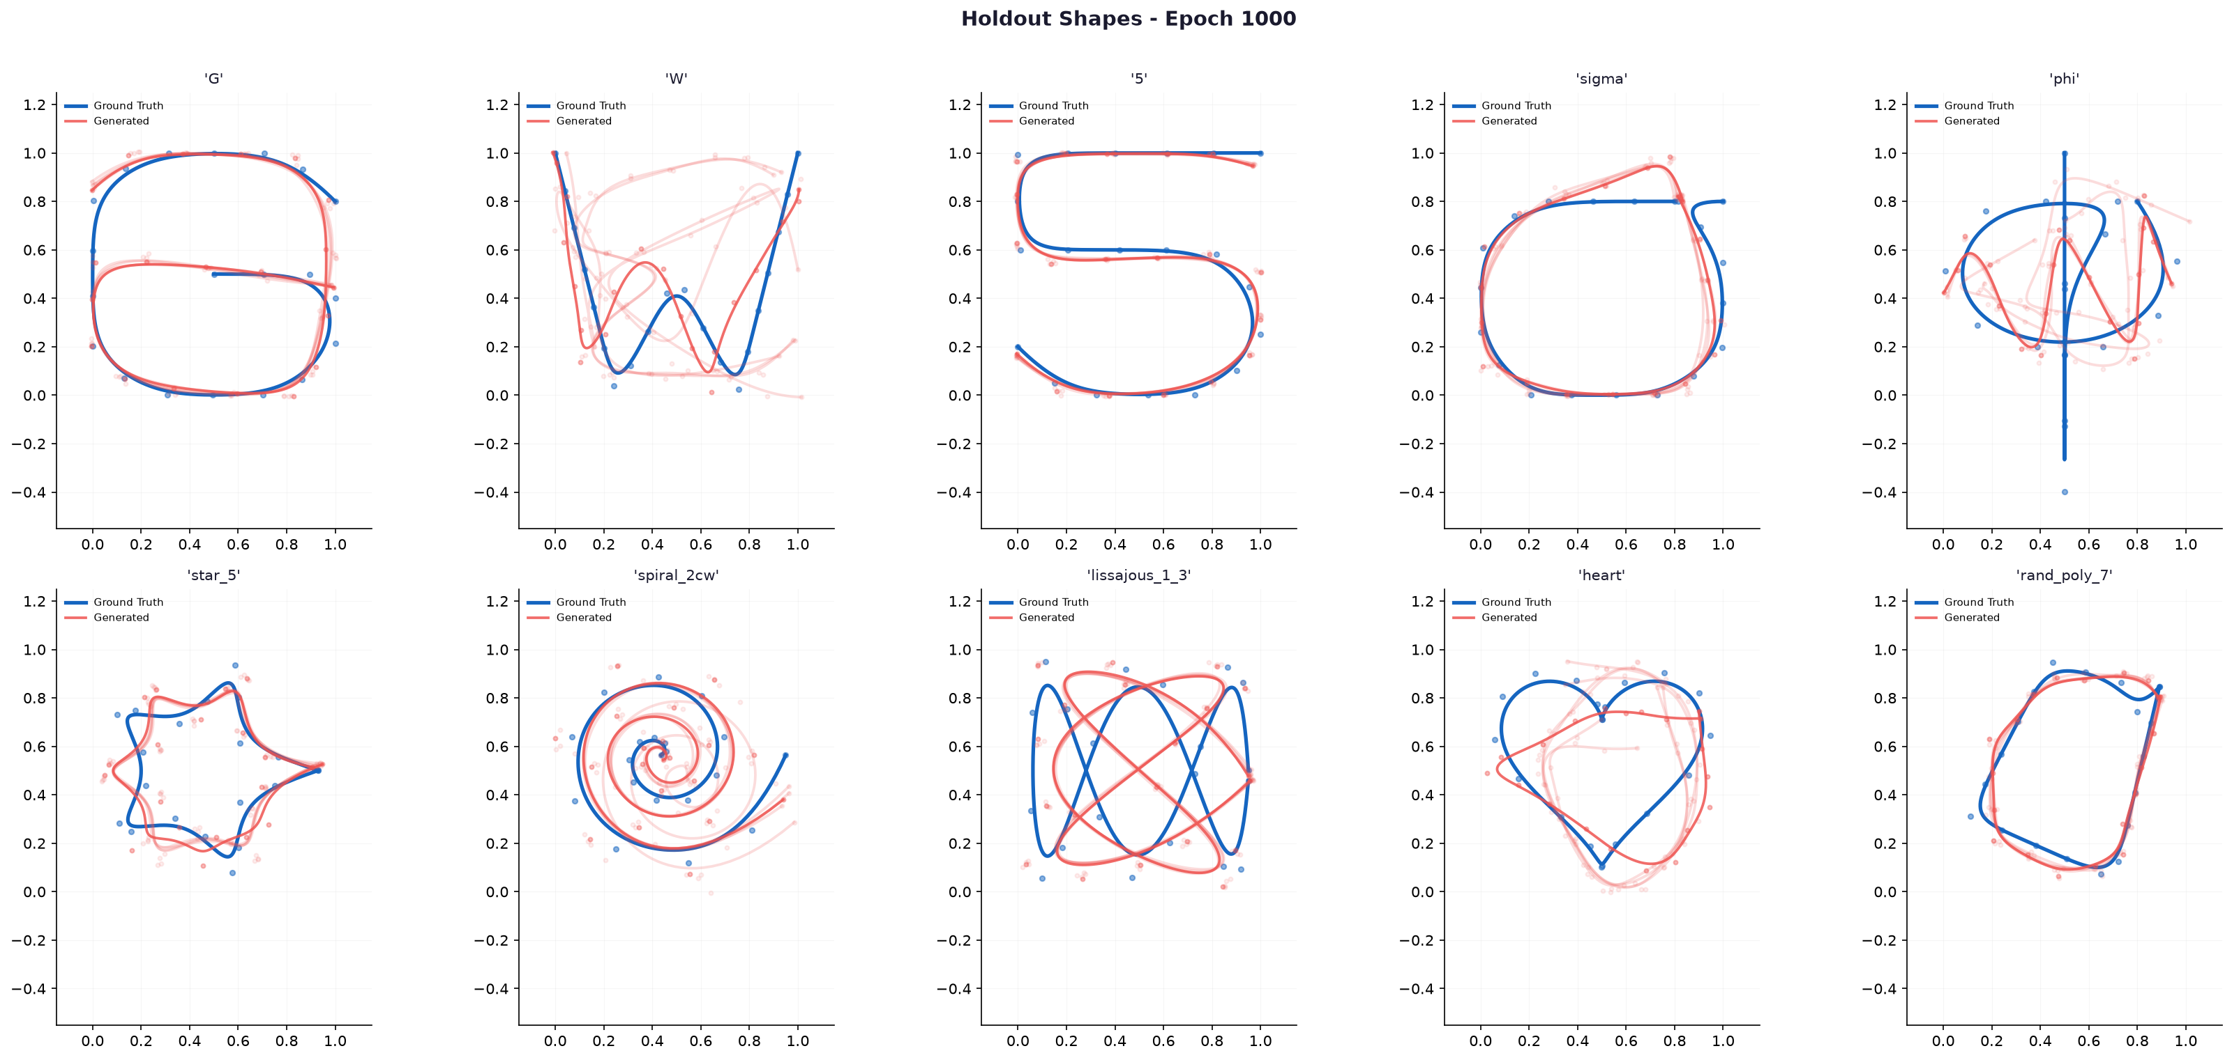
Spectral

Slide 5
Tested ergodic coverage learning
Dataset created: Generated 750 shapes
  Random shapes, shapes based on numbers, (asian) letters etc.
  Sum of gaussian distributions either as lines with gaussian decay or gaussians with defiened covarainces and averages put together
Target trajectory:
  Connect the high probability areas. Define wavy pattern along covariances
  SVGD solver applied to heuristical initialization

Slide 6
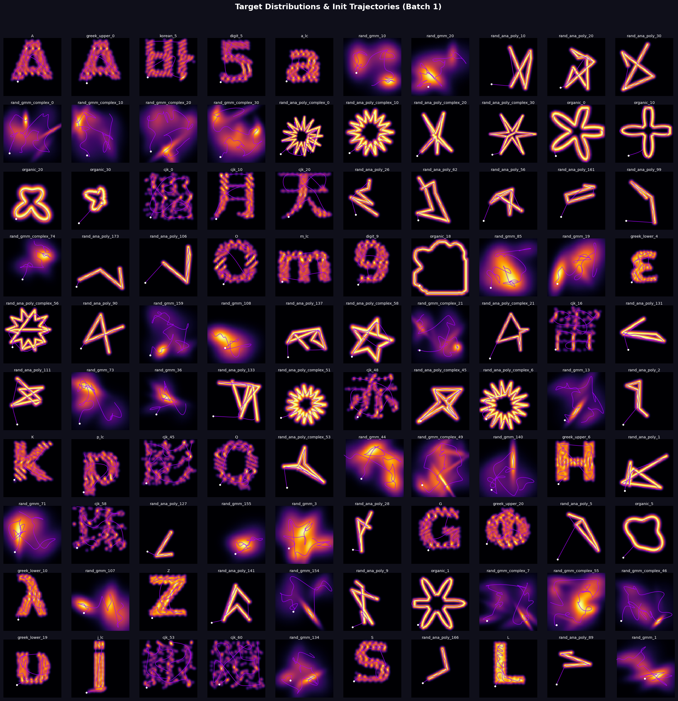
Dataset

Slide 7
Ergodic coverage flow matching
Conditioning based on sampling particles on the target distribution with a third attribute representing the target density value
Also tried spectral decomposition but refuted due to better pointwise conditioning and possible advantages for creating the target density in the first place

Slide 8
Architecture flow matching
Noisy trajectory
Sinusoidal Time embedding
Particle Conditioning
MSE
loss
Film conditioning
U-net architecture
Trajectory
Prediction for
timestep

Slide 9
Architecture flow matching + ergodic loss
Noisy trajectory
Sinusoidal Time embedding
Particle Conditioning
Linear extrapolation of final trajectory
→ ergodic trajectory loss
+
MSE
loss
Film conditioning
U-net architecture
Trajectory
Prediction for
timestep

Slide 10
Architecture self supervised
Noisy trajectory
Particle Conditioning
Ergodic trajectory loss
+
Diversity loss
U-net architecture
Trajectory
Prediction

Slide 11
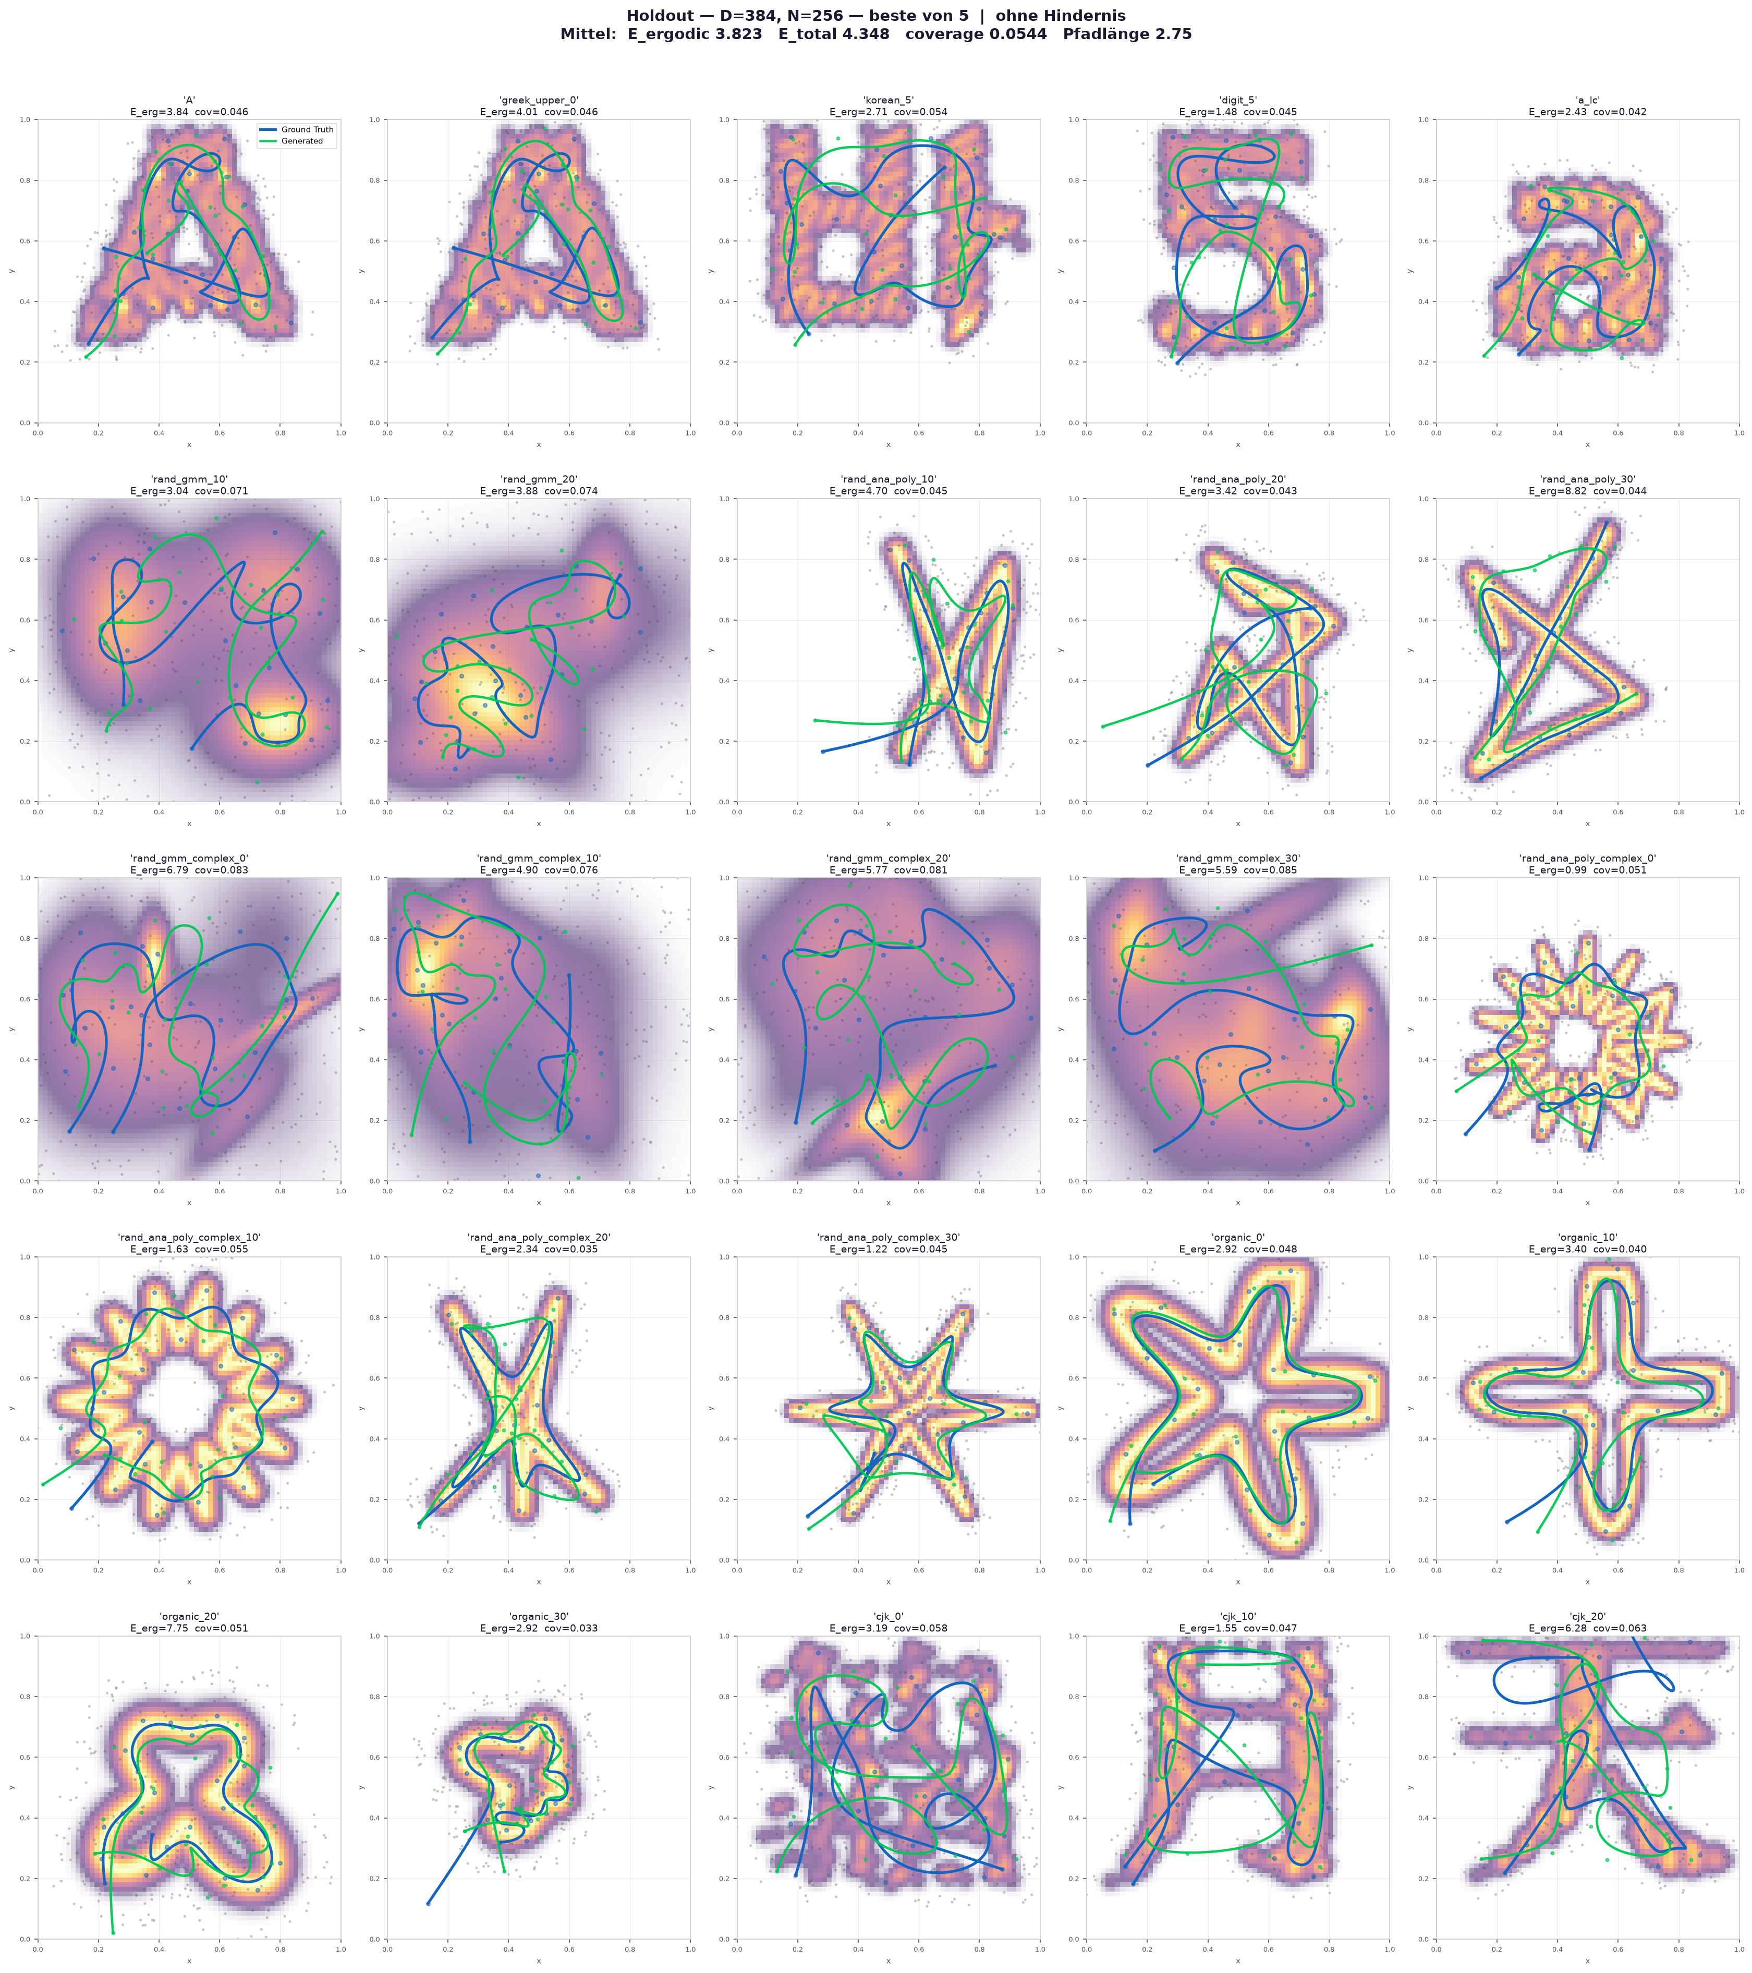
Results: flow matching

Slide 12

Results: flow matching + ergodic loss

Slide 13

Results: self supervised

Slide 14
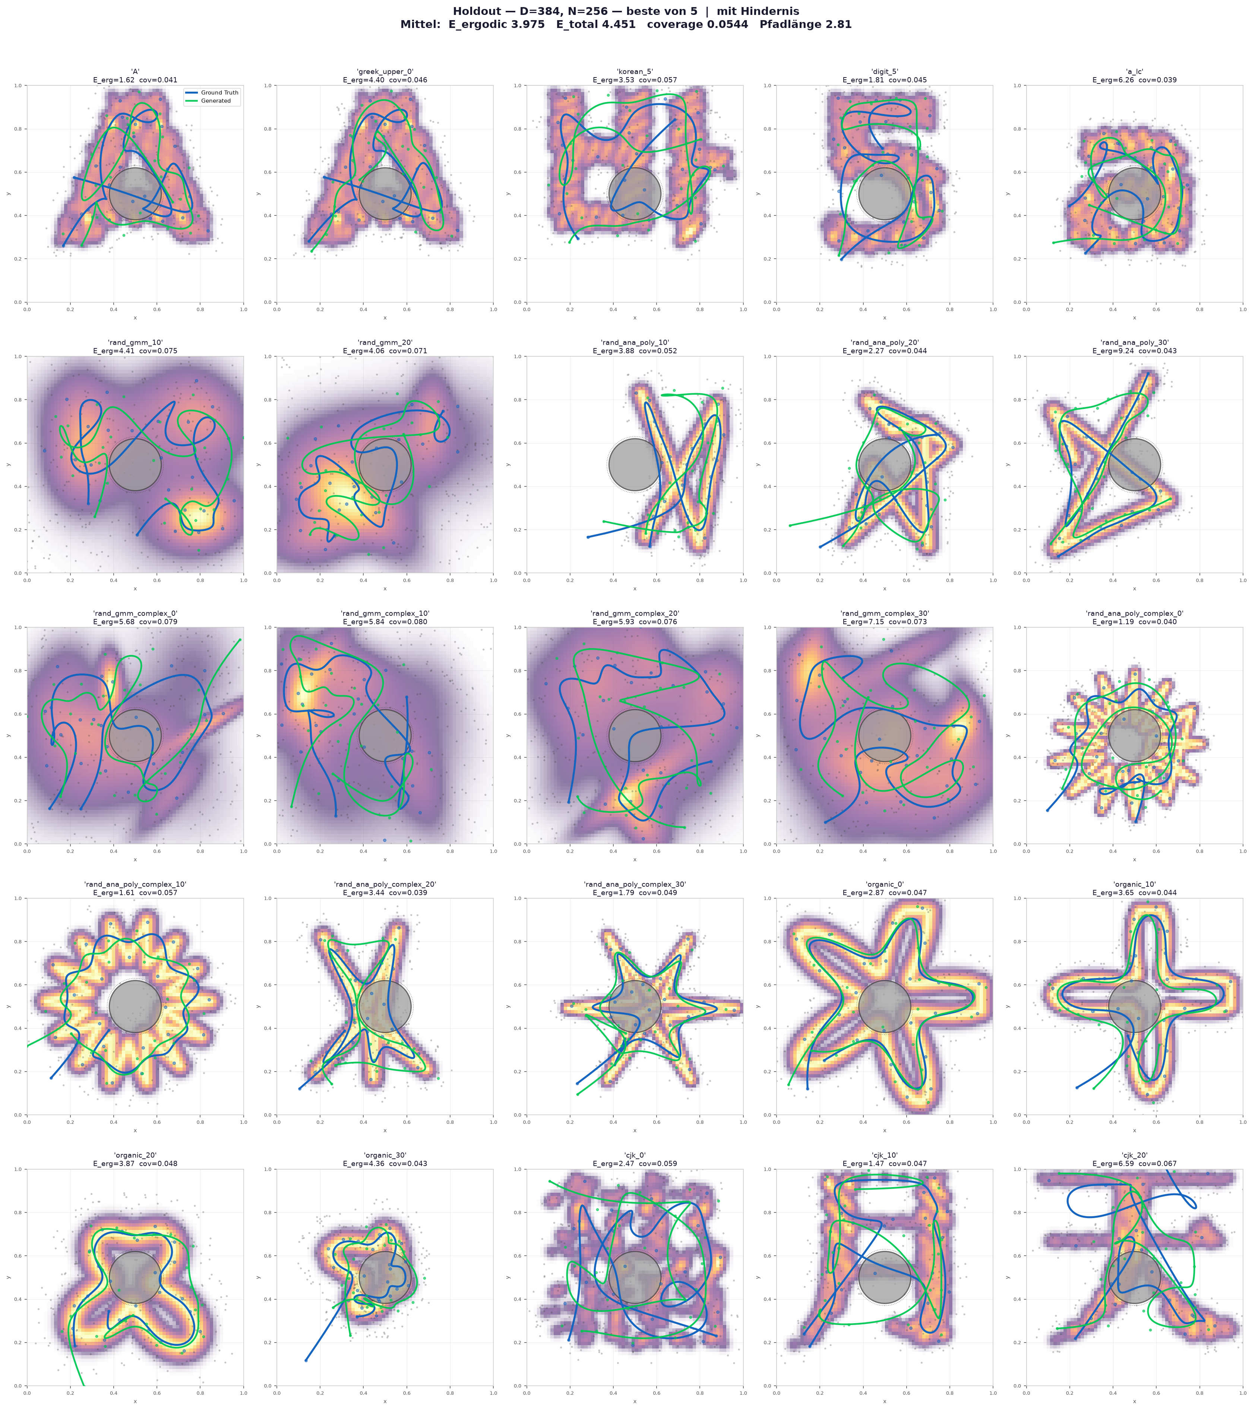
Obstacle inference
Calculate rupulsion force during each euler step during inference
Plus further steps only for applying the obstacle force

Slide 15
Questions/Plans for next week
Include pictures as the biginning of the conditioning pipeline
3D Transfer
Orientaion constraints

