Slide 1
Liora – Project CO2-Emission in France 2013
Philipp Drixelius Jan Oliver Hämmerling Agathe Hoffmann

Slide 2

Introduction
Data Provided
Data about emissions of vehicles, with other specifications
Project Objective Information
Identify technical polluting characteristics & prediction – with Data Analyst focus
and potential
Datasets
ADEME-cataloque of French administration from 2013: 44,850 vehicles type-approved in France, with many (technical) specifications, but selection bias and no reference to actual market volumes.
European EEA-register - 32,332 records: fewer relevant variables, but includes market share information (registrations of vehicles in 2013)
Our aim is to merge the data for enriching analyses, to understand what actually determines a vehicle’s emissions, and inform decision-making with insights from the data — for both manufacturers and regulators.

Slide 3











Method – How we worked together
Tools
Project realized with Python (pandas, numpy, scikit-learn, matplotlib / seaborn and other)
JOH and AH used Positron and PD used VS Code
We shared most relevant data and newest versions on Github
Collaboration
Weekly calls on Zoom with our tutor Matteo #Validation #Methodology
>20 internal team calls through Google Meet #Decision #TaskAllocation
Slack for daily communication
English as working language
Standard Worklow
Framing
Data processing & merging
Explanatory Data Analysis
Feature engineering
Modeling
Consolidation
Evaluation
Iterative process with feedback
Cross review
Sucessive versions/ milestones

Slide 4
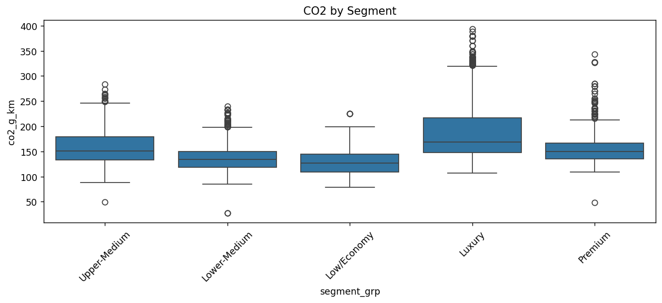
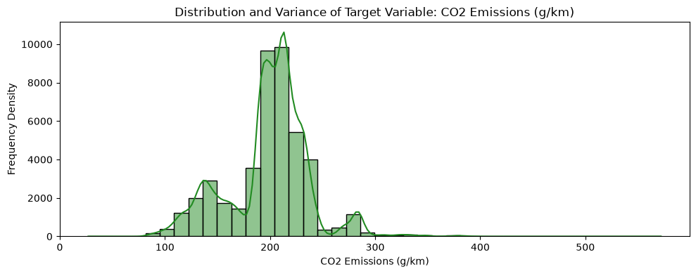
Brief Look at the Original Data
French vehicle catalogue & European registration data — France, 2013
~44,850
~32,332
~60
~52
FR approval catalogue („spec sheet“)
EU-wide registrations (FR filtered)
brands
Variables in both datasets
Dataset structure
Core Variable for Analyses: CO² Emissions (vs Car Segment)
Core Variable for Analyses: CO² Emissions
VEHICLE IDENTIFICATION
Brand · model · commercial name NTIC · TVV
TECHNICAL FEATURES
Body-type · Administrative power · max. power Transmission · kerb weight · Segments
FUEL & CONSUMPTION
Fuel-type · hybrid · urban / extra-urban / combined
EMISSIONS
CO₂ · CO · HC · NOx · HC-NOx · PM
CLASSIFICATION
Market context: EU registration volume is used later for market weighting.

Slide 5
Merging two Datasets as a Main Challenge in this Project
01
Why Required?
02
Why a Challenge?
03
Which Solutions?
Two datasets available:
French Catalogue contains relevant variables with regard to emissions, but skewed car manufacturer/ type distribution - e.g. 86% of all entries from Mercedes with only 3% market share.
EU-Registry provides registration numbers of cars but lacks other relevant variables.
Data merge necessary to take advantage of relevant variables and market volumes.
No single or combined key available to directly link the datasets.
Most discriminating “key” Type–variant–version (TVV) is inconsistently recorded, partly individual/arbitrary manufacturer-specific conventions. Result for e.g. Renault: zero exact matches.
Other variables with errors and inconsistent (if overlapping)
Complexity: Registration count management, 1:n & n:m joins, corrections…
Multi-Step-Strategy where each step targets what the previous one left unmatched.
Iterative data cleaning (duplicates, inconsist…) centrally located in process.
Recalculation of registrations (and other var.) in each step.
Deduplication and variable clean-up as final step of data processing.
Imputation for key variables if <1% NaN.
CO2-emission in France in 2013 – Project Presentation 2026, September 1st

Slide 6
Merging Pipeline Step-by-Step
Sequential strategy moving from strictest to most permissive matching logic - each step replacable if better solution found
S1
Exact match with TVV-variable (21068 matches)
After cleaning and concatinating: Outer join on non-empty Type–Variant–Version key
For each step:
The registration count r is redistributed into r_merged: weighting variable to get market shares.
Some composite variables re-evaluated if new matches add evidence.
Pair ledger registry-update.
Additional steps:
Cleaning of faulty variables and doublettes,
Updating and standardizing variables.
S2
Containment (1482 matches)
Within brand and kw_comp (vehicle’s power) agreement: one TVV string (largely) contained in the other, with or without (trailing) zeros.
S3
Join matched records (5527 matches)
Residual right_only records compared via tv_comp to already matched ones – power, CO₂, kerb weight and fuel-type must agree.
S4
Fuzzy (134 matches)
Vectorised Levenshtein: type exact inside tvv_clean, variant ≥ 80 % similar; same technical constraints as S3.
S5
Selective (995 matches)
If weight coverage <70% for essential brands: Model name plus full technical agreement (if no NaN; no brand lifted above total coverage).
CO2-emission in France in 2013 – Project Presentation 2026, September 1st

Slide 7
Result of Merge
Merged data set covers 1,54 Mio of 1,83 Mio car registration volume in FR 2013 – evenly across the brands that matter.
84.3 %
of registrations linked (weighted)
1,540,238
of 1,827,319 registrations covered
29,206
matched catalogue records
68.6 %
Minimum brand coverage in dataset
Coverage
Only four brands stay below two thirds of their own volume (Lexus, Maserati, Tesla, Rolls-Royce) – together 0.2 % of the market in terms of registrations in 2013.
The twenty brands covering 96 % of registrations are all at 69 % or better: brand-level analysis has no systematic gap.
Weighted coverage by brand (top 8 by volume)
Citroën
92.9
Nissan
90.3
Ford
88.6
But:
After cleaning & deduplication: N=3662 records for modelling.
1 % of records carry 29.7 % of all registrations; the twenty most registered rows are 9.0 % of the market.
Effective sample size is a fraction of the nominal one: weighted vs unweighted analyses answer different questions
Dacia
87.4
Peugeot
86.7
Opel
84.9
Renault
82.4
Volkswagen
72.6
Bars in the darker tone are at or above the overall 84.3 % coverage.
CO2-emission in France in 2013 – Project Presentation 2026, September 1st

Slide 8
Business Questions
From two competing research questions to an actionable, regulation-ready classification tool.
what could these data solve ?
What information is most valuable ?
What are institutions/companies/individuals actually facing today?
Question # 1
How should car brands optimize vehicle characteristics to reduce CO₂ and Nox, weighted by real-world registrations?
Question #2
Can we give each vehicle a single pollution grade, from A to E, so the ecological penalty applies to the worst grades instead of a bracket system?
Both questions are answered from the same merged dataset and the same technical features
#1 - supply side: which characteristics a manufacturer can move to lower emissions
#2 - regulation side: how to turn those same characteristics into a grade that carries a penalty
Together they form one instrument: the grade is credible because #1 showed these features genuinely drive emissions

Slide 9
Problem #1: Modelling and Validation
CO₂ & NOx are predicted from 11 vehicle features, with models selected via leakage-safe cross-validation.
0.86
Weighted R² – CO₂ (test set)
0.92
Weighted R² – NOx (test set)
±7.9 g/km
CO₂ RMSE – uncertainty band
XGBoost / Gradient Boosting
Best model, selected via CV
Approach
CO₂ & NOx predicted from 11 vehicle features, weighted by real 2013 registrations
Train/test split (2,910 / 727 rows) grouped by “sibling” trims & stratified by fuel × segment – no leakage
4 candidate models (Ridge, Gradient Boosting, Random Forest, XGBoost) tuned via weighted 5-fold CV
Validation
Best model per target chosen from cross-validation only; test set touched once, for an honest final check
XGBoost wins for CO₂; Gradient Boosting wins for NOx – both clearly beat the baseline (test R² = −0.02 / −0.05)
Reliable predictions, ready to explore brand-level CO₂/NOx improvement potential (next slides)

Slide 10
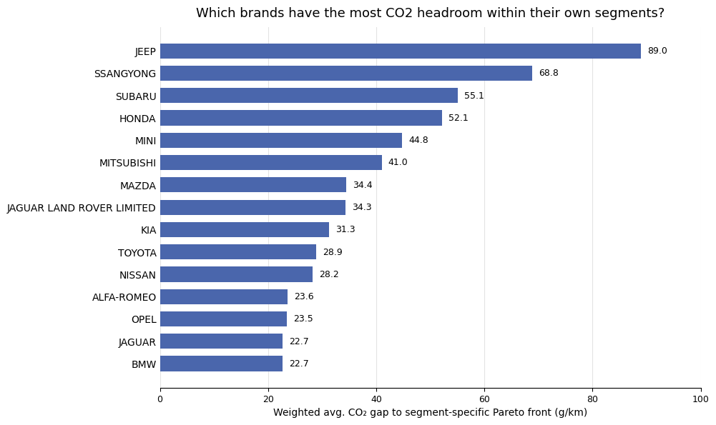
Problem #1: CO₂ Headroom by Brand
A single global optimum favours tiny economy cars – unrealistic for every segment. Fronts are rebuilt per segment, from real high-volume cars.
89.0 g/km
Jeep – largest CO₂ headroom found
Reading the chart
5 segments, 42 Pareto-optimal points – built from real, high-registration “seed” cars, not synthetic extremes
Per car: how much lower could CO₂ be at its own NOx level, on its segment's frontier? Averaged per brand, weighted by sales
Jeep, SsangYong, Subaru & Honda show the biggest CO₂ headroom – about 52–89 g/km with no NOx penalty
4 brands (Porsche, Lexus, Ferrari, Smart) excluded – too few had a comparable same-NOx rival in their segment, not because they're already optimal
Weighted avg. CO₂ gap to segment-specific Pareto front, top 15 brands (g/km)

Slide 11
Problem #1: What Drives CO₂ and NOx ? (SHAP)
SHAP shows each feature's real, per-car contribution in g/km – not just what matters, but by how much.
Mean SHAP impact on CO₂ (g/km, test sample of 300 cars)
13.7 g/km
Vehicle weight – the largest CO₂ driver
Vehicle weight
13.7
Fuel type: Petrol
12.4
What this means for brands
Vehicle weight, petrol fuel & engine size dominate – together they explain most of the CO₂ spread between cars
Caveat: treat 13.7/12.4/12.1 as roughly tied, not a strict ranking – weight, engine size & power are highly correlated in real cars, so SHAP can't cleanly separate credit between them
NOx is driven by a different mix (especially diesel) – SHAP splits this out per target, unlike a single importance ranking
Engine size (cc)
12.1
Engine power (kW)
8.9
Transmission: Auto 4-speed
7.4
Body type: SUV / Off-road
5.5

Slide 12



Problem #2: Framing the Question
From an existing sticker system to a grade that reflects real pollution.
Context
In France, polluting vehicles are already taxed through the “malus écologique”, charged at purchase and tiered on CO2 emissions and vehicle mass, and separately labels vehicles through the Crit'Air sticker system. However, the penalty needs measured emission values, while Crit'Air assigns a class from fuel type and registration year alone.
Idea
To imagine a penalty scheme built on the Crit'Air format but where the class reflects the vehicle's real pollution profile with one grade to replace the current systeme of brackets : simpler to read, simpler to communicate, simpler to apply.
Can we give each vehicle a single pollution grade, from A to E, and apply the ecological penalty to the worst grades?
A new label must be created
The grade must be assignable from the specifications known from the technical specifications alone, with no emission measurement
The grade system for tax purpose must be defendable

Slide 13
Problem #2 : Methodology and Data
Building the multi-pollutant target, erecting strict leakage firewalls, and guaranteeing honest generalization.
Build a Target
No pollution label existed in the source data, so we engineered one : the Pollution score
pollution_score = CO2 50% + NOx 30% + particulates 20%
Discretised into quintiles with grades A to E, five balanced classes
Selecting the features
All emission measurements excluded from the inputs — otherwise the model would simply re-learn our own formula
Focus only on thermic cars
01
02
Eleven predictors kept :
Kerb weight
Engine power
Engine displacement
Width
Front track
Rear track
Fuel type
Transmission
Body type
Segment
Hybrid
Preparing the data
Categorical variables one-hot encoded, numerical variables standardised for the linear model
Stratified 80/20 train/test split, random_state=42, test set never touched during training or tuning
03
Training and comparing
Five models trained :
Evaluated on accuracy, macro F1, 5-fold cross-validation and error severity
04
Logistic Regression
Decision Tree
Random Forest
KNN
Hist Gradient Boosting

Slide 14
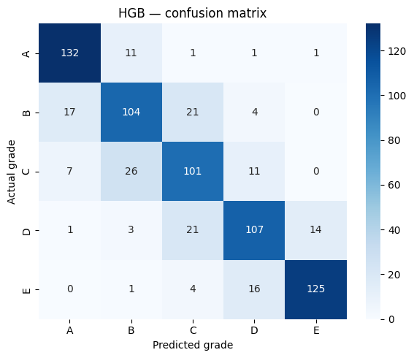
Problem #2: Results
One grade, five classes — and errors that stay where they can be afforded.
Model Selected
Hist Gradient
Boosting
Exact accuracy
78,1% 3.9× the random baseline
Exact grade predicted accross test set vehicles
Adjacent accuracy
96,8%
With ± class tolerance
Extreme confusion
1
…
Five families compared.
Selected for the fewest severe errors, not the highest raw accuracy.
Errors concentrate on the diagonal and its immediate neighbours. Grades B and C are the hardest; A and E are the best identified (F1 0.87 each)
No clean vehicle is graded as a heavy polluter, and no polluter is waved through.
One grade off adjusts the amount. Four grades off charges a clean car or lets a polluter escape.
That is the criterion the model meets.

Slide 15
Learnings
1
The French catalogue and the European register each have notable weaknesses and a few strengths. After intense investigation to find best solutions, a realist approach was adopted: accepting pragmatic trade-offs aimed to produce a dataset that opens up analytical opportunities rather than following full methodological rigour. Any analysis built on this data must therefore take account of the limitations and uncertainties in the data.
2
So what do these modelling outcomes mean? A truly emission-free car doesn't really exist - you can improve CO₂ and NOx, but there's always something else, like production emissions, that you're not even measuring. And what has this project taught us? This project showed us how careful you have to be with the small details, because even small changes can lead to completely different results.
3
The final results deserve as much suspicion as the inputs: Features derived from the target potentially inflate our accuracy without warning. The grading scale resulting from the modelling needs an anchor, and with no absolute threshold available we built ours on quintiles of the existing fleet (it is ok if it is relative). And accuracy alone is not enough: with ordinal grades, how far off an error is counts more than how often it happens.

Slide 16

Thank you Merci Danke
CO2-emission in France in 2013 – Project Presentation 2026, September 1st

