Slide 1
AI Solutions to Automate and Enrich Chatbot Data

Slide 2


CONTEXT
Retail Industry
Customers Need Support
Hard to Provide at Large Scale
Chatbots Used for Scaling

Slide 3
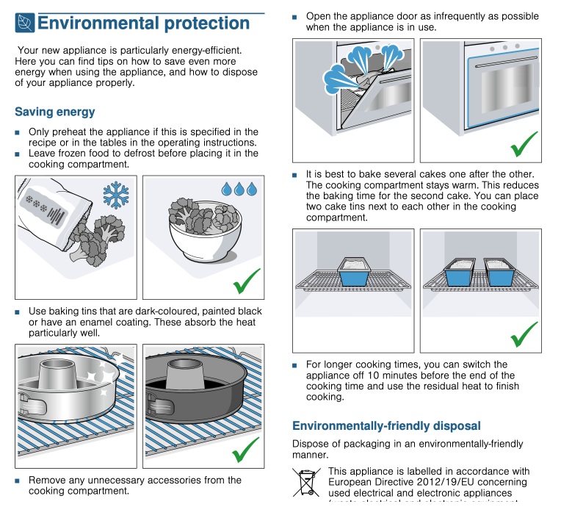
PROBLEM: Extracting Usable Training Data from Product Manuals
Untapped Data Sources
Expensive to Create Training Data
Multilingual Experts Needed

Slide 4
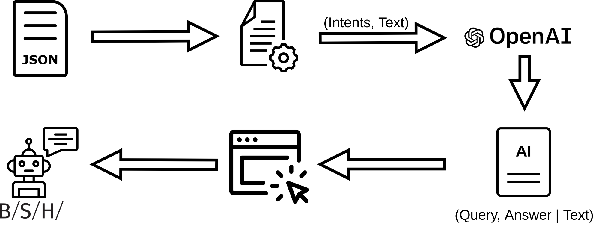
THE SOLUTION

Slide 5




CUSTOMER BENEFITS:
MYRIAD DATA
Chatbot

Slide 6
MARKET:
High Demand
Chatbot market was valued at USD 17 billion market value in 2020
Projected to be USD 102 billion in 2026
Low Competition
No robust solutions in our market sector

Slide 7

BUSINESS MODEL:
Initial Analysis of Data Format Fee
Monthly Fee
Re-train model Cost (based on feedback)

Slide 8


Slide 9
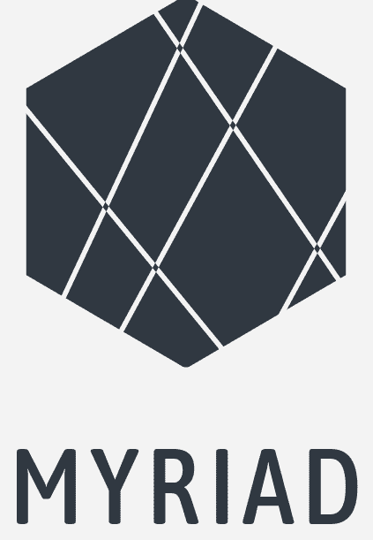





The Team
Christian Hammacher
Kathy-Ann
Heitmeier
Philipp
Gawlik
Miguel Â.
Simões Valente
Robin Strohmeyer
Computational Linguist
Computer Scientist at TU Darmstadt, Germany
Computational Linguist
Artificial Intelligence Researcher
Technical Writer

Slide 10
